Slide 1
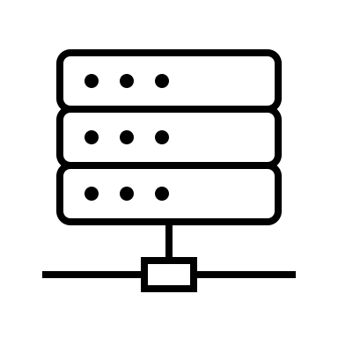
Remote Identity Verification Workflow V2.0 Nov 6, 2024, Kantara Deepfake-IDV Workgroup
Reference Data
Host System
Automated Workflow
Baseline IDV Process
Live Biometric Capture Channel
Edge Device
Data Capture
Signal Processing
IDV Decision
Identity Document Capture Channel
Accepted
Edge Device
Rejected
Data Capture
Comparison
Environmental Risk Factors Channel
Adjudicate
Edge Device
Data Capture
Signal Processing
IDV Decision
Manual Workflow
Process used for opt-out and/or exception handling
Edge Device
Accepted
Live Video Chat
Document
Review
Rejected

Slide 2
Remote Identity Verification Workflow V2.0 Nov 6, 2024, Kantara Deepfake-IDV Workgroup
Reference Data
Host System
8
Automated Workflow
Baseline IDV Process
9
Live Biometric Capture Channel
Edge Device
1
2
Data Capture
Signal Processing
IDV Decision
Identity Document Capture Channel
Accepted
Edge Device
Rejected
3
4
Data Capture
Signal Processing
Comparison
Attack Types
Document
Environmental Risk Factors Channel
Adjudicate
Biometric
Edge Device
Other Data/Signal
5
Data Capture
6
Signal Processing
Attack Vectors
DF Physical Presentation Attack
DF Injection Attack
DF/Modified document; Synthetic ID document
DF/Synthetic Document Injection Attack
Modified or Synthetic Data
Modified or Synthetic Injection Data
DF in live video chat
Reference Data Injection
Insider threats
IDV Decision
Manual Workflow
Process used for opt-out and/or exception handling
Edge Device
Accepted
7
Document
Review
Live Video Chat
Rejected

