Slide 1
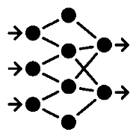
RIDV Process
Host System
NOTE: Signal Processing may be on the edge device, host system, or hybrid
Automated Workflow
Baseline IDV Process
Live Biometric Capture Channel
Edge Device
Data Capture
Signal Processing
Comparison / Analysis
Reference Data
Identity Document Capture Channel
IDV Decision Engine
Edge Device
Accepted
Rejected
Data Capture
Signal Processing
Comparison / Analysis
Reference Data
Environmental Risk Factors Channel
Adjudicate
Edge Device
Data Capture
Signals Processing
Comparison / Analysis
Reference Data
Human Review
Manual Workflow
Process used for opt-out and/or exception handling
Edge Device
Accepted
Data
Review
Rejected
Live Video Chat

