Slide 1
Deepfake-IDV Discussion Group
Deepfake Detection, Protection, and Countermeasures for Remote Identity Verification (RIDV)
November 2024

Slide 2
Deepfake-IDV Discussion Group
The Kantara Deepfake-IDV Discussion Group—Deepfake Threats To Identity Verification & Proofing—was formed in September 2023 to explore how IDPV (Identity Proofing and Verification) systems could be subverted or fooled by “deepfakes,” “Generative AI,” and other AI-related mechanisms.
The group primarily comprised technical experts from within the biometric and digital identity marketplace, including vendors, individual subject matter experts, and contributors from end-user organizations.
The anticipated output of the discussion group was a report describing the nature of the threats, vulnerabilities, and potential countermeasures designed to
Inform purchasers of IDPV services about AI-related techniques that may decrease their effectiveness and
Enable readers to discuss the topic and potential risk mitigation actions within their organization and with IDPV service providers.
This document represents the group’s output and reflects the group’s consensus thinking about deepfake detection, protection, and countermeasures for Remote Identity Verification (RIDV).

Slide 3
Executive Summary
Introduction, blah blah blah

Slide 4
Contents
Introduction
Project Scope
RIDV Process
RIDV Attack Vectors
RIDV Countermeasures
TABLE: RIDV Process, Attack Vectors, Countermeasures
Key Findings and Recommendations
Appendices

Slide 5
Introduction
Introduce concepts of Remote IDV and Deepfakes
Motivation for this Kantara Workgroup
Define Key terms– link to Appendix: Glossary
Introduce Deepfakes
Benefits and Threats (spectrum chart) with descriptions
Current state of the market
Critical Trends
Key Challenges and Dangers
Primary deepfake technologies
Role of GenAI
Regulatory Environment – link to Appendix: Regulations
Standards - link to Appendix: Relevant Standards
Audience – Identify key constituencies:
Enterprise: IT, Security, Cybersecurity
Vendors: Biometric, IAM, CIAM, Fraud, Cyber3eecurity,
Policy Makers: Government and NGO’s in Privacy, Cybersecurity,
Standards/testing/certifications bodies

Slide 6
Scope
OBJECTIVE: Identify key deepfake threats and vulnerabilities and present prevention , detection, and countermeasure capabilities.
USE: Educate and provide best practice recommendations to address the threats posed by deepfakes.
FOCUS: Types of deepfakes in and out of scope
CONTENT
RIDV Process
Deepfake Attack Vectors
Deepfake Prevention, Detection, and Countermeasures

Slide 7
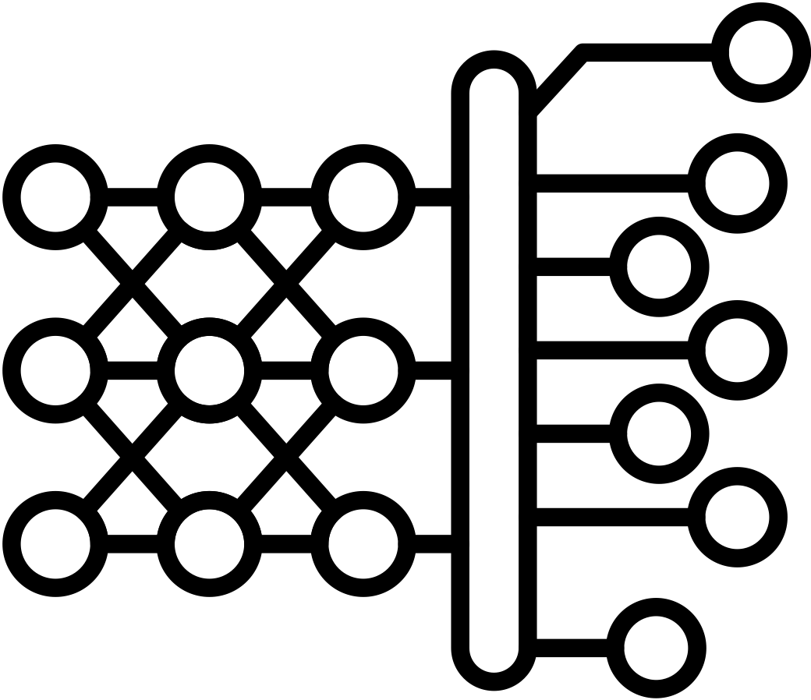
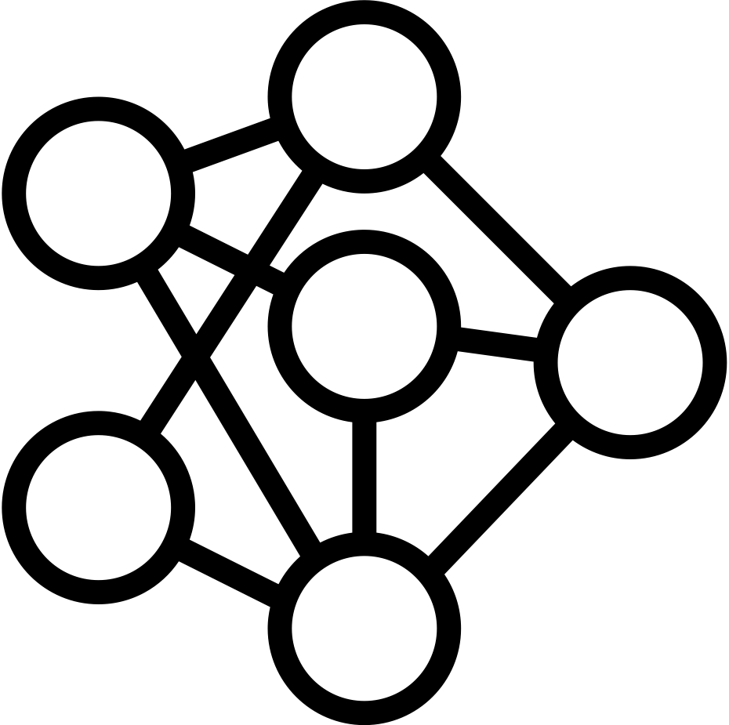
RIDV Process
Host System
Reference Data
Automated Workflow
Baseline IDV Process
Live Biometric Capture Channel
Edge Device
Data Capture
Signal Processing
IDV Decision Engine
Identity Document Capture Channel
Accepted
Edge Device
Rejected
Data Capture
Signal Processing
Comparison
Environmental Risk Factors Channel
Adjudicate
Edge Device
Data Capture
Signals Processing
IDV Decision Engine
Manual Workflow
Process used for opt-out and/or exception handling
Edge Device
Accepted
Live Video Chat
Document
Review
Rejected
6

Slide 8
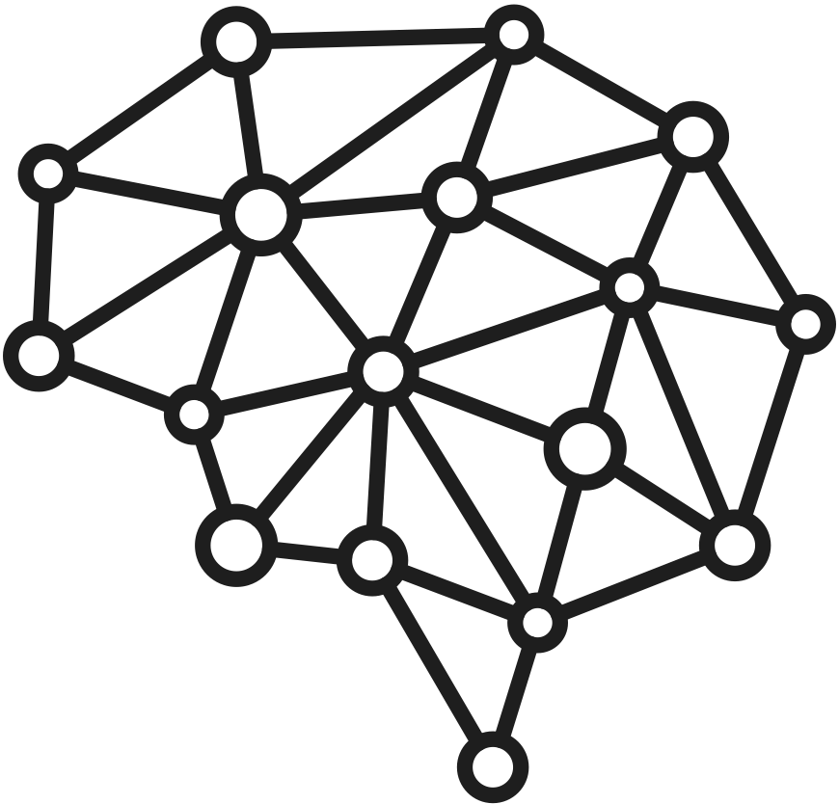
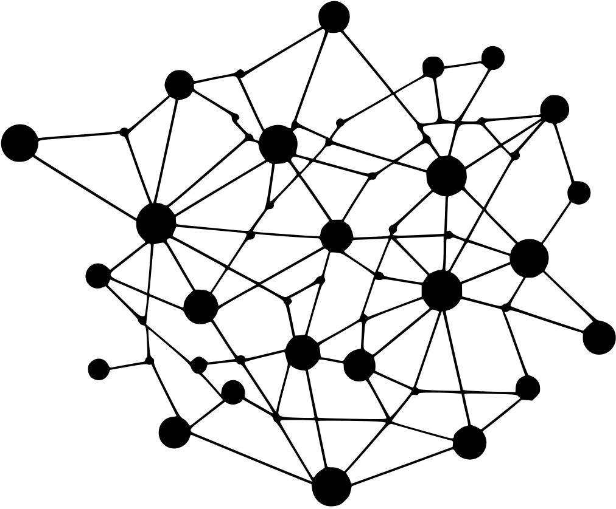
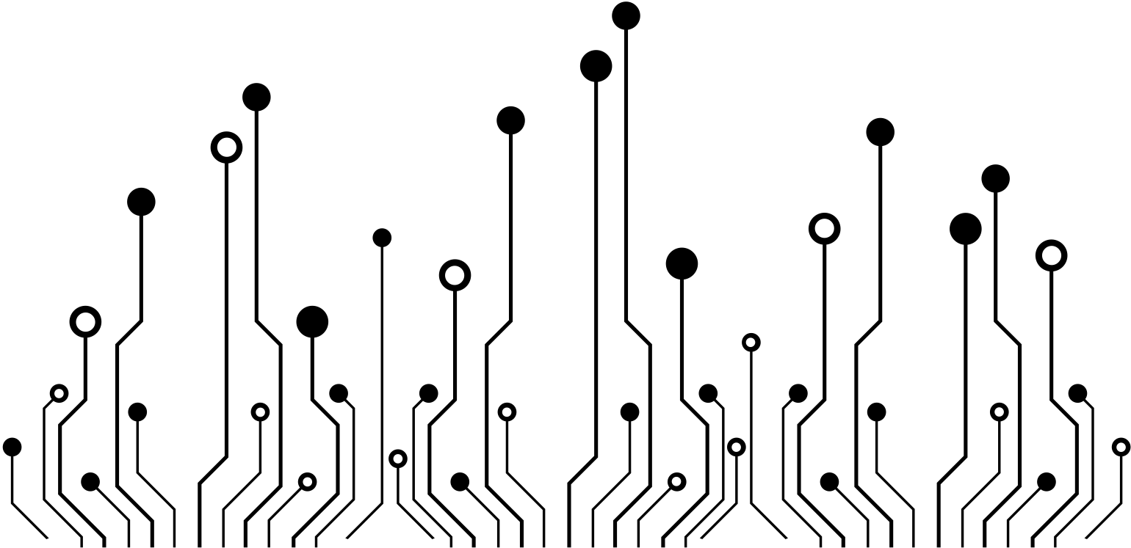
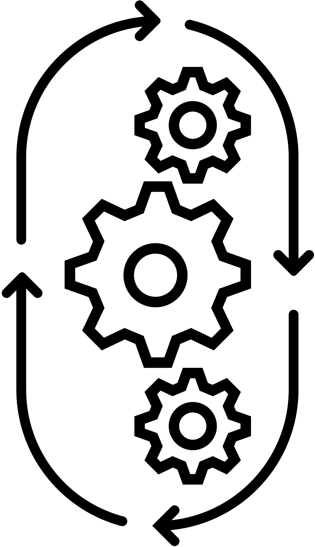
RIDV Process
Host System
Reference Data
Automated Workflow
Baseline IDV Process
Live Biometric Capture Channel
Edge Device
Data Capture
Signal Processing
IDV Decision Engine
Identity Document Capture Channel
Accepted
Edge Device
Rejected
Data Capture
Signal Processing
Comparison
Environmental Risk Factors Channel
Adjudicate
Edge Device
Data Capture
Signals Processing
IDV Decision Engine
Manual Workflow
Process used for opt-out and/or exception handling
Edge Device
Accepted
Live Video Chat
Document
Review
Rejected

Slide 9
RIDV Process Definitions
AUTOMATED WORKFLOW
Live Biometric Capture Channel
Definition
Identity Document Capture Channel
Definition
Environmental Risk Factors Channel
Definition
Comparison
Definition
IDV Decision Engine
Definition
MANUAL WORKFLOW
Live Capture
Definition
Document Review
Definition
IDV Decision Engine
Definition
HOST SYSTEM
Reference Data
Definition

Slide 10
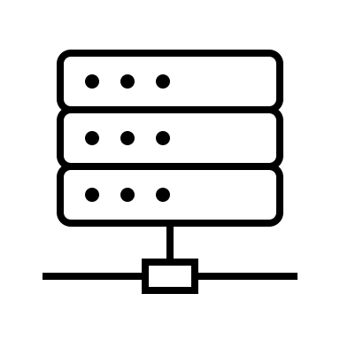
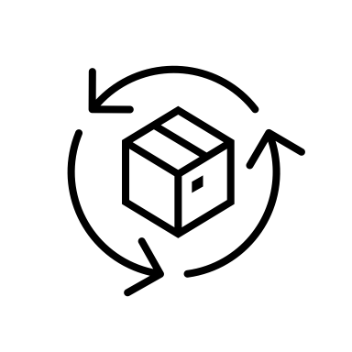
RIDV Attack Vectors
Host System
Reference Data
8
Automated Workflow
Baseline IDV Process
9
Live Biometric Capture Channel
Edge Device
1
2
Data Capture
Signal Processing
IDV Decision Engine
Identity Document Capture Channel
Accepted
Edge Device
Rejected
3
4
Data Capture
Signal Processing
Attack Types
Comparison
Document
Environmental Risk Factors Channel
Biometric
Adjudicate
Edge Device
Other Data/Signal
5
Data Capture
6
Signal Processing
Attack Vectors
DF Physical Presentation Attack
DF Injection Attack
DF/Modified document; Synthetic ID document
DF/Synthetic Document Injection Attack
Modified or Synthetic Data Attack
Modified or Synthetic Injection Data Attack
DF in Live Video Chat Attack
Reference Data Injection
Insider threats
IDV Decision Engine
Manual Workflow
Process used for opt-out and/or exception handling
Edge Device
Accepted
7
Document
Review
Live Video Chat
Rejected

Slide 11
RIDV Attack Vectors
Host System
Reference Data
8
Automated Workflow
Baseline IDV Process
9
Live Biometric Capture Channel
Edge Device
1
2
Data Capture
Signal Processing
IDV Decision Engine
Identity Document Capture Channel
Accepted
Edge Device
Rejected
3
4
Data Capture
Signal Processing
Attack Types
Comparison
Document
Environmental Risk Factors Channel
Biometric
Adjudicate
Edge Device
Other Data/Signal
5
Data Capture
6
Signal Processing
Attack Vectors
DF Physical Presentation Attack
DF Injection Attack
DF/Modified document; Synthetic ID document
DF/Synthetic Document Injection Attack
Modified or Synthetic Data Attack
Modified or Synthetic Injection Data Attack
DF in Live Video Chat Attack
Reference Data Injection
Insider threats
IDV Decision Engine
Manual Workflow
Process used for opt-out and/or exception handling
Edge Device
Accepted
7
Document
Review
Live Video Chat
Rejected
10

Slide 12
RIDV Attack Vectors Defined
AUTOMATED WORKFLOW
Live Biometric Capture Channel
1) Data Capture - Deepfake Physical Presentation Attack Explanation
2) Signal Processing - Deepfake Injection Attack Explanation
Identity Document Capture Channel
3) Data Capture - Deepfake /Modified document; Synthetic ID document Explanation
4) Signal Processing - Deepfake Synthetic Document Injection Attack Explanation
Environmental Risk Factors Channel
5) Data Capture - Modified or Synthetic Data Attack Explanation
60 Signal Processing - Modified or Synthetic Data Injection Attack Explanation
MANUAL WORKFLOW
7) Live Capture- Deepfake in Live Video Chat Attack Explanation
HOST SYSTEM
8) Reference Data- Reference Data Injection Attack Explanation
9) General System- Insider Threats Explanation

Slide 13
RIDV Countermeasures
Host System
Reference Data
8
Automated Workflow
Baseline IDV Process
9
Live Biometric Capture Channel
Edge Device
1
2
Data Capture
Signal Processing
IDV Decision
Identity Document Capture Channel
Accepted
Edge Device
Rejected
3
4
Data Capture
Signal Processing
Comparison
Attack Types
Document
Environmental Risk Factors Channel
Adjudicate
Biometric
Edge Device
Other Data/Signal
5
Data Capture
6
Signal Processing
Countermeasures
DF
DF
DF\
DF
MM
M
DF
R
IN
IDV Decision
Manual Workflow
Process used for opt-out and/or exception handling
Edge Device
Accepted
7
Document
Review
Live Video Chat
Rejected
12

Slide 14
RIDV Countermeasures
Host System
Reference Data
8
Automated Workflow
Baseline IDV Process
9
Live Biometric Capture Channel
Edge Device
1
2
Data Capture
Signal Processing
IDV Decision
Identity Document Capture Channel
Accepted
Edge Device
Rejected
3
4
Data Capture
Signal Processing
Comparison
Attack Types
Document
Environmental Risk Factors Channel
Adjudicate
Biometric
Edge Device
Other Data/Signal
5
Data Capture
6
Signal Processing
Countermeasures
DF
DF
DF\
DF
MM
M
DF
R
IN
IDV Decision
Manual Workflow
Process used for opt-out and/or exception handling
Edge Device
Accepted
7
Document
Review
Live Video Chat
Rejected
13
13

Slide 15
RIDV Countermeasures Defined
AUTOMATED WORKFLOW
Live Biometric Capture Channel
1) Data Capture - Deepfake Physical Presentation Attack Countermeasures
2) Signal Processing - Deepfake Injection Attack Countermeasures
Identity Document Capture Channel
3) Data Capture - Deepfake /Modified document; Synthetic ID document Countermeasures
4) Signal Processing - Deepfake Synthetic Document Injection Attack Countermeasures
Environmental Risk Factors Channel
5) Data Capture - Modified or Synthetic Data Attack Countermeasures
60 Signal Processing - Modified or Synthetic Data Injection Attack Countermeasures
MANUAL WORKFLOW
7) Live Capture- Deepfake in Live Video Chat Attack Countermeasures
HOST SYSTEM
8) Reference Data- Reference Data Injection Attack Countermeasures
9) General System- Insider Threats Countermeasures

Slide 16
RIDV Table
Process, Prevention, Detection and Countermeasures
Step Name | Process | Key Technologies | Attack Vectors | Prevention Process/Tech | Detection Process/Tech | Countermeasures/Process/Tech | Relevant Regulations | Relevant Standards

Slide 17
Key Findings and Recommendations
Introduction, blah blah blah

Slide 18
Appendices
Glossary
Regulations
Technical References
Standards

Slide 19
Appendix: Glossary

Slide 20
Appendix: Regulations

Slide 21
Appendix: Technical References

Slide 22
Appendix: Standards

Slide 23
Join. Innovate. Trust.
Supporting the market to develop the trustworthy use of identity assurance and personal data
kantarainitiative.org
@KantaraInitiative
US Office:
585 Grove Street, Suite 145 PMB 990, Herndon, VA 20170
hello@kantarainitiative.org
+1 571-475-8895
UK Office:
2A High Street, Thames Ditton, KT7 ORY
info@kantarainitiative.co.uk

