Slide 1
Unexpected and Complex Implications of the Internet of Everything (IoE)
Jeff Stollman
Secure Identity Consulting

Slide 2
Agenda
Defining Terms
Promise and Implications
Issues Prompted by IoT
Legal Perspective
Q&A

Slide 3
Defining terms

Slide 4
What is it?
SCADA
Netbooks
Servers
Smart Phones
Internet of Everything
Sensor Networks
Databases
Smart Appliances
Industrial Controllers
Internet of Things
Notes:
The Internet of Everything is a vague term that is prone to a wide array of definitions. I don’t claim to have the “best” definition, but I feel obliged to establish the context for what I will cover in this presentation.

Slide 5
Definition
The Internet of Everything is:
ANY device that is connected to a network.
Notes:
I am sure many of you will take issue with my use of the word “ANY” in this definition. Later, after a few beers, we can fight over it. But I must warn you that I have a black belt in bar singing.
There is also a debate whether a device has to be connected to the big “I” internet in order to be a member of the Internet of Everything. My assumption is that this is not so. Again, this assumption is merely to establish context so that we are not talking past each other. Even though a device is connected to a private network that may not be discoverable via the big “I” Internet, it may have the same capabilities as a device on the Internet – as well as the same vulnerabilities.

Slide 6
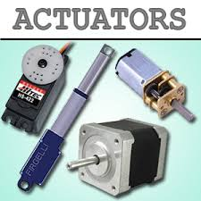
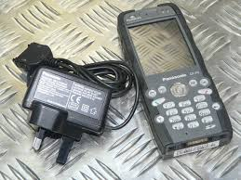
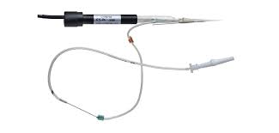
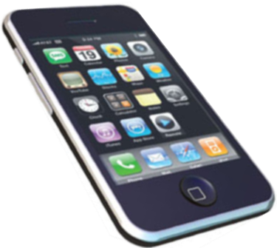
Constituent Devices
1. SENSOR 2. PROCESSOR 3. ACTUATOR
4. Combinations of the above
Notes:
Generally IoE Devices can be categorized as

Slide 7
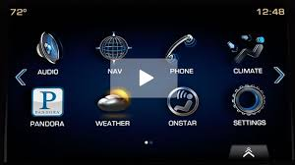
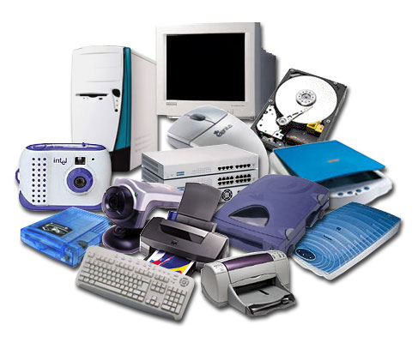
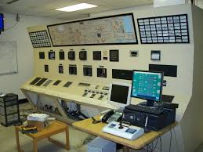
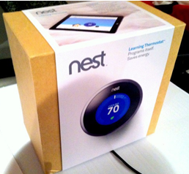
IoE is a superset
IoE
Traditional IT SCADA devices New Smart devices
Notes:
IoE devices are a superset that incorporates
Traditional IT devices (Servers, Clients, Peripherals)
SCADA devices (industrial sensors and control equipment)
New personal devices (smart phones, smart thermostats, smart refrigerators)

Slide 8
Promise and implications
Use Cases

Slide 9
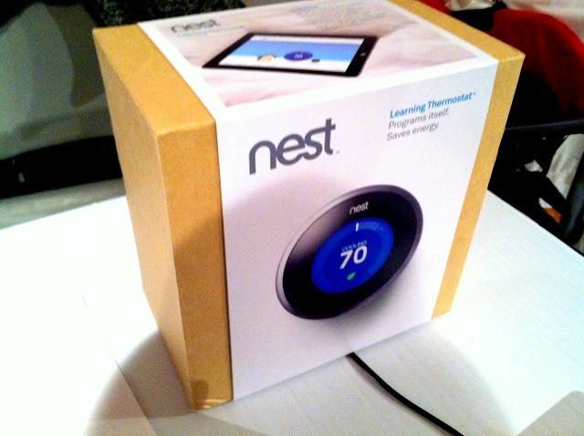
The Promise
Notes:
Why is there so much fuss about the Internet of Everything?
Improve the life of humans by relegating menial and repetitive tasks to automation
Informing you that you are about to run out of milk
Automatically placing an order to replenish your supply of milk
Extend our abilities
Telling your home entertainment system to record a broadcast while you are at work or traveling
Turning up the thermostat in your house to warm it up in anticipation of your return from work or travel
Having your car warn you that a part is about to fail before it events
Having your car check your calendar and schedule an appointment to have the part replaced
Optimizing industrial processes
Load balancing electricity production and distribution across multiple power plants
Managing peak electricity demand within a factory to minimize electricity costs

Slide 10
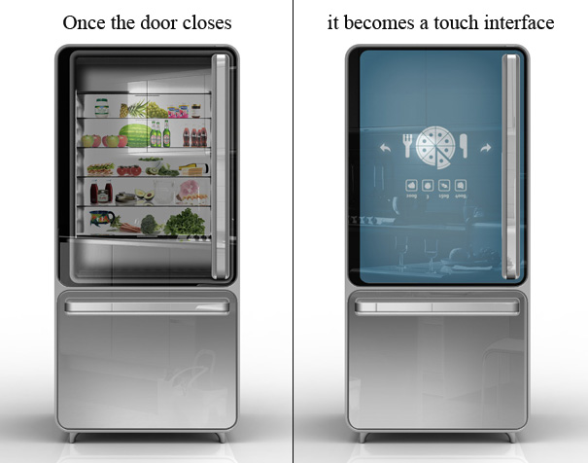
Use Case: Home Appliances – Security and Privacy
Who is ordering your perishables?
Notes:
PROMISE
Automating menial tasks with limited human intervention, a Smart Refrigerator can
Inform you that you are about to run out of milk
Automatically place an order to replenish your supply of milk (or put it on your calendar/task list)
IMPLICATIONS
Assuming that the Smart Refrigerator also takes user input over the network (e.g., to learn that it doesn’t need to order milk when you are going away on a business trip or holiday), this access can pose a problem.
An angry neighbor may access your Smart Refrigerator and cause it to order gallons of milk that you don’t want and which may spoil before you return home to put it away. Alternatively, he may change the settings of your thermostat so that you come home to burst pipes or an extraordinarily high utility bill.
Or, perhaps, someone you angered at work decides to turn on your oven and stove in an attempt to burn your house down.
On a more benign note, what if you neighbor begins tracking your liquor consumption in order to defame you?
Do you, as a homeowner, want the additional responsibility of managing access to a raft of home appliances including alarm clocks, smoke and fire alarms, burglar alarms, digital video recorders, your oven, your stove, your thermostat, your lights, and other electricity consuming devices?
Any smart device that can serve you, is likely to be usable by an adversary with some determination. And because device “hacks” will likely be available online (as malware is today), adversaries don’t need to be computer security experts. They can just follow simple instructions in a good user interface.

Slide 11
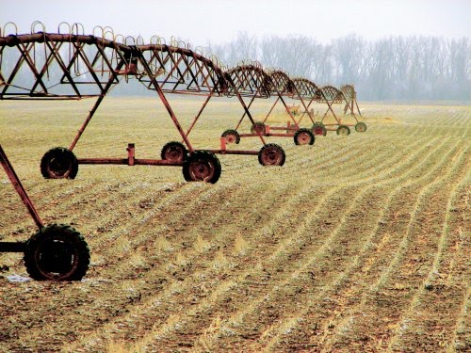
Use Case: Irrigation & Flood Control - Security
Who is ensuring data integrity?
Notes:
PROMISE
Smart irrigation systems can be used to optimize water use, reducing costs for purchasing water on rainy days, and optimizing the environment to maximize crop yields. It can also be used for both irrigation management and flood control of large regions, rather than single properties.
On an individual farm, a sprinkler system may selectively allocate water to different areas of the farm based on sensors of soil dampness, or just reducing watering to account for local rainfall.
In an irrigation or flood control district, sensor data may open dams or route water from wet areas to dry areas to more effectively manage resources.
IMPLICATIONS
In a large flood control district, how long will it take for administrators of the smart network to recognize that a flood control dam has been inadvertently opened and is flooding vast areas downstream.
While such systems would likely have a command and control center, how long will it take to recognize that an adversary has compromised the sensor readings displayed in the C&C center so that everything appears correct?
How many people might die and how much property damage can be created by a determined adversary?
Is the flood control district building in the safeguards sufficient to eliminate a determined adversary.

Slide 12
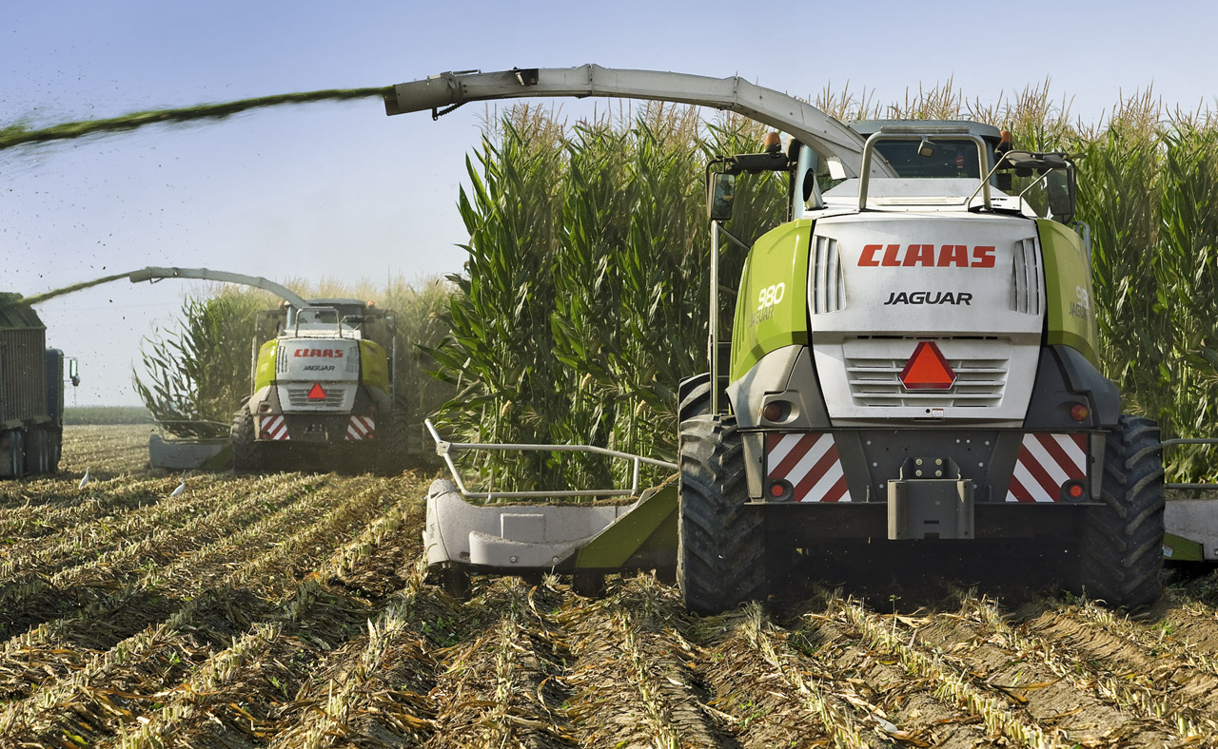
Use Case: Farming – Information Ownership
Who owns the data you collect?
Notes:
PROMISE
In farming, tractors and harvesters come with sensors that detect various soil and crop conditions, crop yields, as well as GPS coordinates. Alternatively, satellites record and transmit ground conditions to subscribers.
These data are relayed back to the manufacturer who builds a database that they license and resell to farmers to help them optimize their yields per acre, per hour of work, per pound of fertilizer, etc.
They can also resell this information to commodity buyers to give them a better bargaining position when they purchase a farmers crop. The data are also valuable to speculators to give them an edge in buying and selling commodity futures.
IMPLICATIONS
Current sales contracts for such Smart Tractors are written by and favor tractor manufacturers. They claim ownership of the data – even when collected by the farmer through his use of the tractor or harvester. The farmer needs to pay a subscription fee to access the data that he has collected to use it for his own purposes.
Obviously manufacturers will have a concern about farmers unlocking and “stealing” the data streams generated by their own tractors. But this is an old problem faced routinely by network providers offering entertainment stations that are restricted by in-home cable boxes that can be compromised. This issue is, therefore, neither new nor unexpected.
But what if a farmer or speculator who seeks to alter the integrity of the data from multiple tractor-based sensors? By dividing the values of the output from sensors on a harvester in half a group of compromised harvesters could create the impression of a bad crop, causing commodity prices to rise, so that the farmer or speculator would reap extraordinary profits when selling his crop.
In such a case, who is responsible for data integrity?
Could it be the farmer who owns the tractor – even though he may not be able to access the data himself?
Is it the harvester manufacturer who collects the data in order to resell it?
Is the farmer legally culpable for manipulating the data on his own harvester – or only those of other unwitting farmers whose harvesters he also compromised?
Alternatively, let’s look at weather data collected from a network of sensors deployed by national weather services during planting season. These could be compromised by an adversary suggesting more or less rainfall has occurred. This may change planting decisions by farmers, creating artificial shortfalls of certain crops and undesirable surpluses in others.
Do the farmers have any recourse for their losses that resulted from bad data?

Slide 13
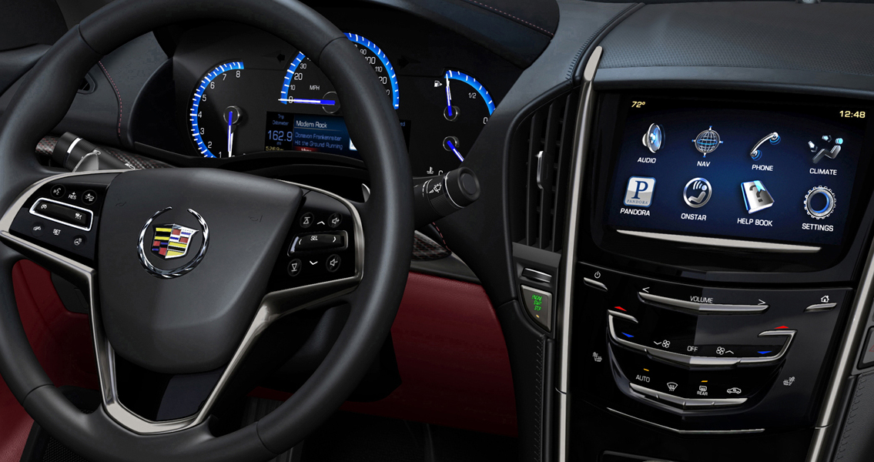
Use Case: Automotive Management – Privacy and Liability
Who is controlling your vehicle?
Notes:
PROMISE
Automotive sensors can track a car’s position, direction, and speed.
This information can then be sold back to the car owner to provide drivers with navigation information.
It can be sold to local business to promote their nearby locations.
If obtained by insurance companies or rental car companies, it can be used to limit their liability and/or charge a premium for drivers who routine speed or drive erratically.
Performance diagnostics data collected by the manufacturer through their in-car sensors can be licensed to dealerships to give them a competitive edge over non-dealer auto repair facilities.
Proximity sensors
Can be used to warn drivers of people, animals, or other road hazards immediately in the road ahead when visibility is poor.
They can also warn of traffic congestion ahead and give guidance on alternate routing.
When smart roads are created,
auto-based sensors can aid drivers in following the road when visibility is poor or the driver is tired.
And such sensors can also be used to support driverless vehicles.
Driverless vehicles
Allow the growing number of the elderly whose reflexes may limit their abilities to drive safely, maintaining their freedom to travel where they want when they want.
Allow intoxicated people to get home safely without creating a danger to others
IMPLICATIONS
In the case of navigation systems and smart roads,
A burglar may track your car and observe you driving away from home suggesting that he can rob your home without being caught?
Who is liable if an adversary creates a false indication of a traffic jam that causes massive rerouting of traffic along secondary roads?
A team of thieves robbing a bank may use this local traffic jam to cover their escape from their burglary.
In the case of driverless cars,
Who is responsible for providing access management to the vehicle systems that keep such vehicles safe?
Who is liable if a relative interested in a quick inheritance compromises the systems and causes a fatal crash?
Who is liable if a terrorist takes control of such a vehicle and creates a massive pile-up on a crowded freeway?
When a bug in the OEM software causes an accident, how long will people suffer until the manufacturer gathers enough data to recognize that the issue is not user or hacker error? Today, years of accidents often accumulate before automakers take responsibility and stage a recall.

Slide 14
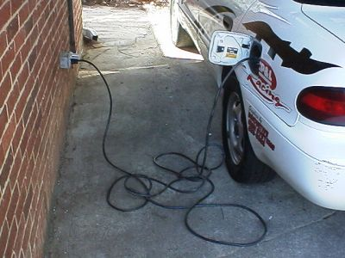
Use Case: Electric Vehicle Recharging Systems – Security and Liability
Who is paying for power from your outlet?
Notes:
PROMISE
The continued improvement in battery systems seems likely to propagate electric cars and the locations from which they can be charged. Because of the large power requirements of such systems, smart charging systems are being developed that would allow me to charge my car at someone else’s charging station, but put the usage on my electric bill.
Some systems require an online transaction to initiate the feed. Others imagine syncing up with the identity of the vehicle. This enables them to avoid imposing tedious authentication and authorization scenarios on the car owner.
IMPLICATIONS
How will the system verify who is the user of such a system?
Who is liable if the system is compromised?

Slide 15
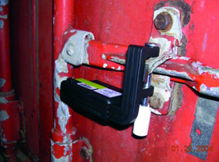
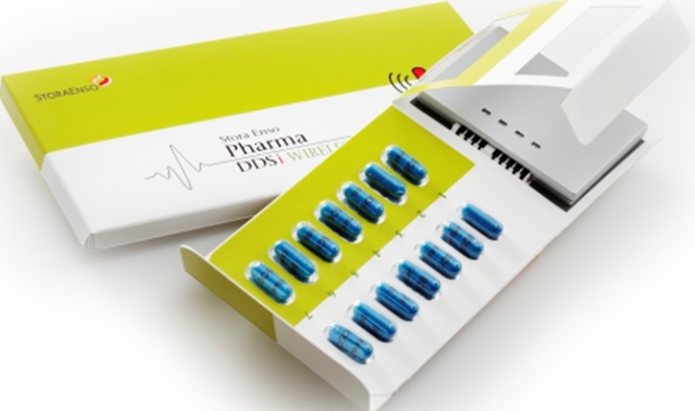
Use Case: Smart Packaging – Privacy and Liability
Who can learn what drugs you are taking?
Notes:
PROMISE
Smart Packaging can transmit when it has been opened, used, overheated, or otherwise compromised.
It can also transmit GPS coordinates of stolen or in-transit cargo.
IMPLICATIONS
Adversaries might track your prescription use to defame you.
If a container of prescription medicine is compromised and causes the death of one or more patients, who might be liable for negligence?
The manufacturer?
The pharmacy?
The dead person?
If there is no legal liability attached, what about the impact on the drug marketer’s reputation?
Who should be responsible for preventing this exploit?

Slide 16
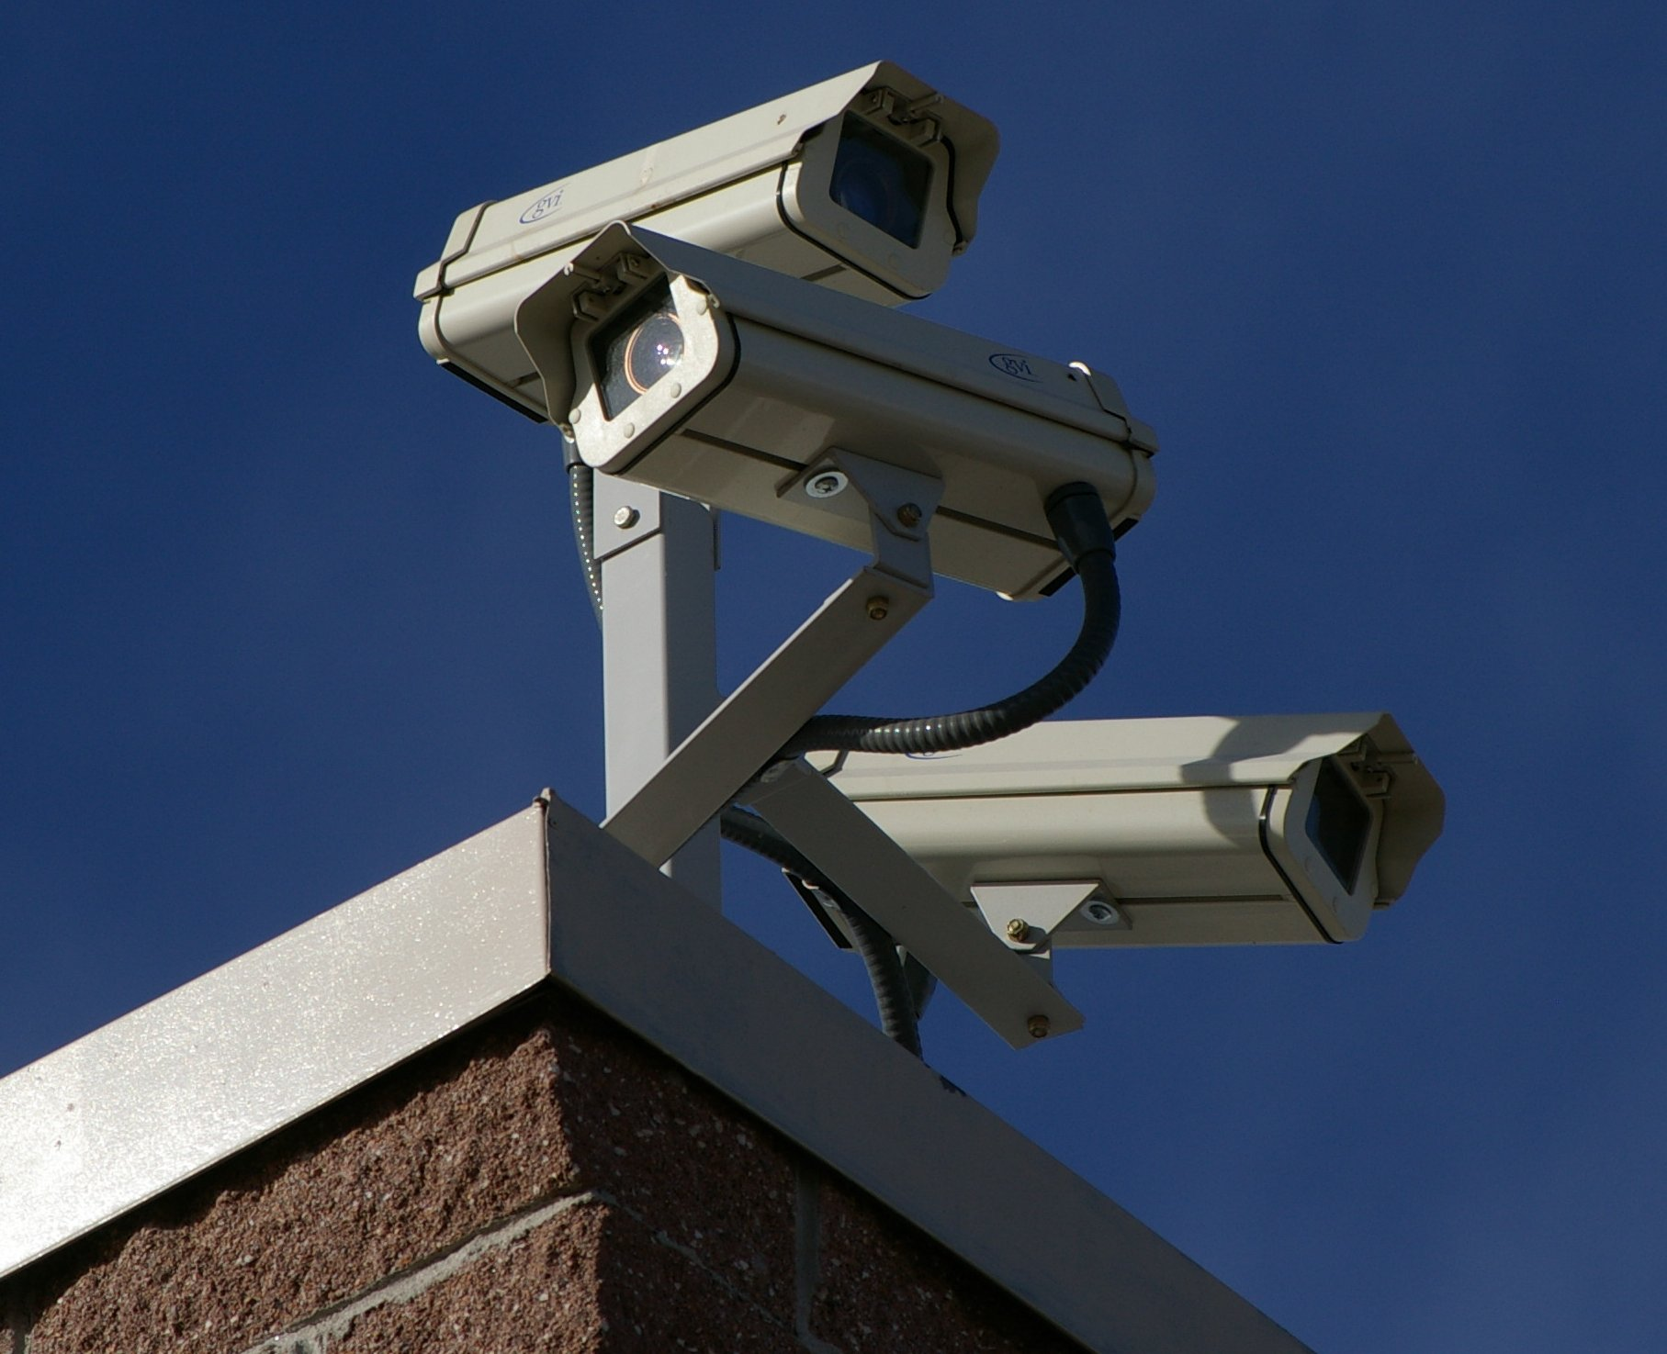
Use Case: Physical Security – Privacy
Does privacy exist anymore?
Notes:
PROMISE
Physical security sensors can make streets and buildings safer.
IMPLICATIONS
Of course, there is the data integrity issue that we all see in the movies where thieves feed video of nothing happening into the data stream from the device to fool the guards into complacency. Nothing new and surprising there.
But who owns the data?
The increase in PUBLIC safety conflicts with the PRIVATE right to be left alone. Are we making the optimal trade-off?
Just because technology enables a capability, does that make it appropriate to use it?
Is our current tack of running roughshod on privacy an Hiroshima-like event whose damages will linger for decades – even after we decide never to use some of the technology again?

Slide 17
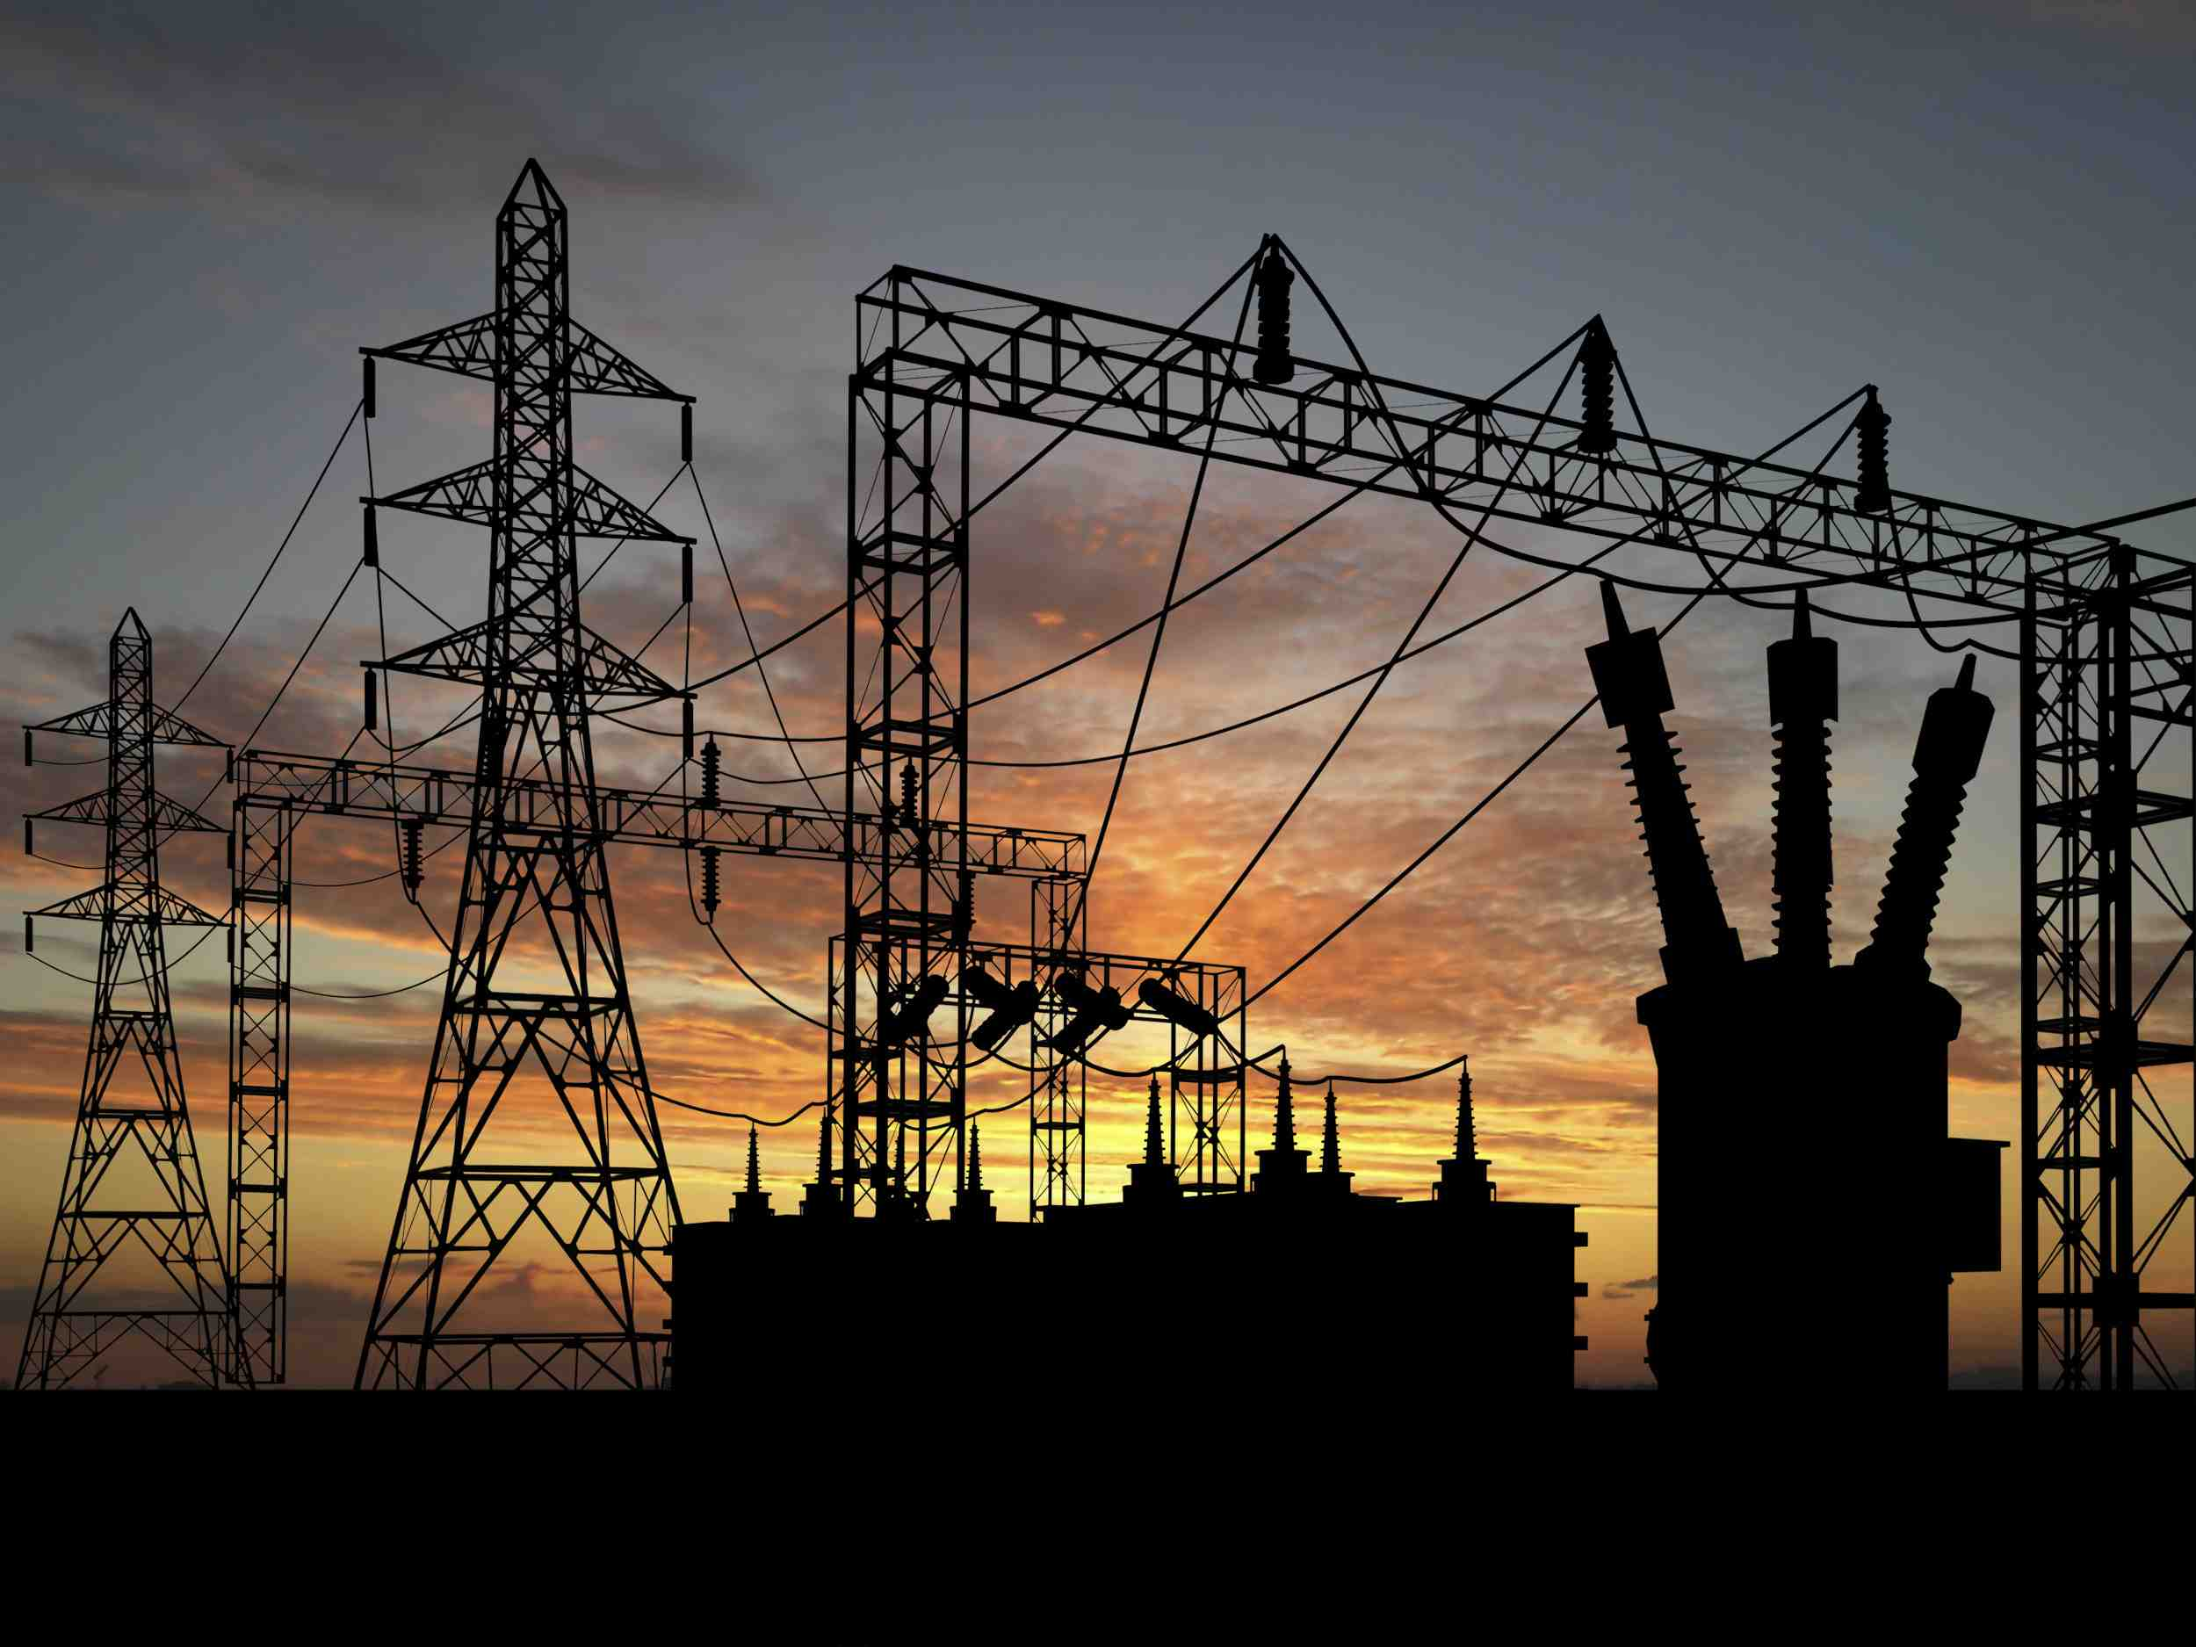
Use Case: Electrical Grid – Security and LIability
Who is managing your power?
Notes:
PROMISE
Linking together large electrical grids holds the promise of
being able to better match energy supply to energy demand,
optimize energy production to reduce overall cost, and
address local load peaks without having to design massive overcapacity into the grid.
IMPLICATIONS
Controlling this grid through a standard network protocol (whether or not it is IP), allows determined adversaries capable of accessing this control network to
blow up transformers,
escalate the cost of electricity generation, and
cause blackouts.
On an electrical grid that includes multiple utilities, possibly across national boundaries, who is responsible for keeping adversaries from wreaking havoc?
Individual utilities?
Command and Control component suppliers?
Regulators?

Slide 18
Issues Prompted By IoT

Slide 19
IoT prompts several areas of concern
Security
Security issues of IoT are not new, but new solutions will be required.
Privacy
Privacy issues of IoT are not new, but new solutions will be required.
Ownership
Device ownership enters a new gray area.
Data ownership represents a brave new world of possibility.
Liability
Liability, as well, opens up a Pandora’s box of complex issues.

Slide 20
Security Questions
As traditional enterprise perimeters disintegrate into a web of devices, how do we secure devices
From an adversary manipulating sensor input data ?
E.g., holding a lighter below an outdoor temperature sensor that triggers an emergency response)
While this could happen today, I submit that the additional layer of abstraction provided by the IoT may prompt less scrutiny of physical security and increase the vulnerability of such systems.
From an adversary manipulating output from a sensor or input to a processor?
E.g., dividing the output from sensors on a harvester in half to create the impression of a bad crop, causing commodity prices to rise
compromising the video feed from a surveillance camera during a burglary
or the altimeter in an airplane to cause it to crash
From an adversary compromising the instruction code in the processor
E.g., changing the rule that prompts an alarm to take no action instead
From an adversary compromising the instruction feed from the processor or the input feed to the actuator
E.g., dividing the changing ON to OFF or a LOW setting to HIGH

Slide 21
Security Questions cont’d.
Will we have the foresight to build in an effective upgrade capability (e.g., for security updates) into devices whose lifetimes may be decades?
Who is responsible for controlling access to the data?
At rest -- on the device
In transit -- between devices
Who is responsible for allowing a “man-in-the-middle” attack when there is no perimeter?

Slide 22
Practical Questions
Will all devices need enough intelligence to manage their own access control?
Will all devices need to be servers to do so?
If devices have enough intelligence (i.e., processing power and storage) to manage access control, will they also have enough processing power and storage to be victims of malware and/or hacking?
Once enough devices are deployed to be of interest to adversaries (e.g., malware and hack publishers), will the burden of managing access to devices outweigh the benefits to be gained from them?

Slide 23
Legal Perspective
Dr. Karsten Kinast LL.M.

Slide 24
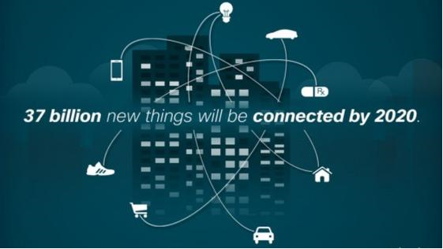
Agenda
Intrusion in private life
Personal Identifiable vs. Anonymous Information
Data profiling
Threat to Security and Privacy
Possible legal solutions
Bildquelle: Cisco

Slide 25
I. Intrusion in private Life
Internet-connected tools are installed in objects that can be remotely controlled
Therefore: They will allow criminals not only to monitor their victims, but also to intrude in their private lives
Problem: Security vulnerabilities = Privacy vulnerabilities!
Allowing criminals to hack various devices connected to the internet
Hacked and remotely controlled household appliances may cause severe distress for the victims
→ Means, access to the data by unauthorized persons for manipulating the tools and spying on the user’s life and behavior

Slide 26
II. Personal Identifiable vs. Anonymous Information
Personal Identifiable Information
Information that can be used on its own or with linked information to identify, contact, or locate a single person, or to identify an individual in context
2. Anonymous information
"Rendering anonymous” means the alteration of personal data so that information concerning personal circumstances cannot be attributed to an identified or identifiable natural person.
3. Pseudonymous information
The name or other identifier will be replaced by a pseudonym in order to prevent the immediate (!) identification of the data subject.
In contrast to anonymity the affected user remains identifiable for at least one person or institution, usually the one who contracts with the pseudonym.
Only anonymous information is uncritical in the sense of data protection!

Slide 27
III. Data Profiling
In principle:
Within the IOE, Pseudonymous information or even Personal Identifiable Information (IP-address, location-information, statistics related to the preferences of the users) could be submitted; companies may collect this user-information
Companies may pass the data to third parties that
… commercialize the information,
… make it public with or without your knowledge (example: private feeds from insecure webcams)
… Or even use it for initiating criminal proceedings
However: Only anonymous information may be legally submitted by the connected tools in order to stay within legal framework.
Also, transfer is legal if an informed consent is given.
2. Problem:
Usually, information is not anonymized. Also, informed consent is rarely (licitly) obtained.
User-profiling in those cases is inconsistent with the data protection laws

Slide 28
IV. Threat to Security and Privacy
Implications of Profiling:
Interference with right of self-determination
Breach of constitutional, civil and public law

Slide 29
V. Possible legal Solutions?
1. More / Better regulation by authorities?
Too much regulation may hinder innovation!
Striking the right balance between regulation and innovation is needed
Technical obligations that assure awareness of the user seem to be not realizable in practice
2. Corporate (vendor) action?
Opportunity to get an informed, voluntary consent of the users
Coupled to the terms and conditions when buying the tools or installing software
By placing notices on the tools
- If devices are installed by the technicians possibility to obtain an informed consent

Slide 30
V. Possible legal Solutions?
3. Self-data protection by the user?
E.g. by using the recommended TOR anonymizing software, in order to conceal its surfing goals
But for this, a brwoser is needed and that for the IOE is not necessarily the case
4. Political dimension:
Necessary awareness: A broad discussion about the risks to our data and what kind of security and risk concept overall we want

Slide 31
Q & A

Slide 32
Additional Slides

Slide 33
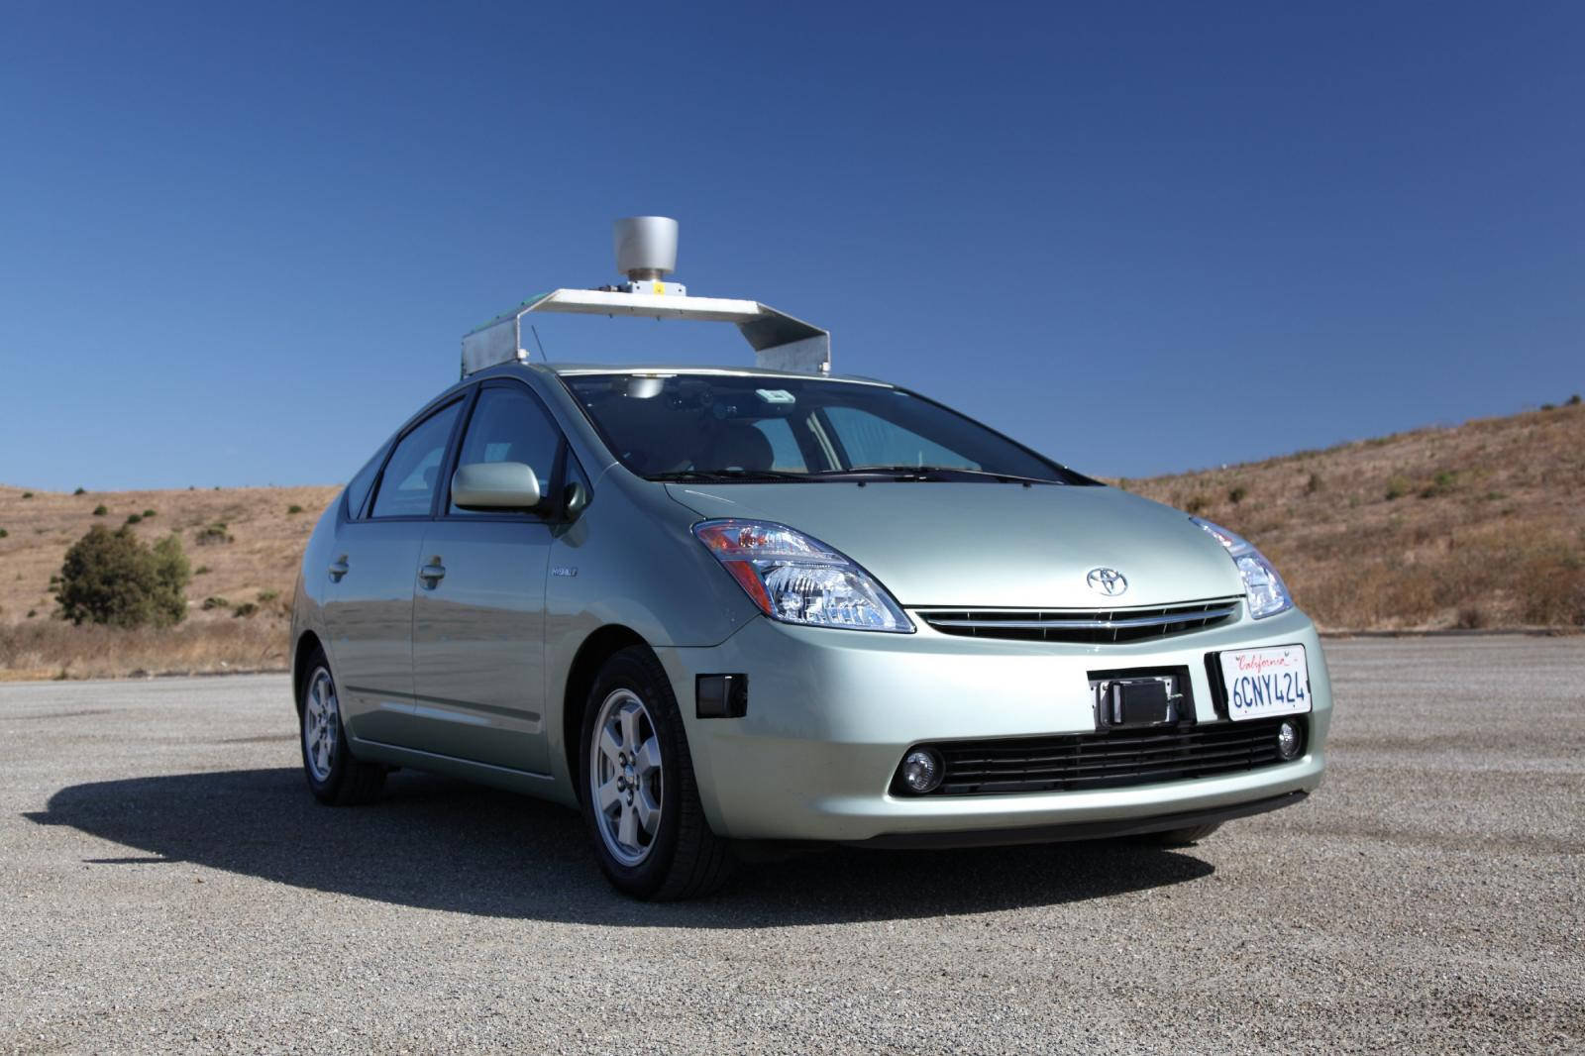
Autonomous Vehicles
Who is responsible in the case of accident?
Notes:
PROMISE
In America where the Baby Boomer generation equates their ability to drive their car as vital to their freedom, an aging population is reaching a point where their safety as drivers is becoming a concern. Among the promises of autonomous vehicles is the ability for elderly or inebriated people to maintain their freedom and flexibility to travel when and where they want using their own car, regardless of their current driving capabilities. Autonomous vehicles also promise to make driving more route and fuel efficient. Driving may also become safer when autonomous vehicles – absent the human characteristics of impatience and competitiveness – don’t fall victim to risky, aggressive driving behavior.
IMPLICATIONS
But who is responsible for providing access management to the vehicle systems that keep such vehicles safe?
Who is liable if a relative interested in a quick inheritance compromises the systems and causes a fatal crash?
Who is liable if a terrorist takes control of such a vehicle and creates a massive pile-up on a crowded freeway?

Slide 34
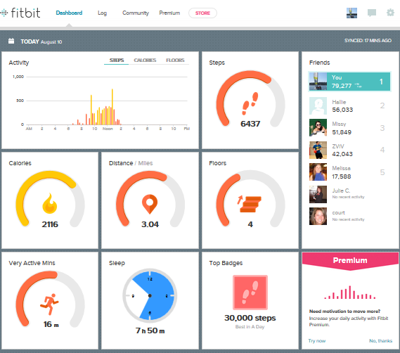
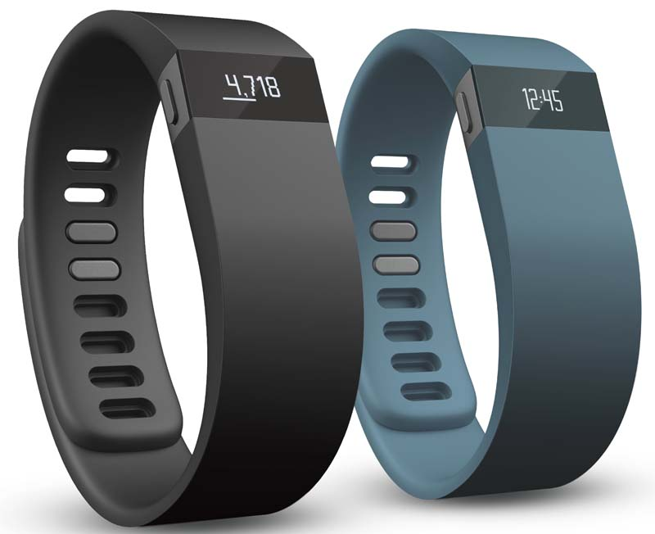
Health
Who is tracking your personal data?
Notes:
PROMISE
Personal health devices such as Fitbit, track biometric statistics to provide prompt feedback on health metrics to allow maximization of training benefits.
The can also provide prompt alerting of health dangers.
Remote controlled implants (e.g., pacemakers, dosage meters) can be reset to address different conditions (e.g., new surgery, athletic event).
IMPLICATIONS
Adversaries may track your biometrics to learn things about you that you consider private.
Adversaries may reset implanted devices to compromise your health, or even cause your demise.
Who manages access control of implanted devices? The doctor? The patient? (What if the patient is not capable of understanding how to manage access?)
Who is liable if the device is reset by someone other than the doctor resulting in injury or death?

