Slide 1
Identity Relationship Use Cases using Entity Relationship Modeling
Scott Shorter, ElectroSoft Services Inc.
2015-03-24

Slide 2
Contents
Intro to Entity Relationship Model syntax
Data Model
Entities, Relationships and Records
Use Cases

Slide 3
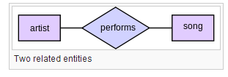
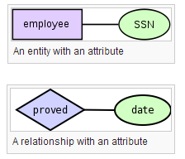
Entity Relationship Models
Entity Relationship Models are used business process engineering and software engineering. These examples give the basic syntax used in this presentation.
Source: http://en.wikipedia.org/wiki/Entity%E2%80%93relationship_model

Slide 4
Data Model
Entities
physical or logical objects that may have relationships with other entities
Relationship
A way for two or more entities to be connected
Record
Data that captures evidence or facts about an action or event

Slide 5
Use Cases
Entity::Person
Entity::Organization
Relationship::Organization Membership
Entity::Device
Record::Device Manufacture and Sale
Relationship::Device Decomposition into Sumcomponents
Record::Device Software Execution
Relationship::Device Ownership

Slide 6
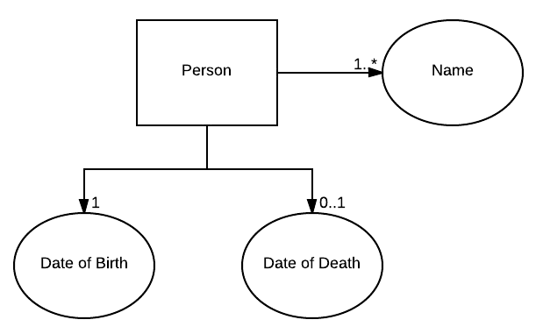
Entity::Person

Slide 7
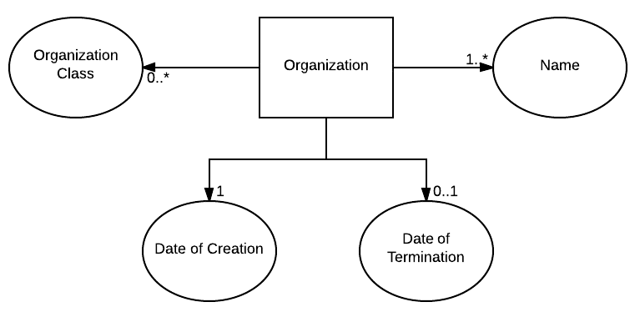
Entity::Organization

Slide 8
Relationship::Organization Membership

Slide 9
Entity::Device

Slide 10
Record::Device Manufacture and Sale

Slide 11
Relationship::Device Decomposition into Sumcomponents

Slide 12
Record::Device Software Execution

Slide 13
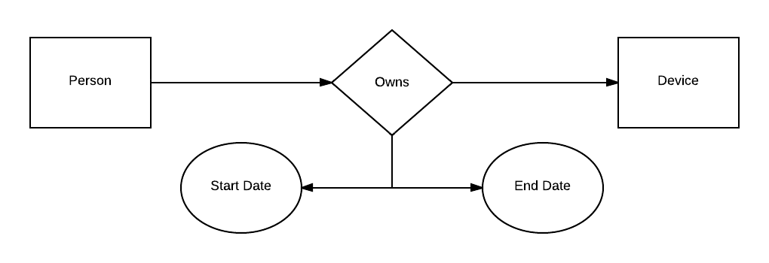
Relationship::Device Ownership

