Slide 1
Lunch ‘n Learn
Security Flaws in the Internet of Things
Scott A. Shorter
2014-07-29
Electrosoft Services, Inc.
1893 Metro Center Drive
Suite 228
Reston, VA 20190
Web: http://www.electrosoft-inc.com
Email: info@electrosoft-inc.com
Tel: (703) 437-9451
FAX: (703) 437-9452
Notes:
Introductions

Slide 2
Contents
Internet of Things defined
Security and privacy vulnerabilities
Research tools
SHODAN search engine
SCADASEC email list (supervisory control and data acquisition)
ICS-CERT (Industrial Control Systems Cyber Emergency Response Team )
Summary and Recommendations

Slide 3
Internet Of Things
The “Internet of Things” is simply that – pervasive online computational capabilities in most technology artifacts
Sensors
Controllers
User Interfaces
Backend infrastructure (interfaces, connections, implementations)
Security and privacy considerations abound

Slide 4
Security and Privacy Vulnerabilities
LIFX smart lightbulbs
Phillips lighting system
Belkin baby monitor
Electronic road signs
Network hardware
Maritime cyber security
SD memory card

Slide 5
LIFX smart lightbulb
Product is a smart LED lighting system controlled over home or office WiFi network using IOS/Android
Crypto weakness exposes Wi-Fi passwords
Hackers within ~30m able obtain secure Wi-Fi network passwords
Vendor released a firmware version that corrects the vulnerability
Source: Dan Goodin at Ars Technica 24 July 2014
http://arstechnica.com/security/2014/07/crypto-weakness-in-smart-led-lightbulbs-exposes-wi-fi-passwords/
Notes:
Nothing more than security through obscurity, which underpins much of today's Internet of things offerings.

Slide 6
Philips Hue Lighting System
Malware attacks on Internet-connected Philips Hue lights cause blackouts.
Hue LED lighting system made by Philips
Researcher discovered the weaknesses & developed proof-of-concept attacks that exploit them
Philips wireless controller uses a weak authentication system to receive commands from trusted smartphones and computers
Security token containing the device's unique media access control identifier that has been cryptographically hashed using a known algorithm
Can only be corrected by removing the device
Source: Dan Goodin at Ars Technica 24 July 2014
http://arstechnica.com/security/2013/08/philips-hue-lights-malware-hack/
Notes:
Discovered by independent security researcher Nitesh Dhanjani
While the so-called Internet of Things phenomenon brings convenience and new capabilities to gadgets, they come at a cost. Namely, they're susceptible to the same kinds of hack attacks that have plagued computer users for decades. The ability to load a Web page that causes house or office lights to go black could pose risks that go well beyond the typical computer threat.

Slide 7
Belkin baby monitor
Hack turns Belkin baby monitor into iPhone-controlled bugging device.
WeMo brand wifi monitor accessible with iDevices
Researcher discovered the weaknesses & developed proof-of-concept attacks that exploit them
Any user on the network can access the monitoring device
No password protection on network device
Source: Dan Goodin at Ars Technica 24 July 2014
http://arstechnica.com/security/2013/10/hack-turns-belkin-baby-monitor-into-iphone-controlled-bugging-device/
Notes:
Also Discovered by independent security researcher Nitesh Dhanjani
In response, Belkin support representatives said the WeMo baby monitor was no more insecure than any other computing device, at least when users follow standard security procedures.
"For homes that use a password for their Wi-Fi, our product is as secure as any item on that network," they wrote. "For someone to get access to the baby monitor a person would need to discover that password."

Slide 8
Electronic Road Signs
Electronic road signs defaced through remote and local exploits
Sloppy security protocols
Public safety concerns
Source: 24 July 2014 Brian Krebs
http://krebsonsecurity.com/2014/06/they-hack-because-they-can/
Notes:
“Investigators in one state believe the compromise may be in part due to the use of weak Simple Network Management Protocol (SNMP) community strings. Investigators in another state believe the malicious actor used Telnet port 23 and a simple password cracker to gain remote access. In one state the malicious actor changed the modem passwords, forcing technicians to restore to factory default settings to regain access.”

Slide 9
Network Hardware
Recent hardware devices under attack
consumer-grade Internet routers
data storage
home automation products
enterprise-class security solutions
Self-propagating malware attacking Linksys routers
ASUS routers & attached storage devices
Common absence of response from manufacturers
Source: 24 July 2014 Brian Krebs
http://krebsonsecurity.com/2014/02/time-to-harden-your-hardware/

Slide 10
Maritime Sector
2011 report from the European Union Agency for Network and Information Security (ENISA)
Found low level of cybersecurity in the maritime sector
Remote controlled container ships, automated port facilities
The maritime sector is very complex and inadequately standardized
Government jurisdictions overlap and compete covering ports and shipping
No holistic approach to managing maritime cyber risks
No economic incentive for better cybersecurity practices
Source: 24 July 2014 ENISA
http://www.enisa.europa.eu/activities/Resilience-and-CIIP/critical-infrastructure-and-services/dependencies-of-maritime-transport-to-icts/cyber-security-aspects-in-the-maritime-sector-1

Slide 11
SD Memory Card
SD memory cards used for man-in-the-middle attacks
Exploit allows malicious code to be injected directly into the device's firmware
Provides access to onboard microcontroller in addition to all incoming and outgoing data
Vulnerability could extend to SSD and USB thumb drive
Source: 24 July 2014 Geoff Gasior
http://techreport.com/news/25831/hackers-demonstrate-firmware-vulnerability-in-sd-cards
Notes:
The vulnerability doesn't have to be used for evil, though. According to Huang, the exploit allows SD cards to be used as a cheap source of microcontrollers for DIY projects. The processors inside common SD cards offer "several times the performance" of an Arduino CPU at "a fraction of the price," Huang says.

Slide 12
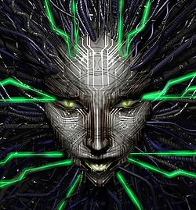
Tools for Research
SHODAN Search Engine
SCADASEC email list
Industrial Control Systems Cyber Emergency Response Team (ICS-CERT)

Slide 13
SHODAN Search Engine
Named after an evil AI from a video game with the acronym: Sentient Hyper-Optimized Data Access Network.
SHODAN is a search engine of internet facing SCADA interfaces
traffic lights, security cameras, heating systems, control systems for water parks, gas stations, water plants, power grids, nuclear power plants and particle-accelerators;
Myriad security flaws including lack of authentication, weak credentials, default credentials, hardcoded credentials, poor entropy, poor key generation, lack of secure channel, etc.
Source: 24 July 2014 Wikipedia
http://en.wikipedia.org/wiki/Shodan_(website)
Notes:
SHODAN Hacking Alerts[13] are live vulnerability RSS feeds regularly pulling search results from the SHODAN search engine.
Bishop Fox's free defensive tools incorporate SHODAN data into its defense alerts
These free RSS alerts can be utilized to perform ongoing monitoring of SHODAN results for any new vulnerability exposures related to organizations. They are part of the free defensive tool suite of the Google Hacking Diggity Project,[14] which form a type of intrusion detection system for search engine hacking (including results from SHODAN, Google, Bing, etc.).

Slide 14
SCADASEC-L Mailing List
SCADASEC’s top priority and goal is to provide education and training awareness programs for both public and private sectors. Information, its availability, and its dissemination, are vital in securing our Nation’s infrastructures.
This group forum is about security discussions, trends and overall discussions pertaining to ‘critical infrastructure protection’ and SCADA/control systems.
Source: 24 July 2014 http://www.infracritical.com/?page_id=53
Notes:
The vulnerability doesn't have to be used for evil, though. According to Huang, the exploit allows SD cards to be used as a cheap source of microcontrollers for DIY projects. The processors inside common SD cards offer "several times the performance" of an Arduino CPU at "a fraction of the price," Huang says.

Slide 15
ICS-CERT
Industrial Control Systems Cyber Emergency Response Team (ICS-CERT)
Part of Department of Homeland Security (DHS) National Cybersecurity and Communications Integration Center (NCCIC)
Provides alerts and advisories regarding ICS cyber vulnerabilities
Operates a Protected Critical Infrastructure Information (PCII) clearinghouse whereby sensitive industry cybersecurity information is shared with authorized recipients with a need-to-know
Source: 25 July 2014 https://ics-cert.us-cert.gov/

Slide 16
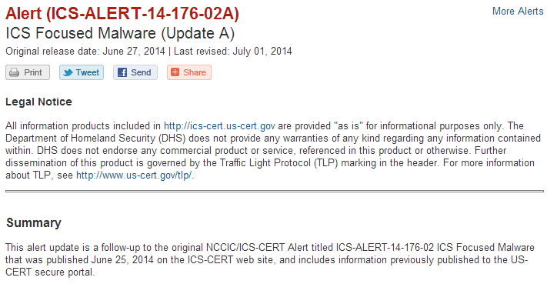
ICS-CERT continued

Slide 17
Summary
So, anything with firmware can be compromised…
…and everything has firmware.
What now?

Slide 18
Recommendations
Developers in the Internet of Things must:
Design all the Things to be upgradeable so that vulnerabilities can be patched, AND
Secure the upgrade process so it’s not an attack vector (trusted channel for firmware images, authentication, access control and accountability)
System Owners in the Internet of Things must:
Maintain complete and accurate asset inventories, and know which Things matter
Insist on the above from suppliers
Monitor the vulnerability status of the Things that matter and patch accordingly

Slide 19
Standards
ISO/IEC 27000 Information Security Management Systems
Security Content Automation Protocol (SCAP) provides mechanisms for discussing IT vulnerabilities – it can and should be extended to the Internet of Things.
Asset Identification, Common Vulnerability Enumeration, Common Platform Enumeration, Common Vulnerability Scoring System
Benchmarks, Check Engines, Asset Reporting Format

Slide 20
Questions?
?

