Slide 1
Redefining Access Control:
A Human-Centric Perspective on
Identification, Surveillance,
and Economic Value Chain
Cyber Security for Next Generation Connectivity Systems
Sal D’Agostino
Rajesh Murthy

Slide 2

Guiding Principles
Human Centricity
Decentralization
Distribution
Heterogeneity
Self Healing

Slide 3
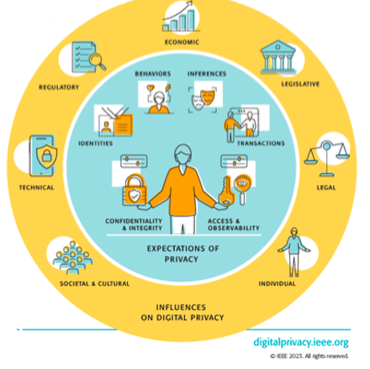

Slide 4
Technology unnecessarily presently circumscribes and grossly limits digital privacy, transparency, and as a result human expectations, and digital identity expression and security. - personal observation…

Slide 5
Digital Privacy is Key to Next Generation Cyber Security
Human to technology governance (human trust and control)​
Requires an inversion of the present situation
Security/surveillance technology -> human abuse
Human uses -> security/surveillance technology utility

Slide 6

Identification as the means of access control
Identifier
  Centrally issued, inherently a risk, (seldom Authoritative, e.g., I-9 number)
Authentication
  Requires exchange of keys/secrets and key management
Authorization
  Permissions in a system, controlled and operated by a 3rd party (authorization and resource servers/services)
  Policy Information Point (Rules) not under personal control

Slide 7

Notice and Consent Receipts
Oldest known form of writing was a business receipt.

Slide 8
Kantara Initiative - Consent Receipt
2012 Open Notice
2018 Consent Receipt v1.1
2020 ISO/IEC 29184 Online privacy notices and consent
2023 ISO/IEC 27560 Consent record information structure
2023 ANCR WG
  Transparency Performance Scheme and Indicators
  Notice/Receipt Record and PII Controller Notice Credential
  Transparency Code of Conduct (Convention 108+)
  AuthC (Authorization from Consent), v2 ANCR Credential Set

Slide 9
Transparency Performance
Timing of Notice (of Risk by Controller)
  Before, At the time of, After (identification/surveillance is taking place)
Content of Notice
  Controller and legally required information (Company, Owners, Security/Privacy Contact/Policy Information, Risk Assessment)
Usability of Notice
  Access to and usability of the Content of Notice
Security Evidence (to support Notice)
  Are security controls relevant to the Content of Notice and Risk Assessment

Slide 10
Controller Credential
Made by a human (Person, Data Subject, PII Principal) of the Controller (3rd Party/Org, Data Controller, PII Controller)
Created independently of the controller using digital transparency
Initially a receipt specific to the controller type – 2FN
Surveillance notice receipt – Notice of Risk
Proof of notice
Then used to make a record of the relationship with the controller
Captures state (RoPA T)
Person (their digital agent) creates access tokens and maintains state
Personal access log

Slide 11
3 Vectors of Contextual Data Governance
Who Controls the Data Sources?
Is Data Protection Required ?
Is it Co-Regulated ?

Slide 12
Levels of Assurance
Level 0. Same level of assurance as a privacy policy
Level 1. Registered in a Directory
Level 2. Data Governance – Certified Operator
Level 3. Data Governance – Regulated Operator Registrar

Slide 13

Consented Surveillance
Human Concentric
Recognize the difference between access and enforcement
Recognize that access control as security countermeasure is surveillance and has inherent identification risks.
Recognize the difference between surveillance for people, not of people.
  Purpose and justification drive the function of technology

Slide 14
AuthC Flow
Notice is captured in a Receipt
This is used to create a 2 Factor Notice (2FN) w/ optional Cyber Notary
Notice of Risk
Proof of Notice
The is used to create a Record and Relationship that can have a Digital Twin
A Consent Receipt is generated and added to the Record (RoPA) to Govern processing (Access)
Does not require identification of the Person/PII Principal/Data Subject

Slide 15

Economic value chain
Creating an access control mechanism where authority is at the decision (access/transaction) point (e.g., with digital twin notarized receipts) may have orders of magnitude social, technical, and economic impact.

Slide 16

Benefits of Ownership
Personal Data Control
Data Protection
Co-Governance

Slide 17
Benefits of Ownership and Control
Improved risk management
Privacy
Security
Increased value of data
Cutting out intermediaries
Speed
Accuracy
Validity
Operational efficiency
Authoritative at decision point
No Questions Unasked

Slide 18

Inversion of Technology
Generative versus extractive
Private AI
Public Infrastructure
Digital Commons

Slide 19



Thanks

