Slide 1
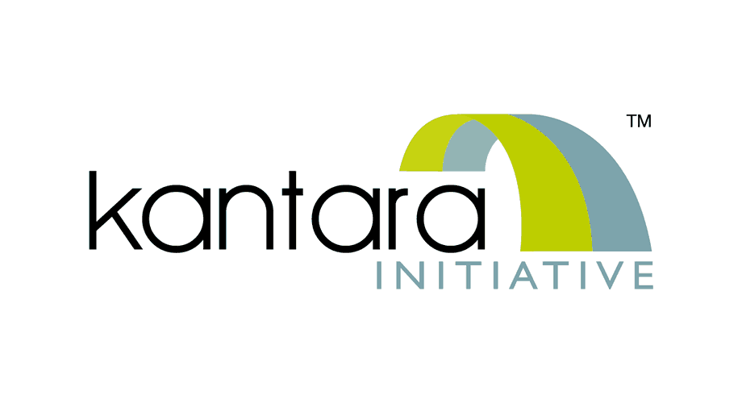
ISO 17065 Certification Overview
Providers Jan 2025, Carol Buttle

Slide 2
What this overview covers
Overview of ISO 17065
Benefits for assessed companies
What ISO 17065 covers and how this affects you
What will Kantara do differently?
A brief list of the documents that support our delivery of a ISO 17065 certification scheme
Q&A

Slide 3
Some terminology
Accreditation:
Accreditation is the assessment of the competence and impartiality of a Conformity Assessment Body and the compliance of their work to nationally and internationally recognised standards or schemes.
Certification:
Certification is the third-party confirmation via audit (assessment and test) of an organisation’s systems or products.
A CAB/CB undertakes audits and assessments and the National Accreditation Body is responsible for making sure they are competent to do so and follow the process as specified in the appropriate standard along with the certification scheme requirements

Slide 4
Why Kantara is making this move
To line up with the industry
To future proof our assessments
To be able to offer additional schemes and extensions to schemes
To provide the increased governance the industry is expecting of conformity assessment bodies
To be able to give greater clarity on cost, duration and scope
To be able to support providers through the process

Slide 5
ISO 17065 - benefits for our clients
Consumer confidence: a certified organisation has a recognised mark and certificate. This gives confidence to consumers that when they verify their identity the underlying products, processes and service have all been fully tested and are compliant
Regulatory compliance: more and more regulators expect certification to be in place to ensure that product, process and service certifications comply with scheme, regulatory and other applicable requirements.
Unbiased certification: our certifications are conducted without bias, conflicts of interest or undue influence. This creates an equal playing field. Increased transparency.
Specialist expertise: the use of specialist identity experts in the certification process enhances the value and credibility of the certified solution.
Consistency and reliability: clarity and consistency in adhering to ISO guidelines results in reliable and uniform product certification practices.

Slide 6
Overview of ISO 17065
ISO/IEC 17065 is the international standard that provides requirements for bodies that perform certification of products, processes, and services.
It is supported by numerous other standards that are interrelated or set the requirements for organisations like Kantara Initiative to achieve and maintain accreditation. (See Appendix slides)
It is recognised by Multilateral Recognition Agreements by international accreditation bodies .
It covers numerous industries and is seen as integral for enhancing consumer trust and market confidence.
It lays down a clear framework for a robust certification process that is grounded on the principles of:
Integrity
Impartiality and independence
Competence and qualification
Consistency and reliability
Transparency and accountability
Confidentiality
These principles are maintained by a mandate in the standard for regular internal audit and management review of the integrity of the certification processes and delivery.

Slide 7
What does ISO 17065 cover?
In full, ISO 17065 is: Conformity assessment — Requirements for bodies certifying products, processes and services. This explains the wide ranging appeal and applicability of the standard across a vast number of industries.
Products: our assessors would be able to certify the products that result from complex processes that meet a specific, final standard or framework.
e.g. NIST 800-63 or the UK DIATF or any emerging schemes we may choose to cover in the US
Services: our assessors would be able to assess and certify services and intangibles that typically include a product or ongoing activity.
e.g. a document checking service or a biometric provision
Processes: our assessors could support the certification of processes–interrelated activities that lead to a product or service or any system that takes inputs to produce output.
e.g. an incident reporting and recovery process or a staff screening process
Individually, each area is particularly useful for security, where assessors are regularly responsible for assessing the compliance and competence of businesses’ and agencies’ overall IT and data security processes. When all three areas are combined, it makes for a very powerful audit/assessment capability.

Slide 8
ISO 17065 Requirements

Slide 9
The standard has stringent requirements
A certification body or conformity assessment body (CAB) must be a legal entity and, as such, can be held accountable and legally liable for the certification and assessment activities it undertakes.
ISO 17065 continuously emphasises the need for impartiality and accountability.

Slide 10
Requirements
The requirements are in depth, mandated and fall into the following categories:
General requirements
Structural requirements
Resource requirements
Process requirements
Management systems requirements

Slide 11
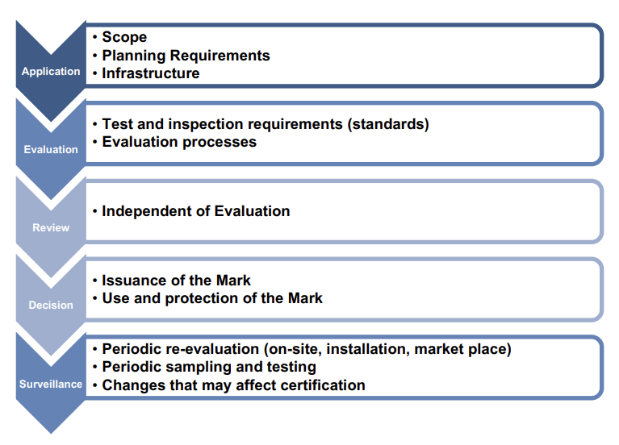
The ISO 17065 process

Slide 12
What will Kantara do differently
Provider approaches Kantara with initial request
An application pack is sent
The certification program team reviews application
The scope is assessed
Availability of audit team is checked
A proposal is sent back to applicant
A contract is signed
The audit/assessments take place
A report is submitted by the audit team and reviewed by technical audit lead
The report is submitted to the ARB for review and decision
The decision is made and successful outcome result is the release of a certificate and entry on the register

Slide 13
Process
Application
Application review
Proposal
The application pack comprises:
Application form
Service Assessment Criteria (SAC) & Statement of Criteria Applicability (SoCA)
Statement of conformity
Service description
Everything needed will be sent to the provider by the certification team.
On receipt of completed application pack the certification reviews. This will make sure that the provider is ready to proceed and has supplied all the necessary information.
It will also make sure that Kantara has the necessary resources and skills to undertake the assessment.
An estimate of the time, duration is made.
A plan is produced.
The proposal will detail:
Costs, duration and timescales
The nominated auditors.
A plan giving full information about what is required, when and by whom.
If Kantara and the provider are in agreement the proposal is accepted and a contract signed.

Slide 14
Process
Evaluation
Review
Decision
The evaluation will use the best method for checking compliance:
Document review
Interviews
Testing etc
A full report is compiled by the assessors.
An independent review by a technical review who had not taken part in the original evaluation will take place in a specified amount of time.
Any further information from the provider will be requested if necessary and when complete the updated report is sent to the certification team who then submit it to the ARB.
The ARB will review the fully completed report. Any clarifications will be requested but all being well, a positive decision is made and agreement for issuance of a certificate.
The certification team will notify the provider of the decision.
Provider is then supplied with certificate and added to the trust list register

Slide 15
Appendix - interrelated standards
ISO/IEC 17065, Conformity assessment – Requirements for bodies certifying products, processes and services
ISO/IEC Directives, Part 2, 2018, 33.2, Conformity assessment schemes and systems
ISO/IEC 17007, Conformity assessment – Guidance for drafting normative documents suitable for use for conformity assessment
ISO/IEC 17024, Conformity assessment – General requirements for bodies operating certification of persons, Clause 8, Certification schemes
ISO/IEC 17067, Conformity assessment – Fundamentals of product certification and guidelines for product certification schemes
ISO 10002, Quality management – Customer satisfaction – Guidelines for complaints handling in organisations
ISO/IEC 17000, Conformity assessment – Vocabulary and general principles
ISO/IEC 17011, Conformity assessment – Requirements for accreditation bodies accrediting conformity assessment bodies

Slide 16
Appendix - interrelated standards (contd)
ISO/IEC 17020, Conformity assessment – Requirements for the operation of various types of bodies performing inspection
ISO/IEC 17021-1, Conformity assessment –Requirements for bodies providing audit and certification of management systems – Part 1: Requirements
ISO/IEC 17025, General requirements for the competence of testing and calibration laboratories
ISO/IEC 17029, Conformity assessment – General principles and requirements for validation and verification bodies
ISO/IEC 17030, Conformity assessment – General requirements for third-party marks of conformity
ISO/IEC 17034, General requirements for the competence of reference material producers
ISO/IEC 17040, Conformity assessment – General requirements for peer assessment of conformity assessment bodies and accreditation bodies
ISO/IEC 17043, Conformity assessment – General requirements for proficiency testing ISO/IEC Guide 23, Methods of indicating conformity with standards for third-party certification systems.

