Slide 1
ANNUAL GENERAL MEMBERS MEETING 5 DECEMBER 2023

Slide 2
2023 AGM - Agenda
10:00 | Welcome & Opening Remarks
10:10 | Organizational Updates DEIA Initiative Update
10:30 | Membership Update
10:35 | Assurance Program Report
10:40 | UK Certification Program Report
10:45 | Leadership Council – Individual Work Group Reports
11:35 | Liaison and Association Engagement
11:40 | Introduction of Candidate Slate for Election of Directors
11:55 | Closing Remarks

Slide 3
Kantara Anti-Trust Statement
ARTICLE 19 COMPLIANCE WITH ANTITRUST LAWS The members will be combining unique experience and skills to foster identity community harmonization, interoperability, innovation and broad adoption through the development of open identity Technical Specifications, operational frameworks, education programs, deployment and usage best practices for privacy-respecting, secure access to online services. This purpose is believed by the Members to be more difficult to achieve through the independent efforts of each company. The Members are committed to fostering open competition. The Members understand that in certain lines of business they are direct competitors and that it is imperative that they and their representatives act in a manner which does not violate any applicable antitrust or competition laws pertaining to monopolistic or anti-competitive practices. Thus, all Members shall comply with all applicable antitrust and competition laws of all relevant jurisdictions. In addition, with the advice of counsel, the Board shall from time to time promulgate detailed Antitrust Compliance Guidelines for the consideration of the Members concerning their participation in the Corporation. These Guidelines are not intended to replace or displace each member’s own antitrust policies but shall operate to guide the Members’ participation in the Corporation. Members are not required to develop or market any offerings and are not precluded from engaging in any business activities whatsoever, even if they are competitive with the activities conducted under these Bylaws.

Slide 4
Organization Updates

Slide 5
Board of Directors Report
Kantara is delivering our mission: To grow and fulfil the market for trustworthy use of identity and personal data
In 2023:
Assurance program participation and revenues are steadily increasing
Kantara’s visibility and significance beyond public sector is increasing
Our executive and members are in demand to present at conferences
Our groups address important industry topics by convening experts and companies
Liaison relationships are more productive and influential
Financial stability and prudent management continue

Slide 6
Board of Directors Report
In 2024 the Board plans improvements:
To corporate governance (clear role divisions between the corporation and corporate governance)
To increase corporate resilience (Director terms and succession planning)
To increase corporate capacity
To establish a multi-year rolling corporate business plan
To prepare US Assurance program for accreditation under ISO standards
To extend assurance programs beyond US Federal/NIST requirements
To support Leadership Council expansion into new related areas and groups
While continuing prudent management of corporate resources to the benefit of Members

Slide 7
Governance Refinements

Slide 8
Context
Pre-2022
Kantara’s board was entirely comprised of representatives from top-level corporate members
2022
Kantara changed this so that the board would be independent of corporate membership status
2023+
In support of Kantara’s long-term ambitions, the Board initiated a review of our Governance documents, policies, and procedures to ensure that our structures are fit-for-purpose, robust, scalable, and embody current best-practice from a governance perspective

Slide 9
Why this matters
Board members are the fiduciaries [trustees] who steer the organization towards a sustainable future by adopting sound, ethical, and legal governance and financial management policies, as well as by making sure the nonprofit has adequate resources to advance its mission.
When there are paid staff in place, rather than steer the boat by managing day-to-day operations, board members provide foresight, oversight, and insight….
– National Council of Nonprofits
Hence, Kantara’s board must be able to…
Take a multi-year view of the organization without becoming ‘stale’
Provide robust and appropriate challenge and oversight whilst remaining operationally agile
Recruit and nurture Directors with appropriately diverse and board-relevant skills, specialisms, and backgrounds
…in line with Kantara’s principles and values.

Slide 10
Workstream Status
WHEN |  | WHAT | STATUS
2023 | Jul-Aug | Agree scope of work Initial review of bylaws | Complete
 | Aug-Sep | Develop initial recommendations Discuss with board Agree next steps | Complete
 | Sep-Dec | Draft bylaw changes (as required) for final board approval and membership notification Identify additional areas (policies etc.) for review Make recommendations for supporting material development | In progress
2024 | Jan-Dec | Progress work as needed | Pending

Slide 11
Key Findings and Outcomes
Issue | Impact | Resolution
1 year term length | Inhibits long-term perspective Inhibits effective individual contributions Risks instability through churn | Move to 2-year terms
No consecutive term limits | Risks staleness and poor governance | Limit consecutive terms to 3
Board oversized | Limits efficiency and effectiveness | Reduce to 11 seats (from 17)
Role conflation | Inhibits robust challenge Risks bias in decision-making | Separate ‘Board Chair’ and ‘President’ roles
THESE UPDATES align Kantara’s governance model with generally accepted best practice lead to a more effective, efficient, responsive and inclusive board improve the board’s ability to deliver, for our members and for the industry

Slide 12
Next steps
By (roughly!) end of 2023
Draft updated bylaws
Board ratifies revised bylaws
Kantara adopts revised bylaws
2024 – onward
Review other policies & procedures and update as necessary to improve effectiveness
Implement updates as needed

Slide 13
Diversity, Equity, Inclusion, and Accessibility (DEIA) Initiative

Slide 14
In 2022, we said we committed to…
Standing up a DEIA Group for:
Fostering greater consistency in the framing of DEI for identity providers and solutions
Creating a summarized report and outlook for industry in the coming months
Driving engagement as a community and helping to evolve our efforts.

Slide 15
What is Our 2023 Progress?
Near-Term Priorities
DEIA Board Subcommittee Charted in June 2023
(Target audience includes service providers, relying parties, standards policies, and policy makers)
Expanding the groups participating actively in the group. We’d love to have you!!!!
1
Scope:
Developing artifacts to document consensus for digital identity taxonomy and terminology
Developing educational collateral to help raise the IQ across business functions
Developing ROI calculators and approaches for DEIA in digital identity
Expanding collaboration across external bodies and industry groups
Developing service provider maturity model and assessment framework
Creating a methodology for measurement of DEIA outcomes in identity to enable ROI analysis for improvements
2
Developing a set of terminology / taxonomy for service providers and relying parties usage to confirm there is consistency.
3

Slide 16
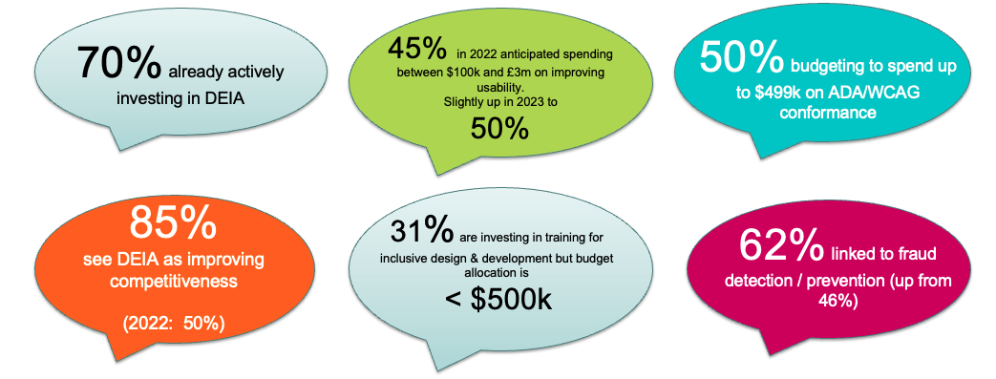
What We’ve Heard from our 2023 Survey

Slide 17
Challenges we’ve heard in our survey (cont…)
Servicing those with no credit file
Defining clear goals and measuring results related to DEIA initiatives
Lack of accepted industry-wide standards, metrics, and guidance on best practice for assessing performance
Challenges to identity verification, government requirements in these areas, misinformation and trust in digital ID solutions, no standardization of these topics beyond accessibility (e.g. WCAG), enterprise vs citizen focus of solution
Integration of indigenous and migrant communities into overall ecosystem.
Ensuring accessibility standards are met
Knowing what data to save and how to report on it.
Kantara sub-committee is using these inputs to prioritize our efforts into 2024!

Slide 18
Membership
Report

Slide 19
2023 Membership by Tier

Slide 20
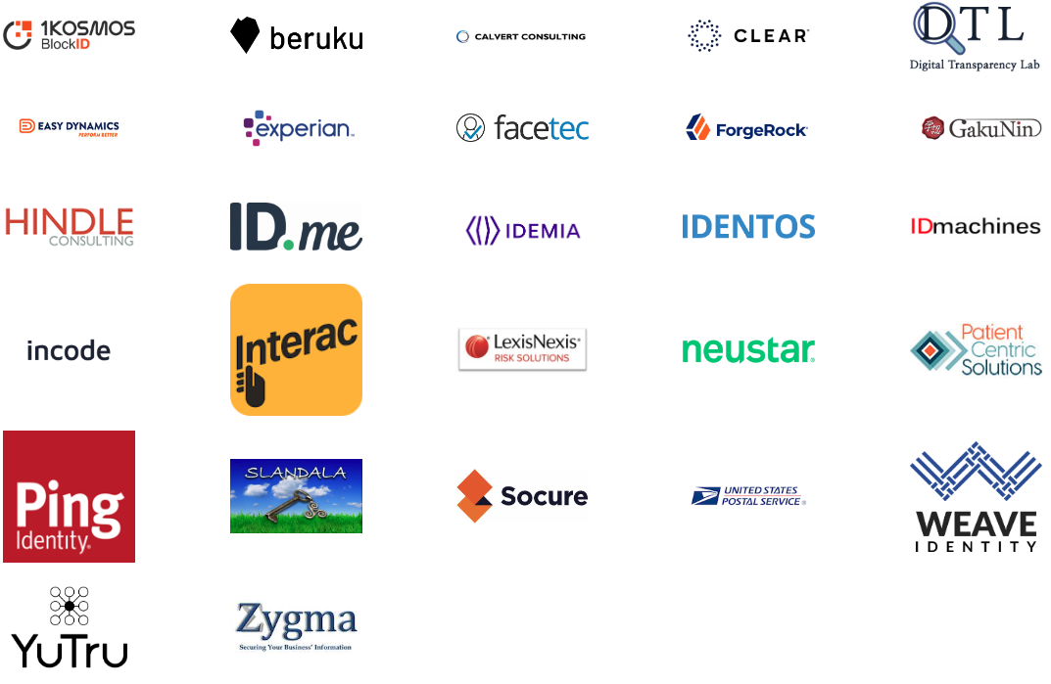
Organizational Members

Slide 21
U.S. Assurance Program

Slide 22
Total Assurance Program Participants
Congratulations to our NEW 2023 Assurance Program Companies
IDEMIA – IAL2 Component Service
Exostar – IAL2 & AAL2 Full Service RTO
JakobsenID – IAL2 & AAL2 Full Service RTO
Incode – IAL2 Component Service
ID Data Web – IAL2 Component Service
Notarize/Proof – IAL2 Component Service
Total Companies: 35
Notes:
Added TEN new companies in 2023!
Seeing an increase in our Full Service Providers – 2 RTOs and a Component Service adding on AAL to be a full service provider

Slide 23
Grants of Approval & Annual Conformity Reviews 2020-2023
Number of Companies
Includes CSPs and Assessors.
Notes:
Grew from 21 Grants of approval to 26 Grants of Approval over 2023.

Slide 24
Assurance Program ~ 2024 Anticipated Changes
Fees remain the same
Reclassifying Current Approvals – Full Service and Component Service
Removal of ‘Technical’ Class of Approval
800-63 rev. 4 release

Slide 25
U.K. Certification Program

Slide 26
UK Certification Program for DIATF Right to Work, Right to Rent, DBS Services
UK Advisory Board Led by Alison McDowell, Beruku, with Andi Hindle and Emma Lindley
Certifications available for Right to Work, Right to Rent, and Disclosure and Barring Service
Certifications for Identity Service Providers (IDSP), Attributes Service Providers (ASP), and Orchestration Service Providers (OSP)
Future plans for Holder Service Providers, for e-wallets, mobile DL, wallet apps, etc.
New staff beginning in 2024

Slide 27
Leadership Council Work Group Reports

Slide 28
Identity Assurance WG

Slide 29
Identity Assurance WG – 2023 in Summary https://kantara.atlassian.net/wiki/spaces/IAWG/overview
NIST 800-63 v4 Public Draft response
IAWG compiled, discussed, agreed on comments to NIST on v4 draft
Work ran from January through April 2023 and submitted successfully
NIST plans to issue a second call for public comments early 2024
Resolution of outstanding issues with service assessment criteria
Assessors and service providers find errors, unclear criteria and other issues as they work with our SAC
IAWG works through these issues as time allows
Work on outstanding issues ran from June to November 2023
Updated documents circulated and uploaded to the Kantara site

Slide 30
Identity Assurance WG – 2024 Plans
Feedback to NIST 800-63 v4 Call for public review
NIST intends to publish a second public review - IAWG will prepare a response
Realignment of IAWG to meet Kantara business plan
Increase focus on assessment scheme development and management
Increase capacity to respond to high priority industry trends
Address needs of non-NIST identity assurance markets
Involvement with different industries to provide guidance as well as mappings so constituents use common language when working together in the industry

Slide 31
User Managed Access WG

Slide 32
User Managed Access WG – 2023 in Summary https://kantara.atlassian.net/wiki/spaces/uma/overview
UK Pensions Dashboard Use-Case Report
After planning a financial sector or open banking report, the group decided to focus on the real UMA implementation by the UK Pensions Dashboard. The report explains the purpose of the dashboard and UMA’s unique value to the initiative. The draft is available for review: https://kantara.atlassian.net/l/cp/vuHNuDSj
OAuth Compatibility & Single Profile Implementations
UMA is composed on two complementary specifications: UMA Grant and Federated Authorization. This summer we discussed how Federated Authorization could be used alone to deliver value to implementers. This is an ongoing project focused on improving UMAs useful in existing OAuth environments

Slide 33
User Managed Access WG – 2024 Plans https://kantara.atlassian.net/wiki/spaces/uma/overview
Health Industry Collaboration
We are preparing some education sessions for the health community about UMA. The goal is to add an UMA testing track to HL7’s FAST Infrastructure (Security & Identity) group.
New Use-Case Report
Following the last two years of these, the group plans to create a new Use-Case report, either for a new industry or an updated one for Health. The specific topic has yet to be confirmed, if you have ideas please join us on Thursday!

Slide 34
Resilient Identifiers for Underserved Populations WG

Slide 35
RIUP WORK GROUP– 2023 in Summary Wiki + Charter: https://kantarainitiative.org/workgroups/riup-wg/
2023 Goals: Definition & use cases for facilitating online identity for underserved populations
Project 1: Defining Underserved Populations
Definition and Description of Underserved Populations (September 2023)
Project 2: Use Cases and Personas - Digital Identifier Inclusion
RIUP investigated several possible approaches and decided to focus on state issued ids and mobile wallets for underserved communities. A draft report Digital Identifier Inclusion has been circulated internally for feedback and the goal is a version 1.0 by EOY 2023.

Slide 36
RIUP WORK GROUP– 2024 Plans Wiki + Charter: https://kantarainitiative.org/workgroups/riup-wg/
Project 2 (2024): Use Cases and Personas - Digital Identifier Inclusion
In 2024, RIUP will pivot to getting new members and feedback for an early update to the Digital Identifier Inclusion report. The goal for the second version of the report is the end of 1st quarter 2024.
Project 3 - Gateway Provider Trust Network
Develop relationships with "gateway" providers toward creating a trust network
Project 4 - Visuals
Fully described use case/customer journey showing where the snags are
Mapping the digital identity divide, gateway providers, populations/# served

Slide 37
Privacy Enhancing Mobile Credentials WG

Slide 38
PEMC – 2023 in Summary Workspace
Implementor’s Report
Final edits in progress. Release in December or January.
Privacy Enhancing Mobile Credentials Report
Work in progress. Requirements for Verifiers, Issuers, and Providers. Due to deliver through 2024.

Slide 39
Anchored Notice and Consent Receipt WG

Slide 40
Anchored Notice and Consent Receipt (ANCR WG) 2023 in Summary
Kantara Recommendation
Transparency Performance Scheme and Indicators
Pending LC and Kantara Voting
Updated Charter, Elections, Roadmap
ANCR Framework
TPI Assessment and Controller Credential
Consent by Default and Authorization from Consent (AuthC)

Slide 41
Anchored Notice and Consent Receipt (ANCR WG) 2023 in Summary
ISO Comments – 2756x
NIST Comments – Cybersecurity Framework, Identity Roadmap, Privacy Framework
Canadian Parliament – Standing Committee on Industry and Technology
Outside funding – DHS – Digital Wallet, EU- NGI Digital Commons
Liaison – IEEE, W3C, others

Slide 42
Deepfake/AI Threats to ID Proofing and Verification DG

Slide 43
Deepfake Threats to IDPV group – 2023 in Summary https://kantara.atlassian.net/wiki/spaces/DGDF/overview
Activity in 2023
Developed a mind map to capture the context of the group’s work
Defined key topic areas and assigned a leader for each
Weekly meetings to explain topic area content to the group and discuss/debate
Meetings are lively and we are all learning rapidly
Actively recruiting leading companies to join

Slide 44
Deepfake Threats to IDPV group – 2024 Plans
Planned Activities
Conclude the collect/curate phase
Develop outbound content from the curated material
Market, promote, engage, present, talk about, raise awareness…
Determine next phase of work (i.e. more discussion? Create requirements documents? )

Slide 45
Liaisons and Associations

Slide 46
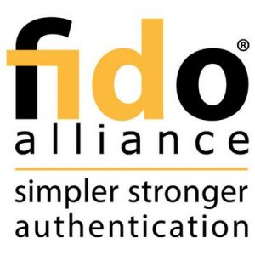
Liaison Activities
FIDO Alliance
OIDF
DIACC
IDPro
Women in Identity
ISO – Work Groups
OECD
INCITS
CARIN Alliance
tScheme

Slide 47
Board of Directors 2024 Slate of Candidates

Slide 48
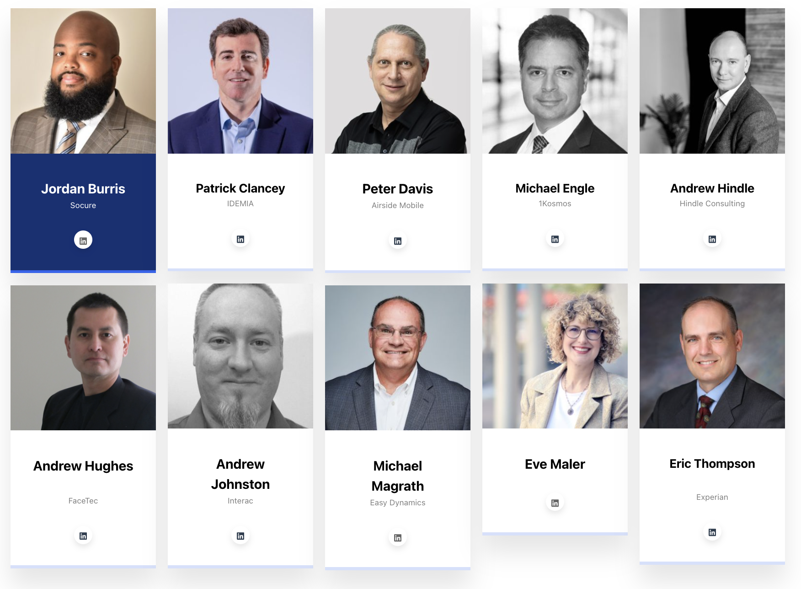
2024 Board of Directors Slate of Nominees
View candidate bios here:
https://kantarainitiative.org/director-nominations-2023/

Slide 49
Closing Remarks
Contact: Staff@kantarainitiative.org
US Assurance Program: Secretariat@kantarainitiative.org
UK Certification Program:
Applications@kantarainitiative.co.uk

Slide 50
Stay in touch!!
Thank You Very Much!
www.kantarainitiative.org
Communications@kantarainitiative.org
@Kantaranews
@KantaraInitiative

