Slide 1
Diversity, Equity and Inclusion
Survey Results, October 2022

Slide 2
Recap: DEI Committee Plan
Communication
Member engagement (+ comms)
Partner engagement
✓
Draft included in this doc
KI BoD meetings
May 19
Jun 16
Jul 21
Aug 18
Sep 15
Oct 20
✓
May 4:
Why DEI matters to us
Jun 22-9: KI’s role in DEI
Jul 6-13: Partnership announcements
✓
✓
Apr 27: Commitment statement
May 11: Success for the DEI cttee
Jun 8:
Survey results
Aug 3: DG leadership
Nov 2: Report announced
Communication
May 17-27: DEI survey
Jun 1 thru Jul 15: Interviews
Jul 25: DG launch
Aug 15 thru Oct 15: Benchmarking / report
Engagement
Apr 25: KIEF and WiD follow-ups
May 13: KIEF and WiD scope / roles
Jun 10: Partnership structures
Jul 15: WiD project funding approach
Sep 30: WiD project funded
Partners

Slide 3
1) Commitment statement
Our commitment to Diversity, Equity and Inclusion stems from our vision of an equitable exchange.
At the heart of this is the idea of equity—the trust that everyone can access what they need. We only achieve this by understanding and accounting for diversity, because it is the diversity of our experiences and perspectives that defines identity.
The attributes and artifacts we use in solutions to establish identity are physical reflections of who we are. So, until we design for inclusion, identity solutions will continue to be incomplete.

Slide 4
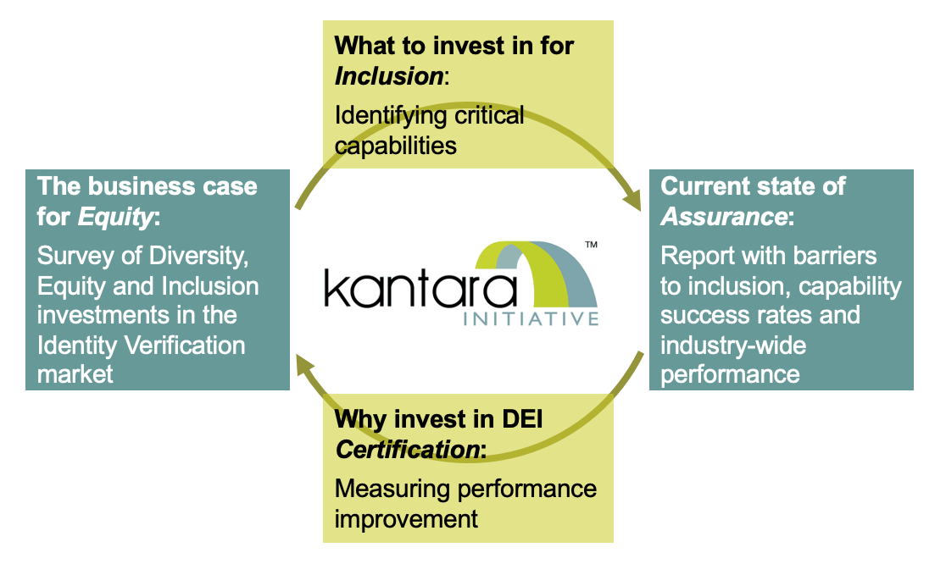
3) Success for the DEI committee
Our new Diversity, Equity and Inclusion (DEI) committee has one lofty goal for 2022: Baseline the current state of DEI capabilities in the identity verification market.
To achieve this, we will survey our members on how they are making the business case for DEI. Next, we will interview DEI leaders across the industry to unpack these results. Then, we will launch a Discussion Group to translate current approaches into a set of shared dimensions and metrics. Our target output is a report synthesizing all of this input into the current state of play to give Relying Parties visibility into what is available and to show Solution Providers the art of the possible.
Our survey launches in the coming weeks, so be on the look out! And if you would like to participate in the process, let us know.

Slide 5
Survey Results – August 2022
The DEI survey is still available to complete HERE

Slide 6
Survey Results – August 2022

Slide 7
Survey Results – August 2022

Slide 8
Survey Results – August 2022

Slide 9
Survey Results – August 2022

Slide 10
Survey Results – August 2022 (Q10 contd)

Slide 11
Survey Results – August 2022 (Q10 contd)

Slide 12
Survey Results – August 2022 (Q10 contd)

Slide 13
Survey Results – August 2022 (Q10 contd)

Slide 14
Survey Results – August 2022 (Q11)

Slide 15
Survey Results – August 2022 (Q12 & 13)

Slide 16
Survey Results – August 2022

