Slide 1
TRUST THROUGH ASSURANCE & VALUE
Kay Chopard, Executive Director November 14 2023

Slide 2
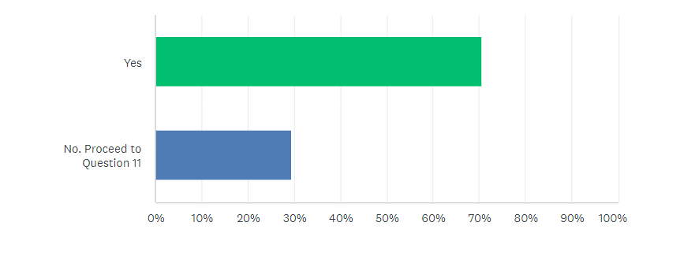
Measuring industry commitment to DEIA - 2023
Annual DEIA Survey to Kantara Members & Supporters
70% already actively investing in DEIA
70% of respondents are actively investing in DEIA
However, this is down from 92% in 2022.

Slide 3
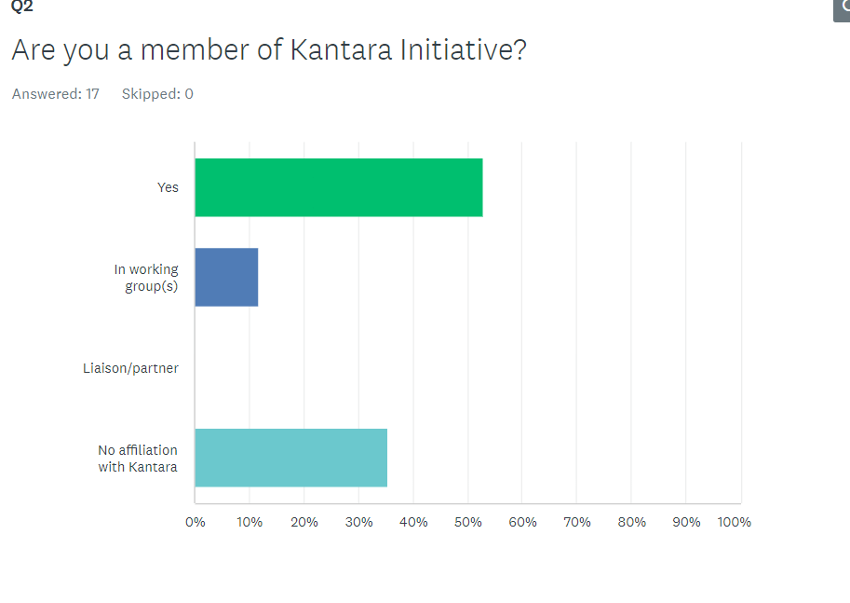
Measuring industry commitment to DEIA - 2023
Profile of respondents – Kantara connection
53% of respondents are members;
35% are not affiliated to Kantara
Last year members made up 73.3% of respondents and none were involved in Work Groups.
This year, over 1/3 of respondents came from outside the organization, suggesting increasing awareness and engagement from the industry in general.

Slide 4
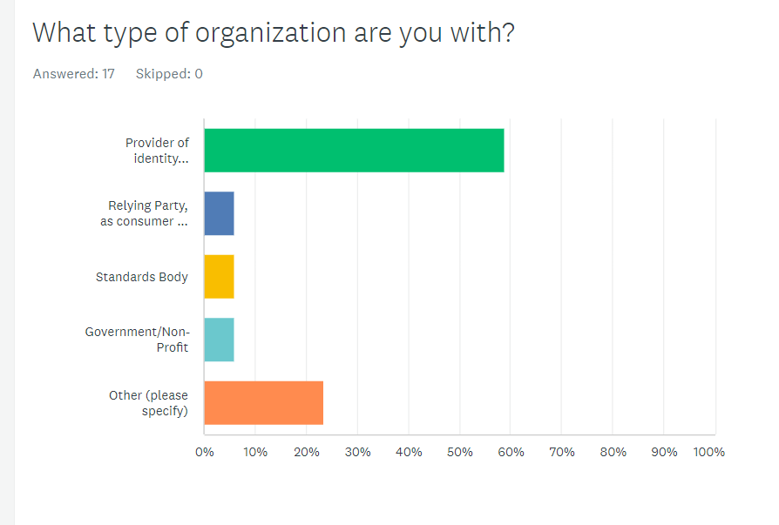
Measuring industry commitment to DEIA - 2023
Profile of respondents – industry types
58% are IDSPs, down from 87% in 2022

Slide 5
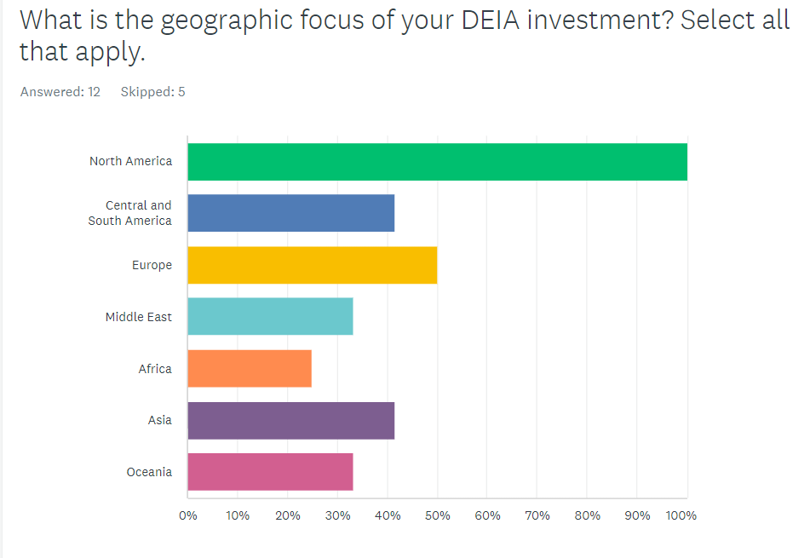
Measuring industry commitment to DEIA - 2023
Profile of respondents – geographic focus of investment
All respondents are focussed on N America as a key territory

Slide 6
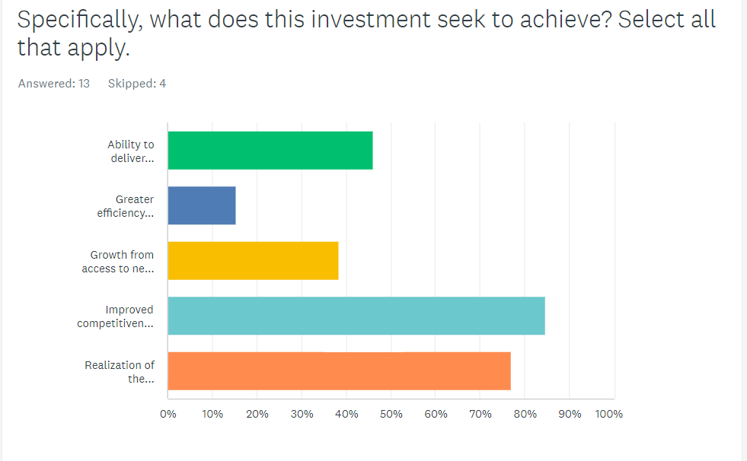
Measuring industry commitment to DEIA - 2023
Rationale for investment
85%
see DEIA as improving competitiveness
(2022: 50%)
In 2022, the biggest category was to help “realize the organizations’ overarching mission” (77%). This year, we see far greater awareness of the competitive advantage of DEIA which is encouraging.

Slide 7
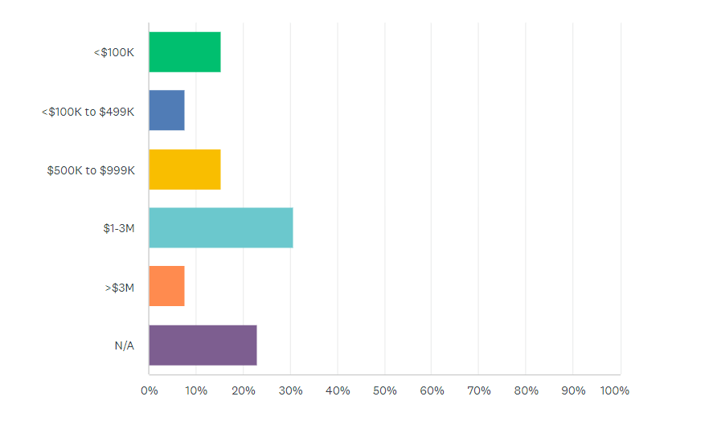
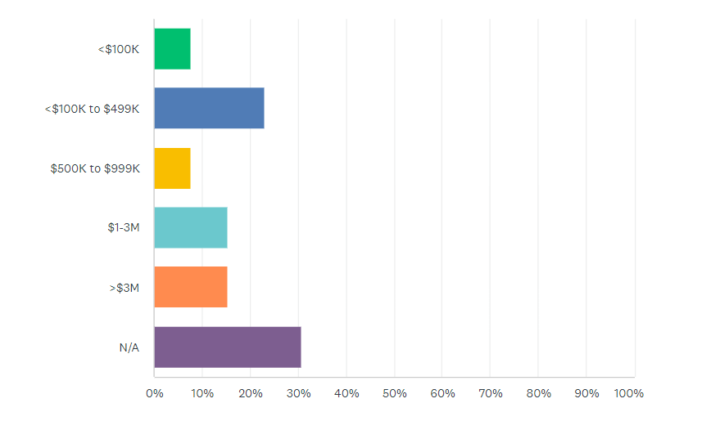
Measuring industry commitment to DEIA - 2023
Annual investment & expected ROI
31% investing $1-3 m
ROI > $500k 44%

Slide 8
Measuring industry commitment to DEIA - 2023
Investment categories/initiatives
54% investment to meet ADA/WCAG regulations
Certification against identity standards 46%
Last year, the biggest investment was on hiring personnel (84%) and advancements in biometrics/face-recognition (69%). (Although “personnel hiring” was omitted from this year’s options.) In 2023, there appears to be greater focus on conformance / standards as well as fraud detection

Slide 9
Measuring industry commitment to DEIA - 2023
Key messages around investment focus
62% linked to fraud detection / prevention (up from 46%)
31% are investing in training for inclusive design & development but budget allocation is
< $500k
45% in 2022 anticipated spending between $100k and £3m on improving usability.
Slightly up in 2023 to
50%
50% budgeting to spend up to $499k on ADA/WCAG conformance

Slide 10
Key DEIA challenges facing organziations
Recruiting First Nations participants with Indian status cards for testing
Building a more diverse and inclusive workforce with our internal workforce (though metrics, training, employee engagement for leaders, managers and employees.
Service those with no credit file
Time & resource constraints
Defining clear goals and measuring results related to DEIA initiatives
Social equality GUI
Create safe, vibrant, inclusive workspaces
Lack of accepted industry-wide standards, metrics, and guidance on best practice for assessing performance
Enhancing security, identification, and authentication for our public and government customers
Aligning new talent requirements from our government customers (specifically certs) with efforts to cast our talent acquisition nets broadly to bring in more diverse experiences and thought
Challenges to identity verification, government requirements in these areas, misinformation and trust in digital ID solutions, no standardization of these topics beyond accessibility (eg WCAG), enterprise vs citizen focus of solution
.

Slide 11
Key DEIA challenges facing organziations
Scope creep
Integration of indigenous and migrant communities into overall ecosystem.
Ensuring accessibility standards are met
How Japanese society cares about DEI
Knowing what data to save and how to report on it.
.

Slide 12
Suggested support from Kantara Initiative
Share the results of this survey and any best practice around how other identity companies are approaching Diversity, Equity and Inclusion
Support in standards for measuring ROI and performance related to DEIA objectives
Define alternative data sources
Work with NIST and the -4 comment cycle to promote definition and adoption of industry-wide standards
Guide & support
Guidance and best practices on how similar use cases or domain have tackled the many challenges that are part of DEIA
Continued conversation and data analysis being shared across markets and with Federal agencies
Learning and education for our team members, customer education programs around best practices/standards in these areas (what does good look like), product and service level trustmarks / assessments against those standards so we can demonstrate our commitment in these areas
Advocacy for standards adoption, pushing the right standards to support real end-user needs
Awareness and thought leadership
NIST conformant test
Share perspectives
.

Slide 13
Measuring industry commitment to DEIA - 2023
Interest in learning about /participating to develop DEIA standards to address the human impact of exclusion?
* Contact details provided for 14 organizations

