Slide 1
Cross-party delegation with User-Managed Access (UMA2)
draft-maler-oauth-umagrant
draft-maler-oauth-umafedauthz
(Presenters xx)
IETF 104 – OAuth Working Group

Slide 2
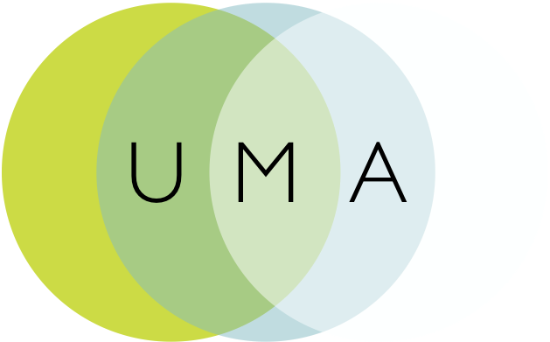
Some background
Contributed draft-oauth-dyn-reg (’10-’11 – fed into RFC 7591)
UMA1 and 1.0.1 contributed: draft-hardjono-oauth-umacore and draft-hardjono-oauth-resource-reg; (latest in Jan ’16 were “stubs” – expired)
Business model contributed: draft-maler-trust-model (‘15 – expired)
Client claims framework contributed: draft-catalano-oauth-umaclaim (‘15 – expired)
Went through a spec refactoring: {core/rreg} to {grant/fedauthz}
Notes:
Work has been done at Kantara Initiative; extension work and the business model work may continue to be incubated there
Sedimenting modular pieces into wider communities where applicable is a goal

Slide 3
Overview of the UMA extension grant draft-maler-oauth-umagrant
Party-to-party: Resource owner authorizes protected resource access to clients used by entities in a new requesting party role
Asynchronous: AS and RS interact with client and requesting party asynchronously wrt resource owner interactions
Policies: Resource owner can configure an AS with authz grant rules (policy conditions), vs. just authz/deny

Slide 4
Overview of UMA federated authorization draft-maler-oauth-umafedauthz
1-to-n services: RSs in different domains can work with one AS in yet another domain
Standard API enables automating resource protection
Resource owner can monitor and control authorization grant rules at AS over time
Scope-grained control: Grants can increase and decrease at the level of individual resources and scopes

Slide 5
Use cases
Patient-directed (consumer-controlled) health/health IoT data sharing
Discovering and aggregating pension accounts and sharing access to financial advisors
Connected car data sharing
Enterprise API access management
Proactive policy-based control of app connections
Access delegation between employees
Profiled by:
OpenID Foundation HEART Working Group
UK Department for Work and Pensions

Slide 6
Known implementations of UMA2 (see also: kantarainitiative.org/confluence/display/uma/UMA+Implementations)
ForgeRock
Gluu
HIE of One – Trustee
IDENTOS
Pauldron
RedHat Keycloak
WSO2

Slide 7
@@topics
Overall diagram(s)?
Swimlanes illustrating:
Alice-to-Bob consented sharing (which otherwise OAuth doesn't do) – many are on the cusp of solving it in a nonstandardized way
Alice-to-Alice sharing with centralized management of resources (which otherwise OAuth doesn't do) – point to discussion of laws/regs/rules for the "multiple portals problem" and its relevance to contexts of "open APIs"
Proactive, reactive, and silent Alice (data subject)-to-whoever and enterprise (non-human)-to-whoever sharing in a (relatively) compact single grant
Rreg vs. resource-indicators (George to help)
RPT contents vs. audience approach; client-to-RS-first and perm ticket mitigates need for aud limitation
Compare to any ACE work?
UMA as ”grant model” exemplar?
Go back and look at any oauth list discussion of UMA points?
How privacy-protective aspects work?

