Slide 1
Cross-party delegation with User-Managed Access (UMA2)
draft-maler-oauth-umagrant
draft-maler-oauth-umafedauthz
(Presenters xx)
IETF 104 – OAuth Working Group

Slide 2
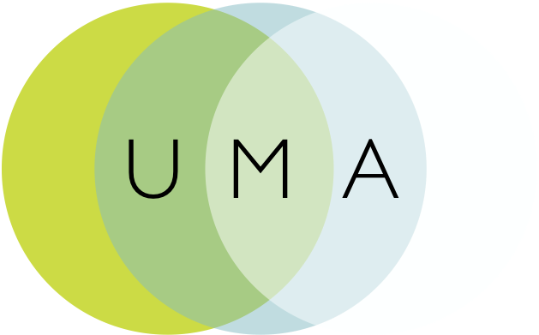
Some background
Contributed draft-oauth-dyn-reg
Contributed UMA 1.0 and 1.0.1 as draft-hardjono-oauth-umacore and draft-hardjono-oauth-resource-reg
Influenced ACE actor and usecase work with draft-maler-ace-oauth-uma
Contributed an UMA “business model” as draft-maler-oauth-umatrust
Contributed a client claims framework as draft-catalano-oauth-umaclaim
Refactored the specs for UMA 2: core/resource-reg became grant/fedauthz
Notes:
Work has been done at Kantara Initiative; extension work and the business model work may continue to be incubated there
Sedimenting modular pieces into wider communities where applicable is a goal
draft-oauth-dyn-reg originally from 2010, fed into RFC 7591
The contributed piece-parts were all part of UMA 1, from around 2015 – all expired and all ultimately folded into UMA2
ACE also in 2015
The UMA1 contributions ultimately turned into “stubs” in 2016 – all expired
UMA 1 to 1.0.1 was to fix a session fixation attack in a rare corner case – the attack was similar to OAuth’s – it was fixed by adding an extension spec that UMA2 obsoletes

Slide 3
UMA extension grant overview draft-maler-oauth-umagrant
Party-to-party: Resource owner authorizes protected resource access to clients used by entities in a new requesting party role
Asynchronous: AS and RS interact with client and requesting party asynchronously with respect to resource owner interactions
Policies: Resource owner can configure an AS with authorization grant rules (policy conditions), vs. just authorize/deny
Resource owner interactions with an AS are “internal” and outside UMA’s scope
Notes:
The AS functions like a policy evaluation engine as in WAM
The AS could end up having a lot of other business rules in addition to RO’s policies, which it executes for enterprise purposes – part of UMA business model (“BLT”)

Slide 4
UMA federated authorization overview draft-maler-oauth-umafedauthz
1-to-n services: Multiple RSs in different domains can work with the AS in yet another domain
Optional standard “protection API” automates resource protection
Resource owner interactions with AS can include monitoring and controlling authorization grant rules over time
Scope-grained control: Grants can increase and decrease by resource and scope
Customized token introspection/access token
*Resource and scope concepts: Slightly different in UMA
Notes:
More about “resources” in a bit

Slide 5
Typical use cases
Alice to Bob:
Patient-mediated (consumer-controlled) health data and health device sharing
Discovering and aggregating pension accounts and sharing access to financial advisors
Connected car: data and car sharing
Enterprise to Alice (initial RO is an organization):
Enterprise API access management
Access delegation between employees
Alice to Alice:
Proactive policy-based control of app connections
Profiled/referenced by:
OpenID Foundation HEART Working Group
UK Department for Work and Pensions
OpenMedReady Alliance
Notes:
Clients can be “dumber” about scopes while it’s smarter about bad flows (can recover better when it doesn’t get an access token without introducing risk)
API developers won’t have to introduce scope logic directly; can externalize entitlement logic so that a product manager etc. can define it (“open scopes”)

Slide 6
Known implementations of UMA2 (see also: kantarainitiative.org/confluence/display/uma/UMA+Implementations)
ForgeRock
Gluu (open source in part)
HealthyMePHR
HIE of One – Trustee (open source)
IDENTOS
Pauldron (open source)
RedHat Keycloak (open source)
WSO2 (open source)

Slide 7
Abstract sequence for UMA2 grant
Entities
RO not shown here
because its interactions can be asynchronous
with respect to client/RqP interactions
An UMA-enabled client can be public or confidential

Slide 8
Abstract sequence for UMA2 grant
Initial resource request
Client goes to RS first, a pattern familiar from web access management
API call must contain sufficient context for RS to derive relevant RO and AS in order to conduct further RS-AS communications

Slide 9
Abstract sequence for UMA2 grant
Discovery/ binding
Permission ticket is initially conveyed by RS (from AS) in the header (ticket=); client must present it at AS later, possibly (in rotated-value form) repeatedly
AS discovery is through the header (as_uri=); OAuth discovery doc at .well-known/uma2-configuration has some extension metadata

Slide 10
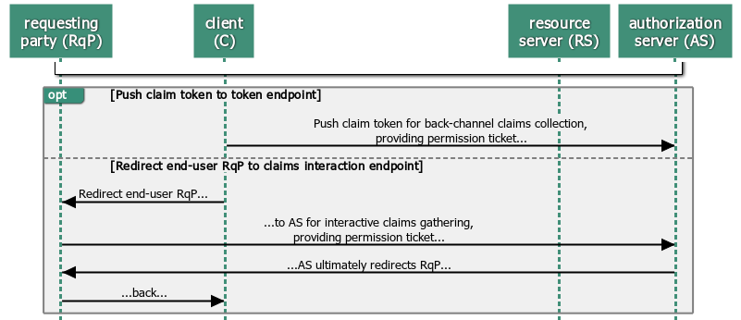
Abstract sequence for UMA2 grant
Main grant flow/claims collection
Grant flow (urn:ietf:params:oauth:grant-type:uma-ticket) has some options: front-channel (interaction)/back-channel (push) initiation and looping
AS generates new ticket value for each client request/RqP redirect if no error; token endpoint gets additional WAM-like errors need_info, request_submitted, request_denied

Slide 11
Abstract sequence for UMA2 grant
Success/ token issuance
Authorization assessment post-claims collection is AS-internal, but some constraints are defined around scopes requested vs. granted etc. (“set math”)
Happy path is basically like other OAuth grants; RPT (custom “requesting party” access token) can be upgraded, revoked, and introspected; AS can also issue a PCT (refresh-token-ish “persisted claims token”)

Slide 12
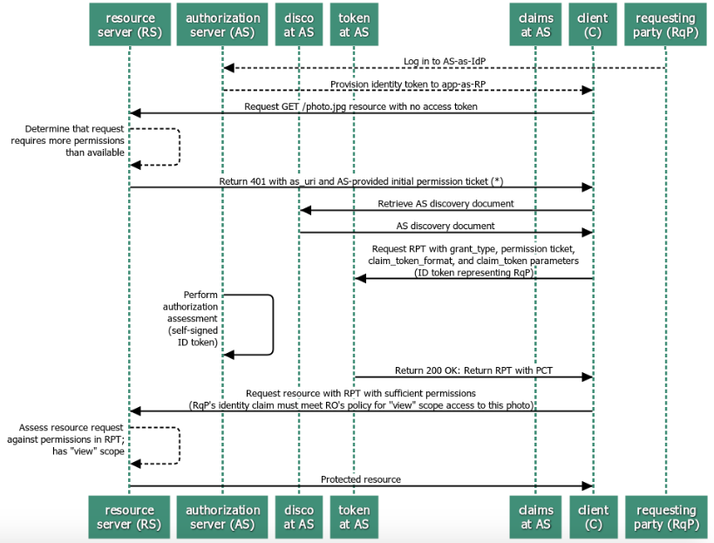
Sample sequence with pushed claim token
“Assertion” pattern
Notes:
Most commonly implemented

Slide 13
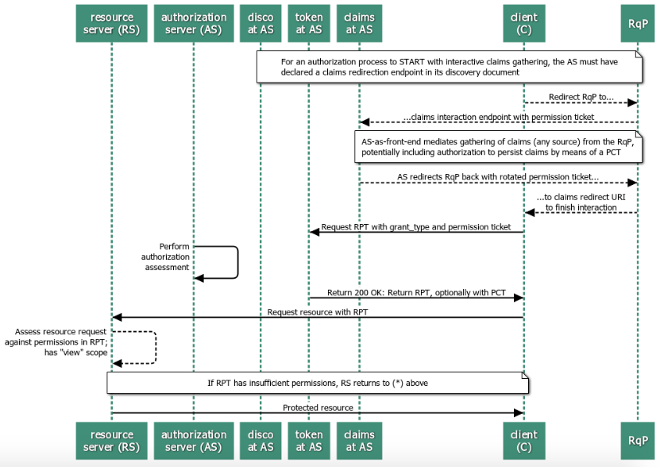
Sample sequence with interactive claims gathering
“Authz code” pattern

Slide 14
The AS can present a standard protection API to enable “federating” RS’s
RS calls a resource registration endpoint to put a resource under AS protection
JSON payload in request
AS responds with a resource ID
Resource can have own unique scopes
RS calls a permission endpoint to request a permission ticket
RS delivers it to the client after initial (tokenless) resource request
RS optionally calls a customized token introspection endpoint
Enhances token introspection response object per the JSON above
Protection API is OAuth-protected
Requires a scope of uma-protection
Access token with this scope is called a “PAT” to distinguish from an RPT
An RS is thus a client of the AS
An RO thus has a formal means of authorizing resource protection

Slide 15
@@Building UMA clients
API developers don’t have to introduce scope/entitlement logic as directly (“clients can be dumber about scopes”)
Error flows are easier to handle (“clients can be smarter about bad flows”; “can recover better when they don’t get an access token without introducing risk”)
Client-to-RS-first flow and permission ticket construct bind the the access token to its audience fairly firmly, though at some protocol chattiness cost
Notes:
So it is reported by implementers…

Slide 16
@@Resource indicators and resource concepts
tbs
Rreg vs. resource-indicators (George to help)
RPT contents vs. audience approach; client-to-RS-first and perm ticket mitigates need for aud limitation
Notes:
So it is reported by implementers…

Slide 17
@@AS discovery: method comparisons
How it’s done in various specs
Notes:
So it is reported by implementers…

Slide 18
@@Offline/IoT use cases
ACE has offline use cases, as does UMA (but not fully solved for)
ACE has no permission ticket
ACE token is PoP (UMA makes bearer mandatory to implement but is open to others)
Notes:
So it is reported by implementers…

Slide 19
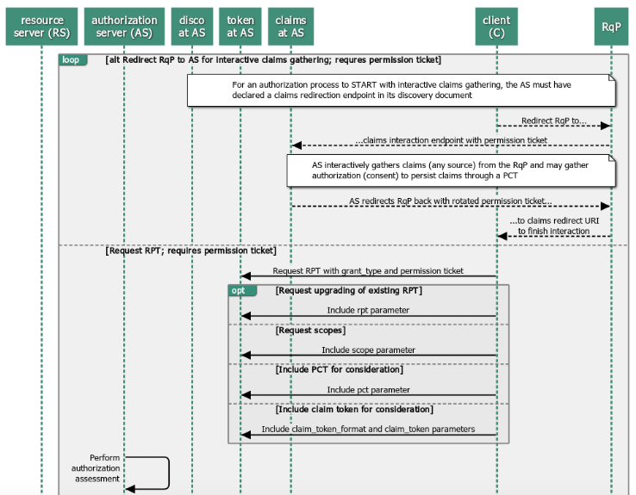
UMA grant building blocks, part 1
Redirection and token endpoint options

Slide 20
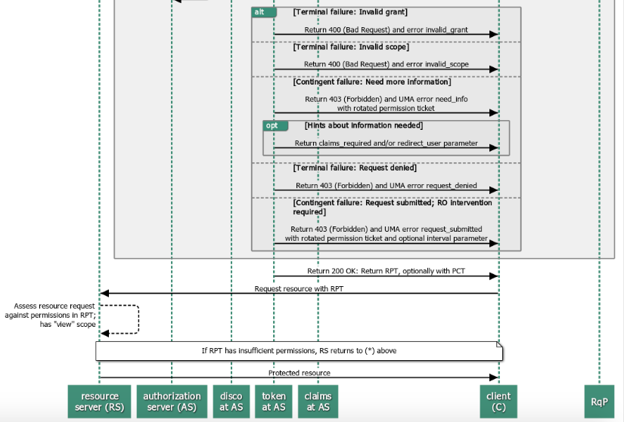
UMA grant building blocks, part 2
Error conditions and looping

Slide 21
@@other topics
Compare to different OAuth grants? (authz code, assertion…) See Bertrand blog post
Go back and look at any oauth list discussion of other UMA points?
How privacy-protective aspects work? UMA business model?

