Slide 1
Cross-party delegation with User-Managed Access 2.0 (UMA2)
draft-maler-oauth-umagrant draft-maler-oauth-umafedauthz
Eve Maler (eve.maler@forgerock.com) and Maciej Machulak (maciej.machulak@gmail.com)
IETF 104 – OAuth Working Group

Slide 2
Topics
Overview(s)
Implementation and use in the wild
Basic flows in the UMA grant
Basic flows in UMA federated authorization
If time: UMA Grant details
If time: Privacy implications and the UMA business model
Conclusion and next steps
Notes:
Taking a “progressive disclosure” approach
If Maciej is on site: Suggest getting together this evening to discuss at more length

Slide 3
Overview(s)

Slide 4
While OAuth enables constrained delegation to apps…
Resource owner
Client
A
T
Authorization server
D
…
Resource server
A
authorization
T
token
D
discovery

Slide 5
…UMA enables cross-party sharing, in a wide ecosystem
Resource owner
Requesting party
Ahead of time
Anytime
Anytime
At run time
After the fact
Client
UX
Share
Monitor
Withdraw
Opt in
Approve
A
T
Authorization server
D
R
P
I
C
…
…
…
Resource server
Resource server
Resource server
A
authorization
T
token
D
discovery
R
resource registration
P
permission
I
token introspection
C
claims interaction
Notes:
“Data subject” control of data sharing has privacy implications, particular in the current regulatory environment

Slide 6
UMA 2.0 overview
OAuth extension grant for “Alice-to-Bob” delegation (resource owner to a new requesting party role)
Optional interface (OAuth-protected) that makes the AS “centralizable”
Nicknames for the new and enhanced tokens

Slide 7
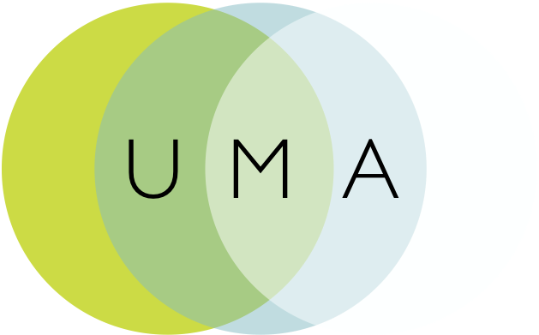
IETF history
Contributed draft-oauth-dyn-reg
Contributed UMA 1.0 and 1.0.1 as draft-hardjono-oauth-umacore and draft-hardjono-oauth-resource-reg
Influenced ACE actor and usecase work with draft-maler-ace-oauth-uma
Contributed an UMA “business model” as draft-maler-oauth-umatrust
Contributed a client claims framework as draft-catalano-oauth-umaclaim
Refactored the specs for UMA2: core/resource-reg became grant/fedauthz
Notes:
Why all the contributions? Sedimenting modular pieces into wider communities is a goal, to promote adoption where applicable
draft-oauth-dyn-reg originally from 2010, fed into RFC 7591
The contributed piece-parts were all part of UMA 1, from around 2015 – all expired and all ultimately folded into UMA2
ACE also in 2015
The UMA1 contributions ultimately turned into “stubs” in 2016 – all expired
UMA 1 to 1.0.1 was to fix a session fixation attack in a rare corner case – the attack was similar to OAuth’s – it was fixed by adding an extension spec that UMA2 obsoletes

Slide 8
UMA grant overview draft-maler-oauth-umagrant
Party-to-party: Resource owner authorizes protected resource access to clients used by entities in a requesting party role
Asynchronous: Resource owner interactions are asynchronous with respect to the authorization grant
Policies: Resource owner can configure an AS with authorization grant rules (policy conditions), vs. just “authorize”/“deny”
These configuration interactions with an AS are outside UMA’s scope
“For example, bank customer (resource owner) Alice with a bank account service (resource server) can use a sharing management service (authorization server) hosted by the bank to manage access to her various protected resources by spouse Bob, accounting professional Charline, and and financial information aggregation company Decide Account, all using different client applications. Each of her bank accounts is a protected resource, and two different scopes of access she can control on them are viewing account data and accessing payment functions.”

Slide 9
UMA federated authorization overview draft-maler-oauth-umafedauthz
1-to-n: Multiple RS’s in different domains can work with an AS in yet another domain
Optional standard “protection API” automates resource protection
Enables resource owner interactions with an AS such as monitoring and controlling authorization grant rules over time
Scope-grained control: Grants can increase and decrease by resource and scope
Customized token introspection/access token
*Resource and scope concepts: Slightly different in UMA
“…bank customer (resource owner) Alice has a bank account service (resource server), a cloud file system (different resource server hosted elsewhere), and a dedicated sharing management service (authorization server) hosted by the bank. She can manage access to her various protected resources by spouse Bob, accounting professional Charline, financial information aggregation company DecideAccount, and neighbor Erik (requesting parties), all using different client applications. Her bank accounts and her various files and folders are protected resources, and she can use the same sharing management service to monitor and control different scopes of access to them by these different parties, such as viewing, editing, or printing files and viewing account data or accessing payment functions..”
Notes:
More about “resources” in a bit

Slide 10
Implementation and use in the wild

Slide 11
Typical use cases
Alice to Bob:
Patient-directed (consumer-controlled) health data and health device sharing
Discovering and aggregating pension accounts and sharing access to financial advisors
Connected car: data and car sharing
Enterprise to Alice (initial RO is an organization):
Enterprise API access management
Access delegation between employees
Alice to Alice:
Proactive policy-based control of app connections
Profiled/referenced by:
OpenID Foundation HEART Working Group
UK Department for Work and Pensions
OpenMedReady Alliance

Slide 12
Known implementations (see also: kantarainitiative.org/confluence/display/uma/UMA+Implementations)
ForgeRock – financial, healthcare, IoT, G2C…
Gluu (open source) – API protection, enterprise, G2C…
ShareMedData – healthcare
HIE of One / Trustee (open source) – healthcare
IDENTOS – healthcare, G2C
Pauldron (open source) – healthcare
RedHat Keycloak (open source) – enterprise, IoT…
WSO2 (open source) – enterprise…

Slide 13
Basic flows in the UMA grant

Slide 14
Abstract sequence for UMA2 grant
Entities
RO not shown here
because they may not be around when the (public or confidential) client shows up
How the client learned the protected resource location is outside UMA’s scope; e.g., RqP could have clicked a link or notification

Slide 15
Abstract sequence for UMA2 grant
Initial resource request
Client goes to RS first, a pattern familiar from web access management – and now ACE

Slide 16
Abstract sequence for UMA2 grant
Discovery/ binding
A permission ticket is initially conveyed by RS (from AS) in the header (ticket=); client must present it at AS later; the ticket binds the three
AS discovery is through the header (as_uri=); OAuth discovery doc at .well-known/uma2-configuration has some extension metadata
Notes:
Neil Madden has said on the OAuth list: Prefers WWW-Authenticate header for discovery because it makes the authentication challenge self-contained, it allows more than one AS to be specified (though UMA doesn’t explicitly allow that?), and it allows a proxy to add its own AS uri as a Proxy-Authenticate header, independently of the main resource server’s AS.

Slide 17
Permission ticket: like an authorization code
Binds client, RS, and AS: The client is untrusted and the RS and AS may also be loosely coupled; the ticket binds them
RS chooses permissions: The RS interprets the client’s resource request and chooses what permissions to request
Refreshed for security: The grant lets the client return to the AS in case of a non-fatal error; the AS refreshes the value after the client presents it each time
Notes:
More about “resources” in a bit

Slide 18
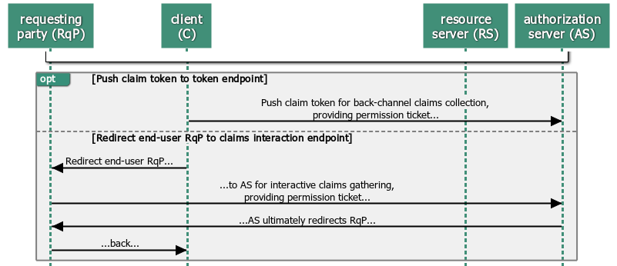
Abstract sequence for UMA2 grant
Main grant flow/claims collection
Grant flow (urn:ietf:params:oauth:grant-type:uma-ticket) has options: front-channel (interaction)/back-channel (push) initiation and retrying
AS generates new ticket value for each client request/RqP redirect in case of non-final errors; token endpoint has additional WAM-like errors need_info, request_submitted, request_denied

Slide 19
Abstract sequence for UMA2 grant
Success/ token issuance
Assessment is AS-internal, but there are “set math” requirements
Happy path is like other OAuth grants; RPT (custom “requesting party” access token) can be upgraded, revoked, and introspected; AS can issue a refresh token (no re-assessment) and also a PCT (refresh-token-ish “persisted claims token”)

Slide 20
Authorization assessment
For a scope request to have an effect, the client must have registered scopes with the AS first
Permissions (scopes) in the ticket influence the assessment
The AS can choose to error vs. granting only some of the requested scopes
Notes:
“Treat each scope in {RegisteredScopes ∩ RequestedScopes} as matching any available scope associated with a resource found in the permission ticket.”

Slide 21
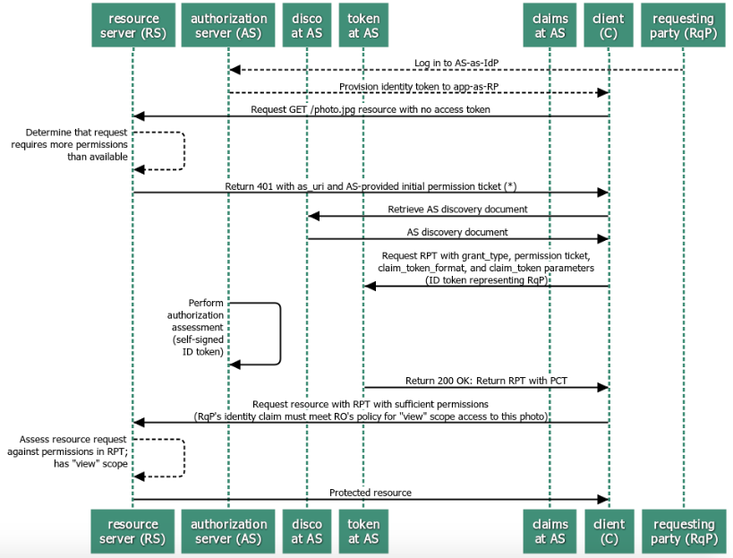
Sample sequence with pushed claim token
“Assertion” pattern
Notes:
Most commonly implemented to date; “narrow ecosystem”

Slide 22
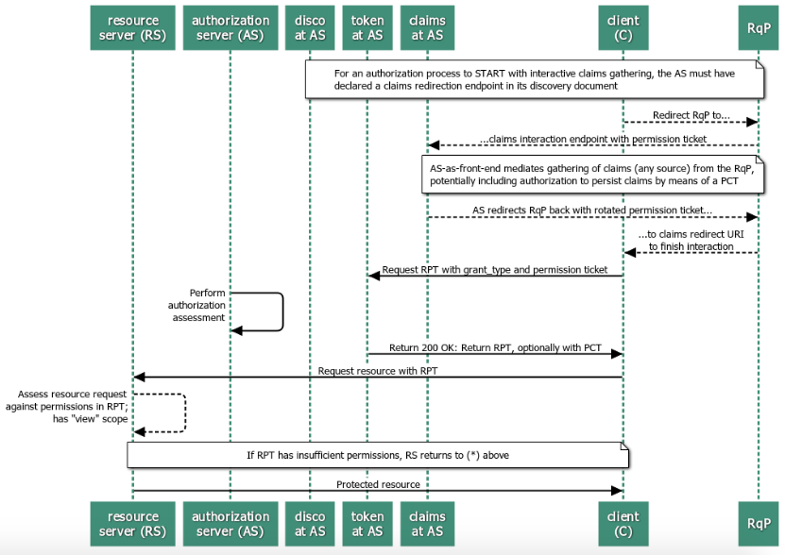
Sample sequence with interactive claims gathering
“Authz endpoint” pattern
Notes:
Useful for, e.g., patient wanting to get a second opinion from a doctor they know but their AS has never heard of
Access to the browser means the AS can get access to the session without bothering the user (human RqP)

Slide 23
Some observations on UMA clients
API developers don’t have to introduce scope/entitlement logic as directly; enables externalization of entitlement logic without imposing a policy language
“Clients can be a lot dumber about scopes”
“Permissions and policies that govern access to resources get a lot more manageable”
Error flows are easier to handle
“Clients can be smarter about bad flows”
“Clients can recover better when they don’t get an access token, without introducing risk – a ‘unauthorized’ error returns permission ticket and AS location”
Notes:
So it is reported by implementers…
ACE is now doing something similar in the case of getting “Unauthorized”

Slide 24
Basic flows in UMA federated authorization

Slide 25
The AS can present a standard protection API to enable “federating” RS’s
RS calls a resource registration endpoint to protect a resource
JSON payload in request
RS calls a permission endpoint to request a permission ticket
RS delivers it to the client after initial (tokenless) resource request
RS optionally calls the token introspection endpoint
Enhances the token introspection response object per the JSON above
Protection API protected with OAuth
Requires uma-protection scope
An access token with this scope is a “PAT”
An RS is thus a client of the AS
And an RO has a formal means of authorizing resource protection
Client credentials for an “enterprise RO”

Slide 26
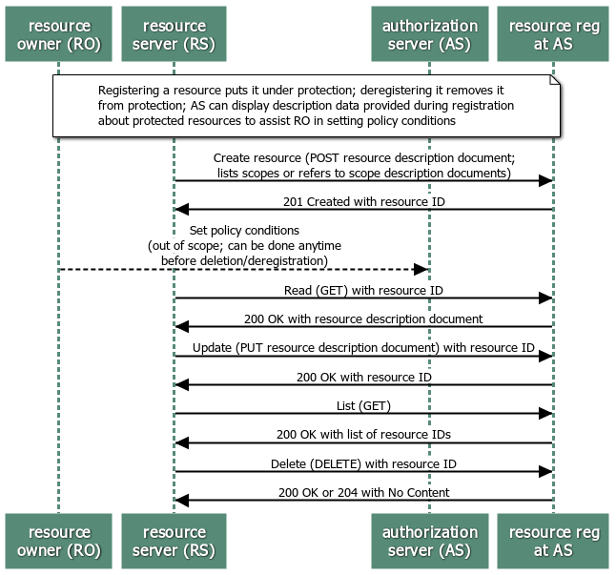
Protection API
Resource registration endpoint/API
Notes:
Required to support this endpoint if using the protection API
Just shows the happy path
Currently there is no standard way to register resources in bulk

Slide 27
Resources and scopes
The RS is authoritative for what its (potentially multiple) “resource” boundaries are
It describes them in resolvable description documents
Scopes can be simple strings or resolvable description documents
rs1
read
write
download
rs2
read
write
rent
Notes:
More about “resources” in a bit

Slide 28
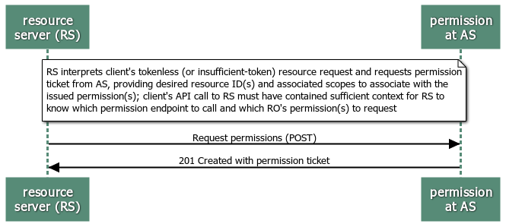
Protection API
Permission endpoint
Notes:
Required to support this endpoint if using the protection API
Just shows the happy path

Slide 29
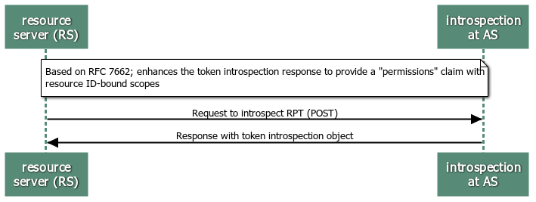
Protection API
Token introspection endpoint
Notes:
Optional to support this endpoint if using the protection API
Just shows the happy path

Slide 30
Observations on tokens, tickets, and discovery
The permission ticket binds the RPT to its audience firmly
Doesn’t require the client to signal where it intends to use the access token (à la draft-ietf-oauth-resource-indicators)
Requires the client to attempt access to a resource that turns out to be protected (à la the “Dynamic Scopes” discussion of Jun 2018)
The RPT assumes bearer, and the PAT makes bearer MTI, but PoP is mentioned as an option (draft-ietf-oauth-mtls didn’t exist)
The ACE token is PoP
The protection API assumes the RS is online to request a permission ticket
ACE has proposed a binding mechanism that works when RS is offline
Returns an AS Request Creation Hints message as a CBOR map; has a mandatory element AS with an absolute URI and optional parameters audience, kid, nonce, and scope
Notes:
We haven’t stated that the AS should perform an RS-by-RS audience check but could
Neil Madden has said on the OAuth list: Prefers WWW-Authenticate header for discovery because it makes the authentication challenge self-contained, it allows more than one AS to be specified (though UMA doesn’t explicitly allow that?), and it allows a proxy to add its own AS uri as a Proxy-Authenticate header, independently of the main resource server’s AS.

Slide 31
If time: UMA Grant details

Slide 32
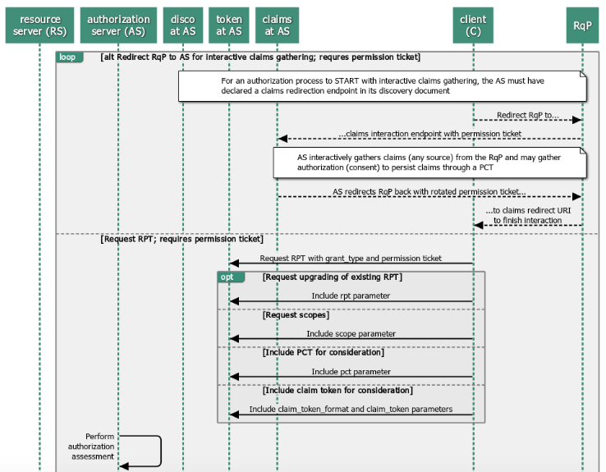
UMA grant details
Redirection and token endpoint request options

Slide 33
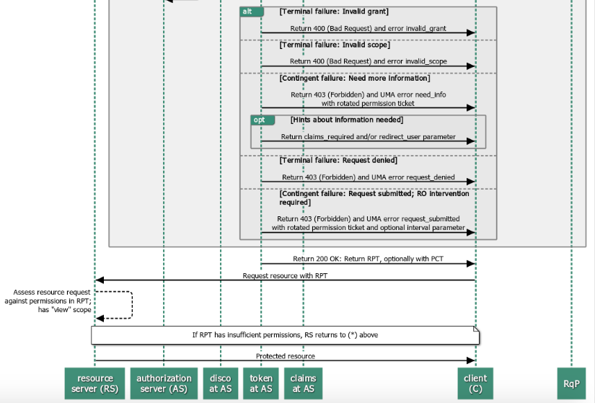
UMA grant details
Error conditions and retries

Slide 34
If time: Privacy implications and the UMA business model

Slide 35
Relevance for privacy
Implications for adherence to regulations mentioning consent and data subject control of personal data (GDPR, CCPA, OB, PSD2, CDR...):
Asynchronous resource owner control of authorization grants and enabling resource owner to monitor and manage grants from a “dashboard”
Auditability of grants (representing “consent”) and PAT-authorized AS-RS interactions
Work is well along to define an UMA business model
Allows modeling real-life data-sharing relationships, their changes, and relevant legal devices (laws, contracts, licenses)
Technical artifacts (token, messages, etc.) are mapped to these devices
Goal: tear down artifacts and build up new ones in response to state changes

Slide 36
(Most) legal relationships in the business model
resource owner
requesting party
Resource Rights Administrator
Requesting Agent
Licenses-perm-getting-to
(Agency Contract)
Delegates-perm-authority-to
Delegates-mgmt-to
(Access Contract)
Permits-knowing- claims
Delegates-seek- authority-to
authorization server
resource server
client
Authorization Server Operator
Resource Server Operator
Client Operator
Licenses-perm-
granting-to
Licenses- perm-getting-to

Slide 37
Conclusion and next steps

Slide 38
UMA adds…
…to the client
Simpler next-step handling at every point
Can become “really dumb”
…to the RS
Standardized manageability of protected resources
Externalize authorization services while remaining authoritative for API and scopes
…to the RO
Control data sharing and device control with others
True delegation of access to them (no password sharing)
…to the AS
Interoperability of authorization services
No need to store data to offer authorization services for it
…to the RqP
Can seek access to a protected resource as themselves
Token revocation becomes more consequential when it’s party-to-party

Slide 39
Relationship of the UMA and OAuth WGs
The UMA WG would like to have a liaison relationship with the OAuth WG
Operational interop work and “business model” work continues at Kantara
Proposes for the OAuth WG to adopt the UMA2 specs as work items
The UMA WG is willing to continue UMA2 technical profiling work and/or to work out transition efforts as required
There are several mutual WG participants, which allows for high-bandwidth communications

