Slide 1
Cross-party delegation with User-Managed Access (UMA2)
draft-maler-oauth-umagrant draft-maler-oauth-umafedauthz
Eve Maler (eve.maler@forgerock.com) and Maciej Machulak (maciej.machulak@gmail.com)
IETF 104 – OAuth Working Group
Notes:
Taking a “progressive disclosure” approach
(If Maciej is on site: Get together this evening to discuss at more length)

Slide 2
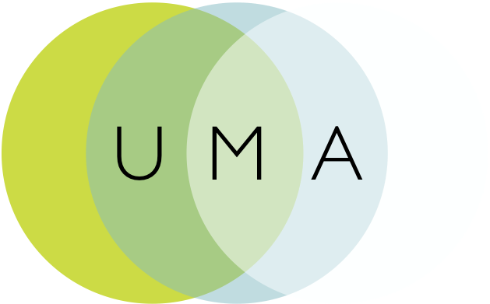
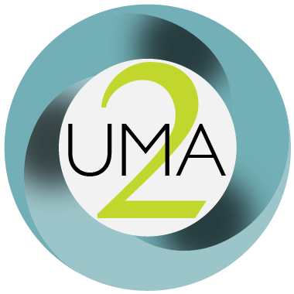
Some background
Contributed draft-oauth-dyn-reg
Contributed UMA 1.0 and 1.0.1 as draft-hardjono-oauth-umacore and draft-hardjono-oauth-resource-reg
Influenced ACE actor and usecase work with draft-maler-ace-oauth-uma
Contributed an UMA “business model” as draft-maler-oauth-umatrust
Contributed a client claims framework as draft-catalano-oauth-umaclaim
Refactored the specs for UMA2: core/resource-reg became grant/fedauthz
Notes:
Work has been done at Kantara Initiative; extension work and the business model work may continue to be incubated there
Sedimenting modular pieces into wider communities where applicable is a goal
draft-oauth-dyn-reg originally from 2010, fed into RFC 7591
The contributed piece-parts were all part of UMA 1, from around 2015 – all expired and all ultimately folded into UMA2
ACE also in 2015
The UMA1 contributions ultimately turned into “stubs” in 2016 – all expired
UMA 1 to 1.0.1 was to fix a session fixation attack in a rare corner case – the attack was similar to OAuth’s – it was fixed by adding an extension spec that UMA2 obsoletes

Slide 3
UMA 2.0 overview
OAuth extension grant for “Alice-to-Bob” delegation (resource owner to a new requesting party role)
Optional interface (OAuth-protected) that makes the AS “centralizable”
Nicknames for the new and customized tokens

Slide 4
UMA grant overview draft-maler-oauth-umagrant
Party-to-party: Resource owner authorizes protected resource access to clients used by entities in a requesting party role
Asynchronous: Resource owner interactions are asynchronous with respect to the authorization grant
Policies: Resource owner can configure an AS with authorization grant rules (policy conditions), vs. just “authorize”/“deny”
These configuration interactions with an AS are outside UMA’s scope
“For example, bank customer (resource owner) Alice with a bank account service (resource server) can use a sharing management service (authorization server) hosted by the bank to manage access to her various protected resources by spouse Bob, accounting professional Charline, and and financial information aggregation company Decide Account, all using different client applications. Each of her bank accounts is a protected resource, and two different scopes of access she can control on them are viewing account data and accessing payment functions.”

Slide 5
UMA federated authorization overview draft-maler-oauth-umafedauthz
1-to-n: Multiple RS’s in different domains can work with an AS in yet another domain
Optional standard “protection API” automates resource protection
Enables resource owner interactions with an AS such as monitoring and controlling authorization grant rules over time
Scope-grained control: Grants can increase and decrease by resource and scope
Customized token introspection/access token
Resource and scope concepts: Slightly different in UMA
The RS is authoritative for what its (potentially multiple) “resources” are
It registers them and their (potentially distinct) scopes at the AS, which assigns resource IDs
R1
S1
S2
S3
R2
S1
S2
S4
Notes:
More about “resources” in a bit

Slide 6
Typical use cases
Alice to Bob:
Patient-directed (consumer-controlled) health data and health device sharing
Discovering and aggregating pension accounts and sharing access to financial advisors
Connected car: data and car sharing
Enterprise to Alice (initial RO is an organization):
Enterprise API access management
Access delegation between employees
Alice to Alice:
Proactive policy-based control of app connections
Profiled/referenced by:
OpenID Foundation HEART Working Group
UK Department for Work and Pensions
OpenMedReady Alliance
Notes:
Clients can be “dumber” about scopes while it’s smarter about bad flows (can recover better when it doesn’t get an access token without introducing risk)
API developers won’t have to introduce scope logic directly; can externalize entitlement logic so that a product manager etc. can define it (“open scopes”)

Slide 7
Known implementations of UMA2 (see also: kantarainitiative.org/confluence/display/uma/UMA+Implementations)
ForgeRock
Gluu (open source)
ShareMedData
HIE of One – Trustee (open source)
IDENTOS
Pauldron (open source)
RedHat Keycloak (open source)
WSO2 (open source)

Slide 8
Abstract sequence for UMA2 grant
Entities
RO not shown here
because they may not be around when the (public or confidential) client shows up
How the client learned the protected resource location is out of scope; e.g., RqP could have clicked a link or notification, etc.

Slide 9
Abstract sequence for UMA2 grant
Initial resource request
Client goes to RS first, a pattern familiar from web access management – and now ACE

Slide 10
Abstract sequence for UMA2 grant
Discovery/ binding
A permission ticket is initially conveyed by RS (from AS) in the header (ticket=); client must present it at AS later; this binds the three
AS discovery is through the header (as_uri=); OAuth discovery doc at .well-known/uma2-configuration has some extension metadata
Notes:
More about permission tickets in a bit

Slide 11
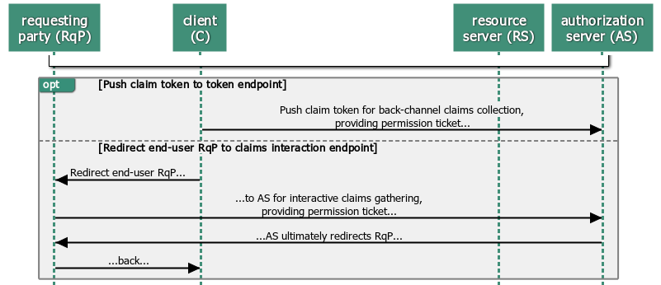
Abstract sequence for UMA2 grant
Main grant flow/claims collection
Grant flow (urn:ietf:params:oauth:grant-type:uma-ticket) has options: front-channel (interaction)/back-channel (push) initiation and looping
AS generates new ticket value for each client request/RqP redirect if no error; token endpoint has additional WAM-like errors need_info, request_submitted, request_denied

Slide 12
Abstract sequence for UMA2 grant
Success/ token issuance
Assessment is AS-internal, but there are “set math” requirements (see kantarainitiative.org/confluence/display/uma/ UMA+Implementer's+Guide)
Happy path is like other OAuth grants; RPT (custom “requesting party” access token) can be upgraded, revoked, and introspected; AS can issue a refresh token (no re-assessment) and also a PCT (refresh-token-ish “persisted claims token”)

Slide 13
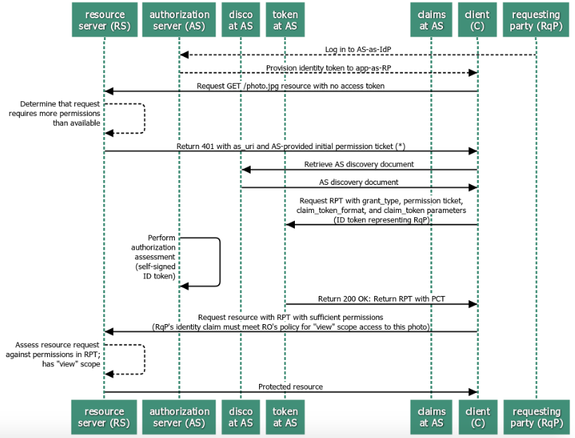
Sample sequence with pushed claim token
“Assertion” pattern
Notes:
Most commonly implemented to date; “narrow ecosystem”

Slide 14
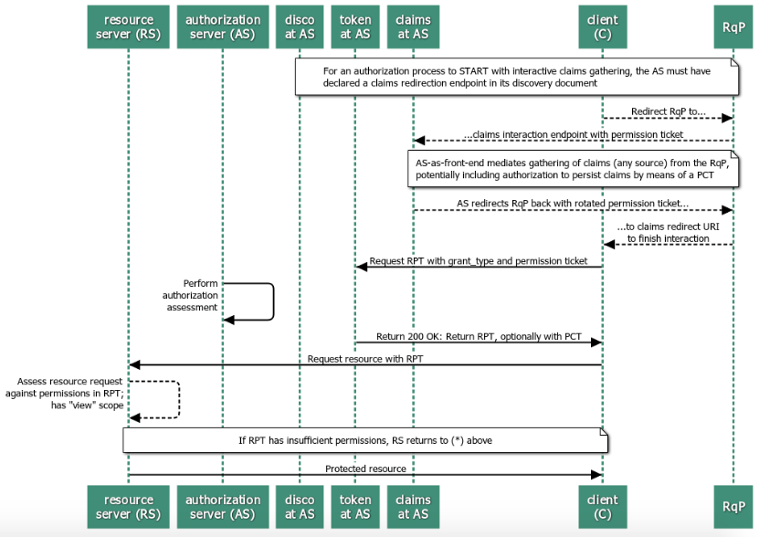
Sample sequence with interactive claims gathering
“Authz code” pattern
Notes:
Useful for, e.g., patient wanting to get a second opinion from a doctor they know but the AS has never heard of

Slide 15
The AS can present a standard protection API to enable “federating” RS’s
RS calls a resource registration endpoint to put a resource under AS protection
JSON payload in request
AS responds with a resource ID
Resource can have own unique scopes
RS calls a permission endpoint to request a permission ticket
RS delivers it to the client after initial (tokenless) resource request
RS optionally calls a customized token introspection endpoint
Enhances token introspection response object per the JSON above
Protection API is OAuth-protected
Requires a scope of uma-protection
Access token with this scope is called a “PAT” to distinguish from an RPT
An RS is thus a client of the AS
And an RO thus has a formal means of authorizing resource protection

Slide 16
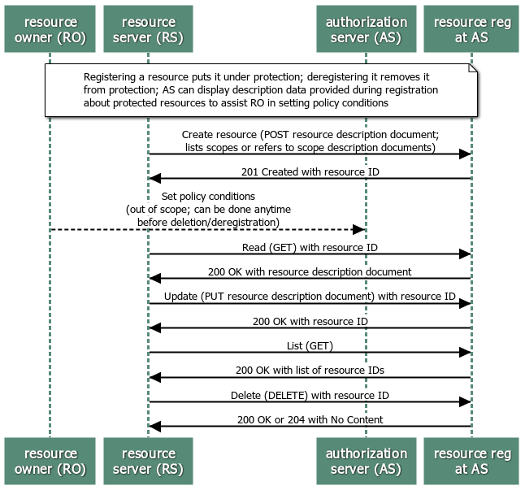
Protection API
Resource registration endpoint/API
Notes:
Required to support this endpoint if using the protection API
Just shows the happy path
Currently there is no standard way to register resources in bulk

Slide 17
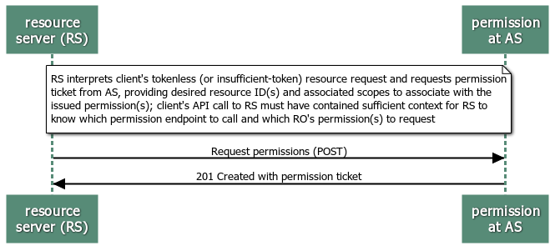
Protection API
Permission endpoint
Notes:
Required to support this endpoint if using the protection API
Just shows the happy path

Slide 18
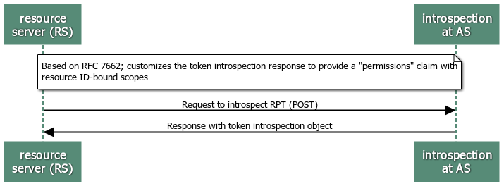
Protection API
Custom token introspection endpoint
Notes:
Optional to support this endpoint if using the protection API
Just shows the happy path

Slide 19
Some observations on UMA clients
API developers don’t have to introduce scope/entitlement logic as directly
“Clients can be dumber about scopes”
Error flows are easier to handle
“Clients can be smarter about bad flows”
“Clients can recover better when they don’t get an access token, without introducing risk – a ‘unauthorized’ error returns permission ticket and AS location”
Notes:
So it is reported by implementers…
ACE is now doing something similar in the case of getting “Unauthorized”

Slide 20
Some observations on tokens and tickets
Client-to-RS-first flow and permission ticket construct bind the access token to its audience fairly firmly, though at some protocol chattiness cost
From the grant spec: “An RPT is unique to a requesting party, client, authorization server, resource server, and resource owner”
RPT assumes bearer and PAT makes bearer MTI, but PoP is an option
ACE token is PoP
Protection API requires the RS to be online to request a permission ticket
ACE has proposed a similar-but-different binding mechanism that works in RS-offline circumstances
Returns an AS Request Creation Hints message as a CBOR map
The message has a mandatory element AS specifying an absolute URI and some optional parameters: audience, kid, nonce, and scope
Notes:
So it is reported by implementers…

Slide 21
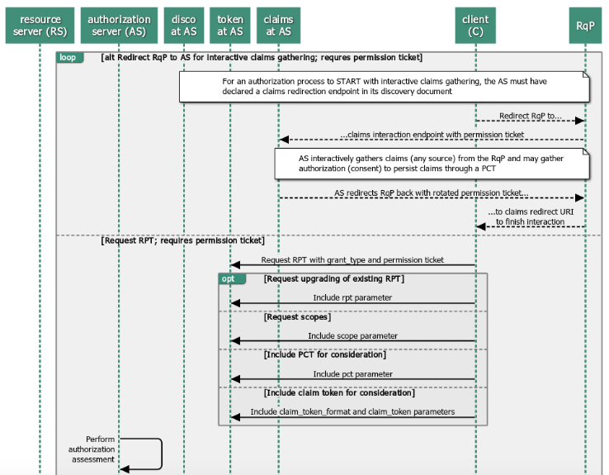
UMA grant as building blocks
Redirection and token endpoint options

Slide 22
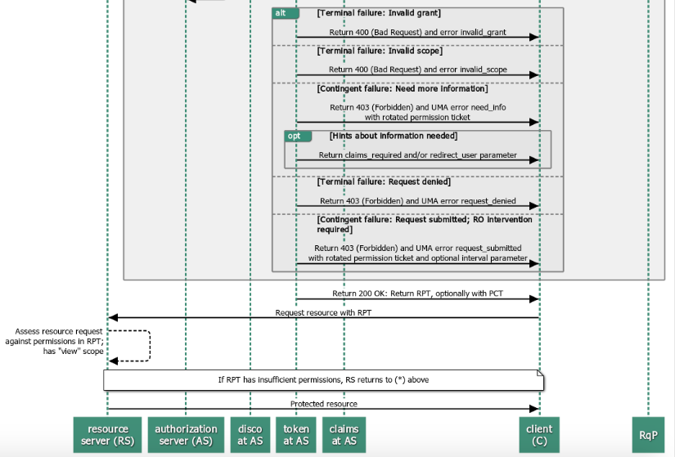
UMA grant as building blocks
Error conditions and looping

Slide 23
@@other topics
Go back and look at any oauth list discussion of other UMA points? Have we missed any by now?
How privacy-protective aspects work? GDPR/CCPA/OB/PSD2 relevance? CIBA relevance/gaps?
UMA business model?

