Slide 1


User-Managed Access
(UMA) 101
Eve Maler, Kantara Initiative UMA Work Group chair
@xmlgrrl | @UMAWG | tinyurl.com/umawg
IIWXXVIII | 30 Apr 2019

Slide 2
Topics
Overview in OAuth terms
UMA in action
The technical big picture
The UMA grant
Federated authorization
Authorization assessment
Privacy and “BLT” (business-legal-technical) implications

Slide 3
Overview in OAuth terms

Slide 4

OAuth enables constrained delegation of access to apps
Resource owner
Benefits:
Flexible, clever API security framework
Alice can agree to app connections and also revoke them
Client
A
T
Authorization server
D
Resource server
A
authorization
T
token
D
discovery

Slide 5
UMA adds cross-party sharing…
Resource owner
Requesting party
Benefits:
Secure delegation
Alice can be absent when Bob attempts access
Helpful error handling for client applications
Client
A
T
Authorization server
Resource server

Slide 6

…in a wide ecosystem…
Resource owner
Requesting party
Benefits:
Alice controls trust between a service that hosts her resources and a service that authorizes access to them
Client
A
T
Authorization server
Resource server
Notes:
Building the bridge to trust

Slide 7



…of resource hosts
Resource owner
Requesting party
Benefits:
• Resource hosts can outsource authorization management – and liability – to a specialist service
• Alice can manage sharing at a centralizable service
• Bob can revoke his access to Alice’s resources
Client
A
T
Authorization server
D
R
P
I
C
Resource server
Resource server
Resource server
A
authorization
T
token
D
discovery
R
resource registration
P
permission
I
token introspection
C
claims interaction
Notes:
Building more bridges

Slide 8

UMA user experience opportunities
Resource owner
Ahead of time
Anytime
Anytime
At run time
After the fact
UX
Share
Monitor
Withdraw
Opt in
Approve

Slide 9

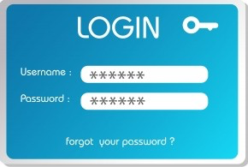



Benefits for service providers: a summary
True secure delegation; no password sharing
Scale permissioning through self-service
API-first protection strategy
Foster compliance through standards
9
control
transparency
protection

Slide 10

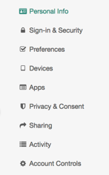




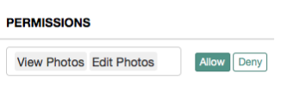
Benefits for patients and consumers: a summary
Choice in sharing with other parties
Convenient sharing/approval with no outside influence
Centralizable monitoring and management
Control of who/what/how at
a fine grain
10

Slide 11
Typical use cases
Alice to Bob (person to person):
  Patient-directed health data/device sharing
  Discovering/aggregating pension accounts and sharing access to financial advisors
  Connected car data and car sharing
Enterprise to Alice (initial RO is an organization):
  Enterprise API access management
  Access delegation between employees
Alice to Alice (person to self/app):
  Proactive policy-based control of app connections
Profiled or referenced by:
  OpenID Foundation HEART Working Group
  UK Department for Work and Pensions
  OpenMedReady Alliance

Slide 12
Known implementations
(more detail at tinyurl.com/umawg)
ForgeRock – financial, healthcare, IoT, G2C…
Gluu (open source) – API protection, enterprise, G2C…
ShareMedData – healthcare
HIE of One / Trustee (open source) – healthcare
IDENTOS – healthcare, G2C
Pauldron (open source) – healthcare
RedHat Keycloak (open source) – API protection, enterprise, IoT…
WSO2 (open source) – enterprise…

Slide 13
UMA in a nutshell
Developed at Kantara Initiative
  V2.0 complete in Jan 2018
Leverages existing open standards:
  OAuth2
  OpenID Connect and SAML (optional but popular)
Specs contributed to IETF OAuth in Feb ‘19
Profiled by multiple industry sectors
  Financial, healthcare
UMA business model effort (“BLT”) supports legal licensing for personal digital assets
  Example: Mother (legal guardian) manages sharing for child (data subject); child becomes old enough and starts to manage sharing herself

Slide 14
UMA in action

Slide 15
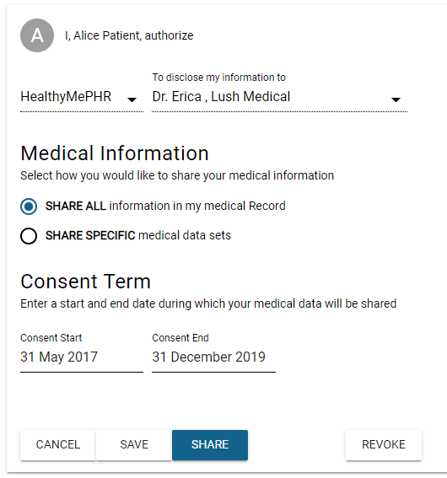
ShareMedData
Patient Alice creates a policy to share with Dr. Erica, she selects her sharing preferences, and presses SHARE
Patient sharing is easy!
SHARE

Slide 16
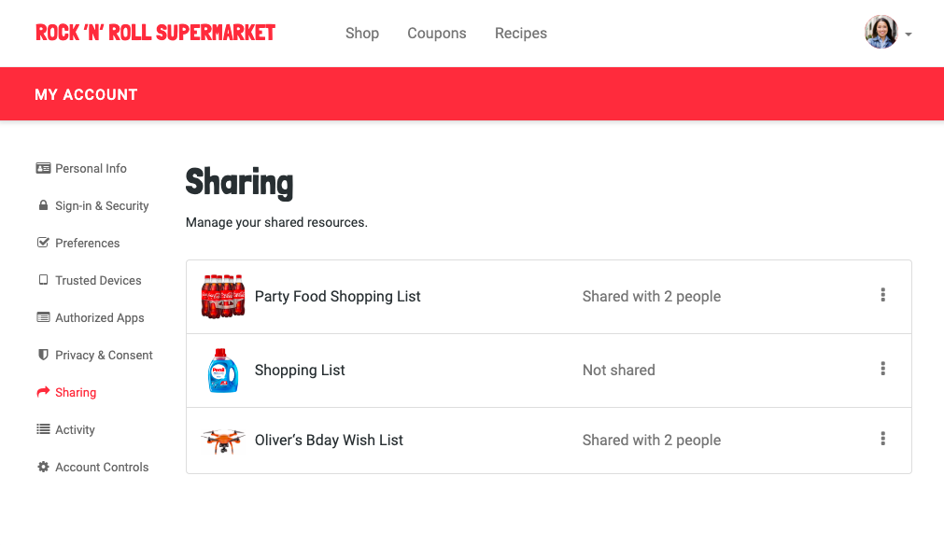
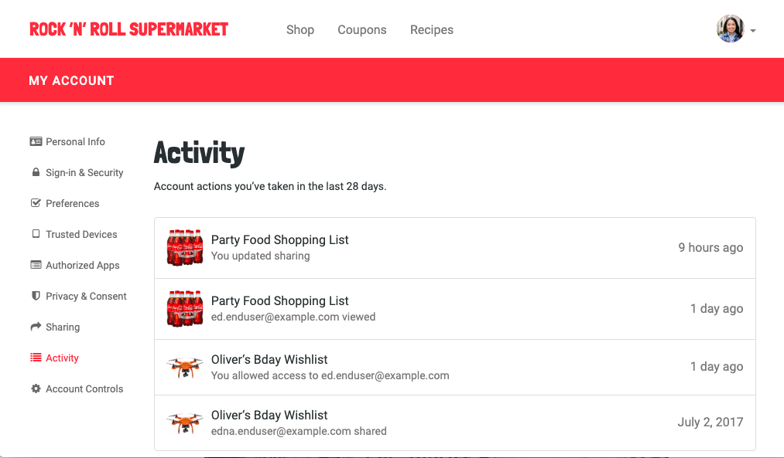
ForgeRock Identity Platform

Slide 17
The technical big picture

Slide 18
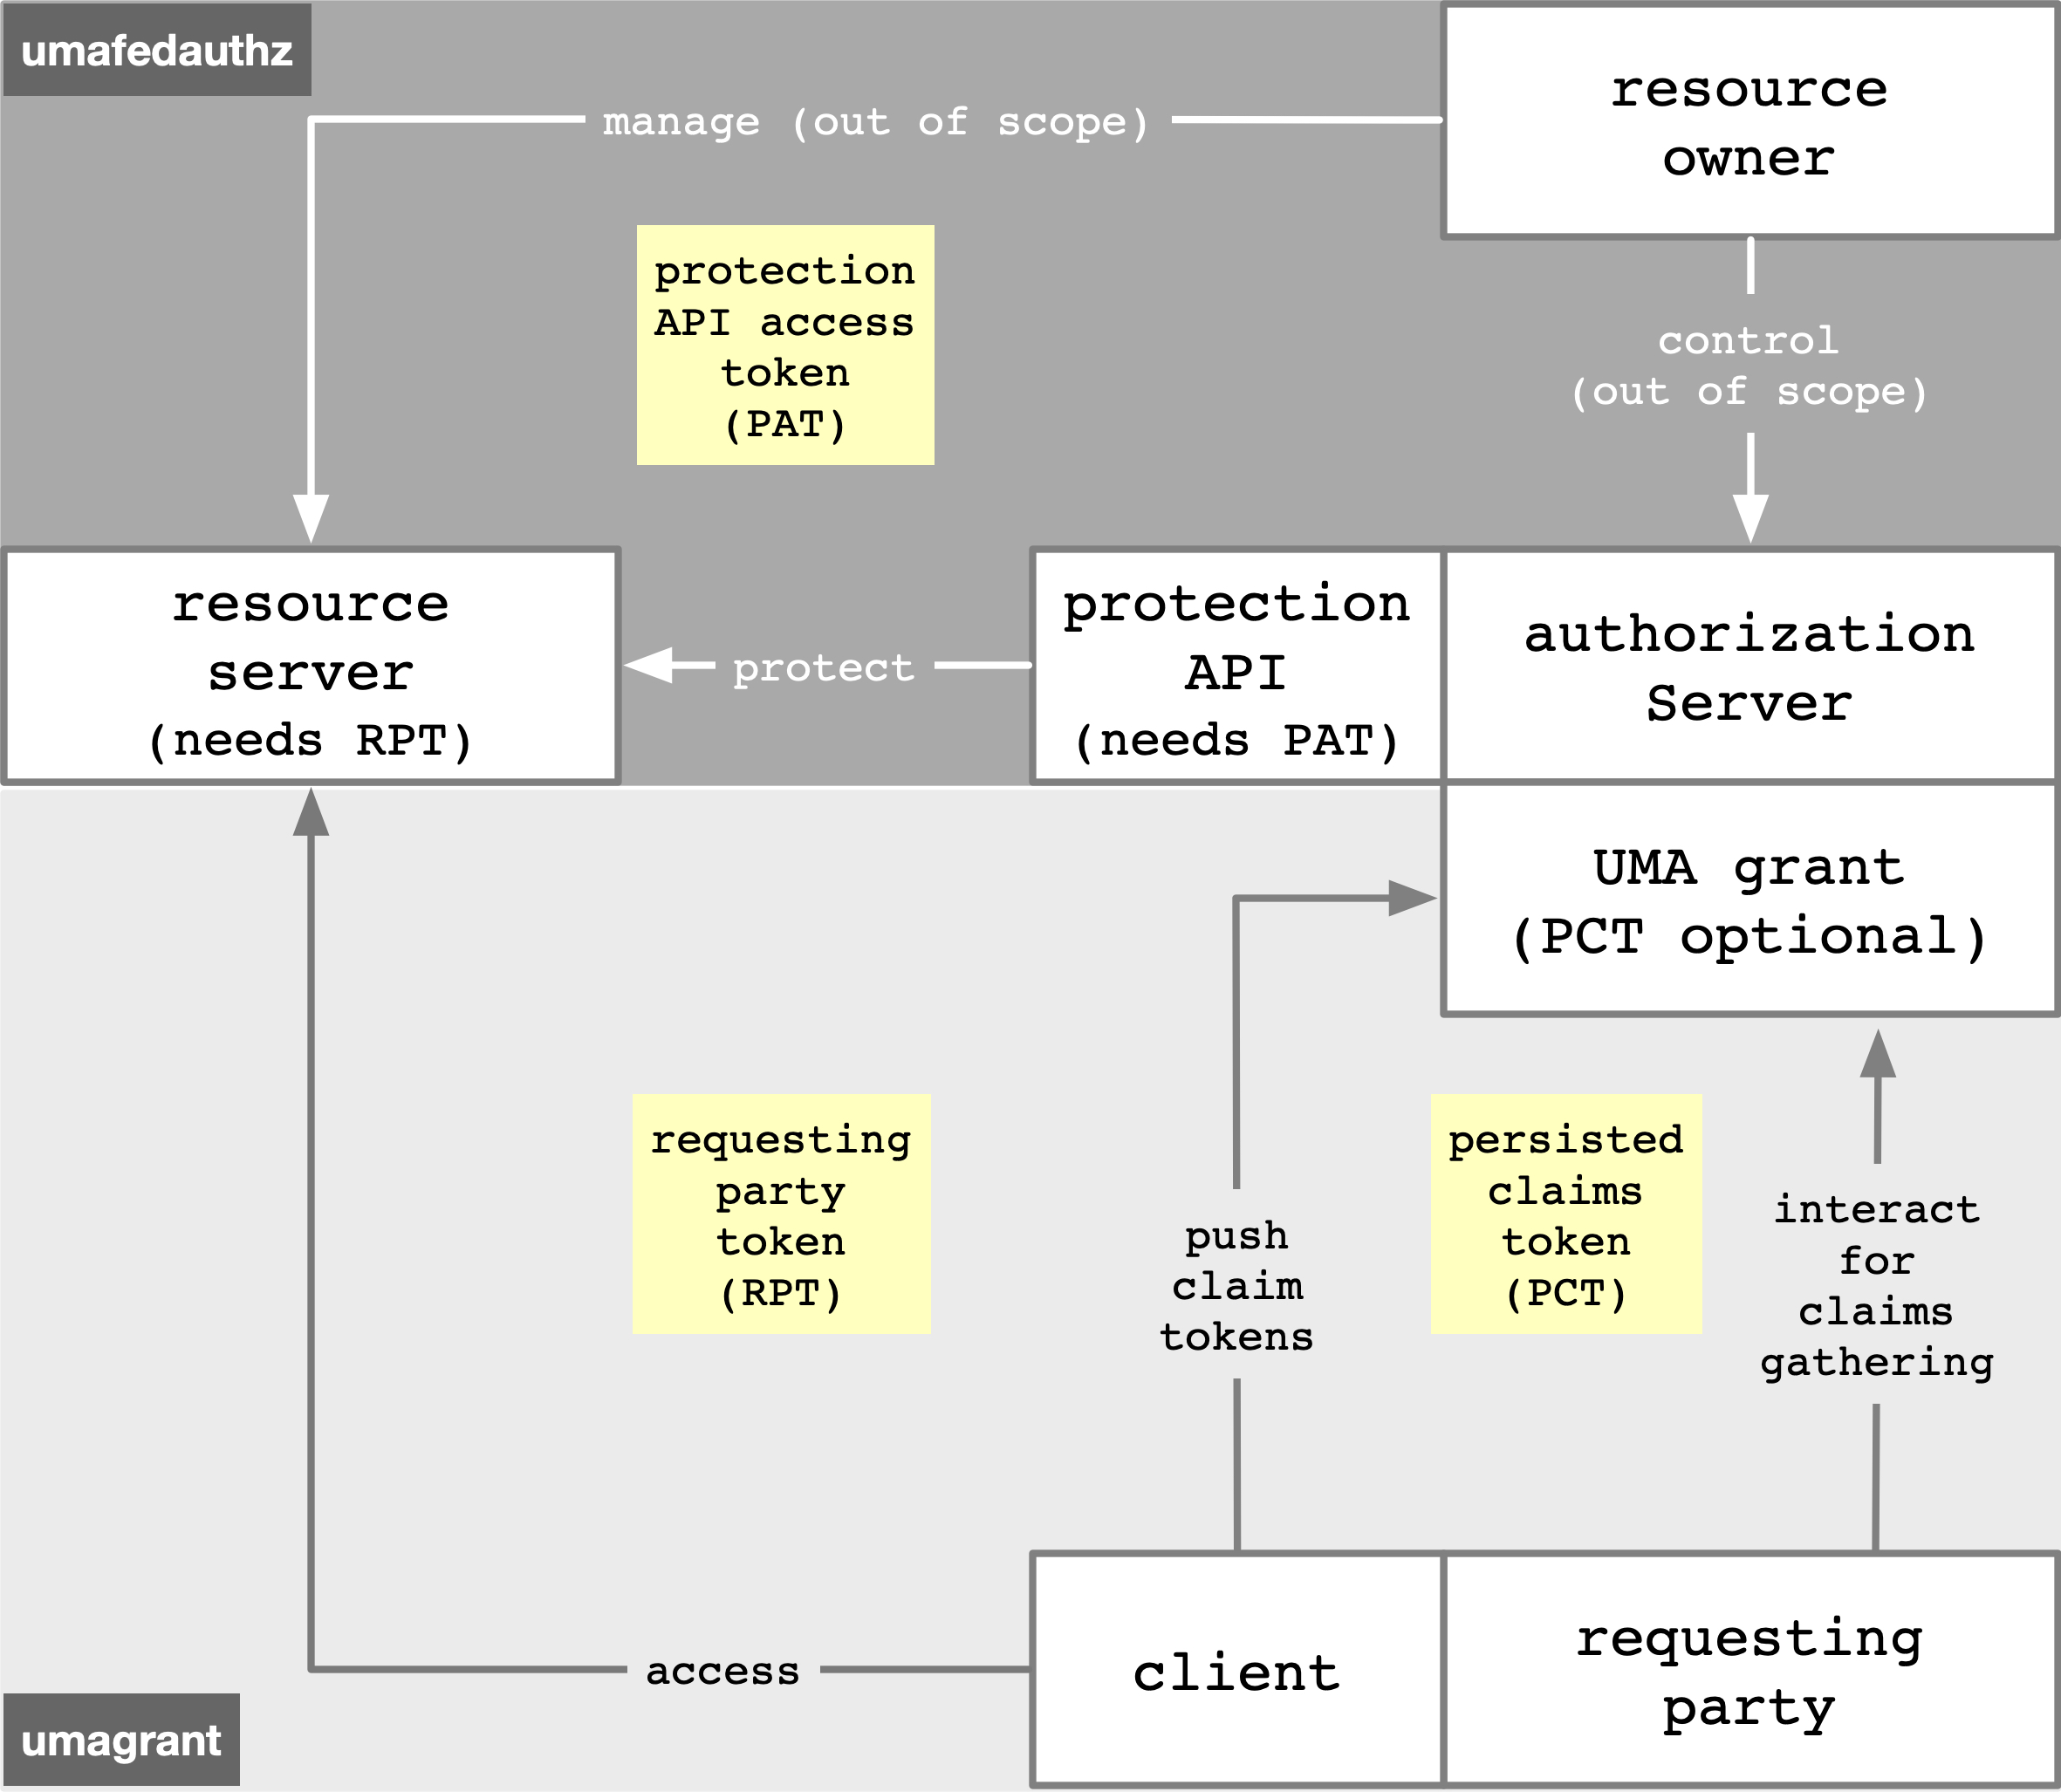


The marvelous spiral of delegated sharing, squared
The UMA grant of OAuth enables Alice-to-Bob delegation
UMA standardized an API for federated authorization at the AS to make it centralizable
There are nicknames for enhanced and new tokens to keep them straight
Notes:
The access token for the UMA grant spec is the RPT == requesting party token
The access token for the federated authorization spec is the PAT == protection API access token
A new refresh token-like structure that helps the AS give the requesting party a better experience is the PCT == persisted claims token

Slide 19
The UMA extension grant adds… docs.kantarainitiative.org/uma/wg/rec-oauth-uma-grant-2.0.html
Party-to-party: Resource owner authorizes protected-resource access to clients used by requesting parties
Asynchronous: Resource owner interactions are asynchronous with respect to the authorization grant
Policies: Resource owner can configure an AS with rules (policy conditions) for the grant of access, vs. just authorize/deny
  Such configurations are outside UMA’s scope
Resource owner
Client
Requesting party
UX
Share
Monitor
Withdraw
Opt in
Approve

Slide 20
UMA federated authorization adds… docs.kantarainitiative.org/uma/wg/rec-oauth-uma-federated-authz-2.0.html
1-to-n: Multiple RS’s in different domains can use an AS in another domain
  “Protection API” automates resource protection
  Enables resource owner to monitor and control grant rules from one place
Scope-grained control: Grants can increase/decrease by resource and scope
Resources and scopes: RS registers resource details at the AS to manage their protection
Authorization server
Resource server
Resource server
Resource server

Slide 21
The UMA grant

Slide 22
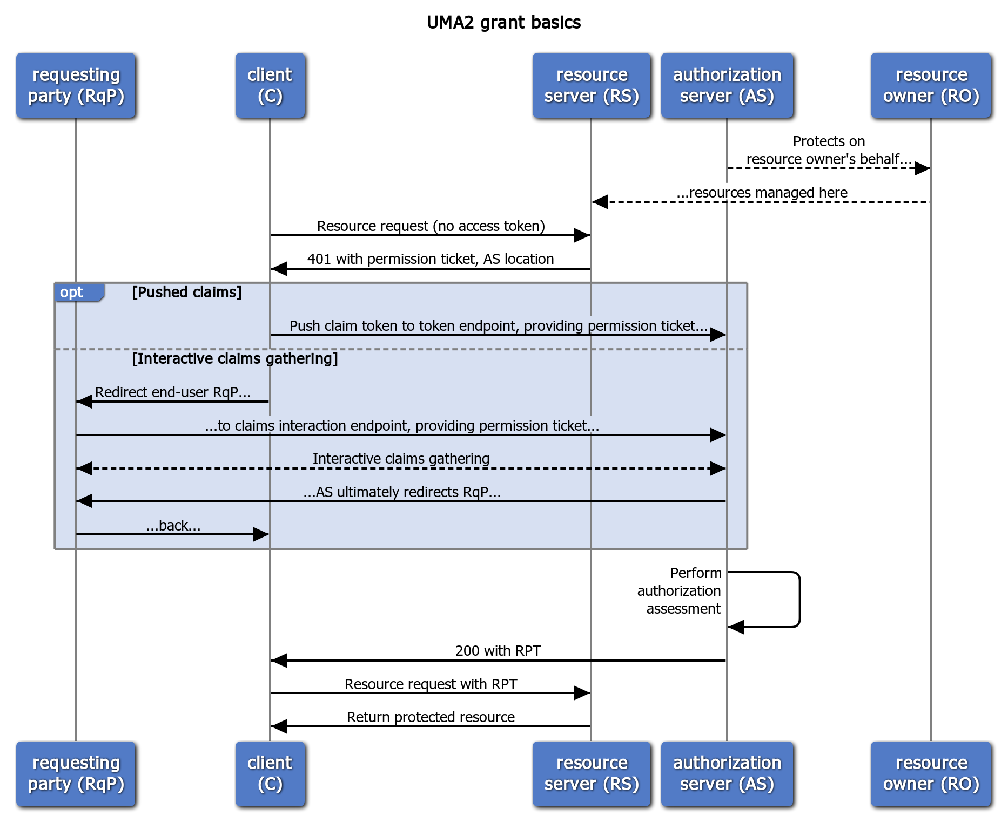
The UMA extension grant flow and its options
The AS is acting as an agent for an absent RO
The client’s first resource request is tokenless
The RS provides a permission ticket and allows AS discovery
There are two claims collection options for meeting policy
Authorization assessment and token issuance has guardrails
RPTs can be upgraded, revoked, introspected, and refreshed

Slide 23
The permission ticket: how you start building a bridge of trust
Binds client, RS, and AS: Every entity may be loosely coupled; the whole flow needs to be bound
  It’s like an overarching state parameter or “ticket-getting ticket”
  Or maybe even a bit like an authorization code
Refreshed for security: The client can retry RPT requests after non-fatal AS errors, using either claims collection option of the grant flow
  The AS refreshes the permission ticket when responding with such errors

Slide 24
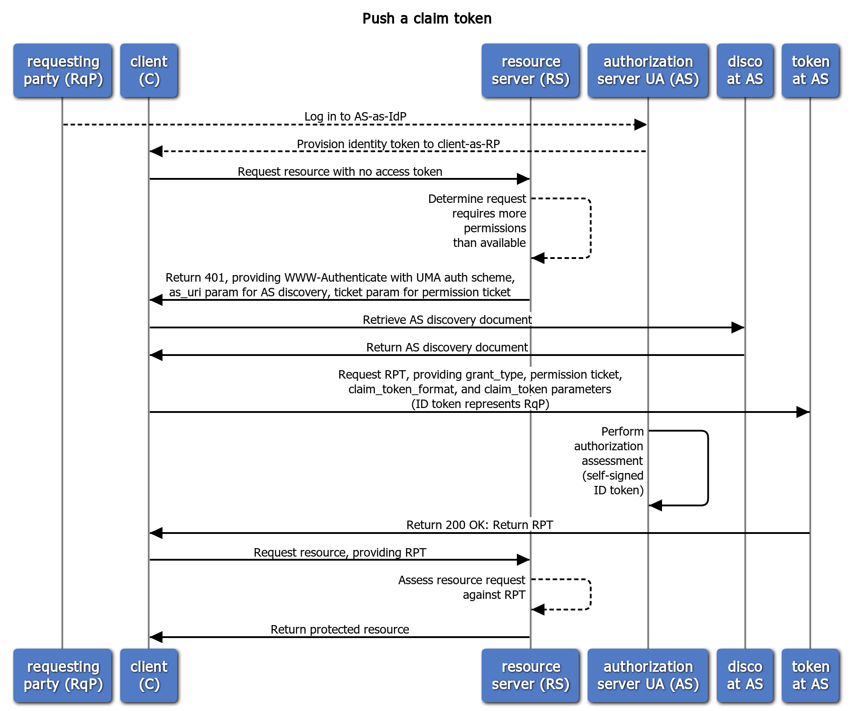
Pushed claims scenario: for wide-ish ecosystems
The AS is the requesting party’s IdP and the client is the RP
More detail on the RS’s initial response to the client
The client pushes its existing ID token to the token endpoint
The AS is in the primary audience for this token
Somewhat resembles SSO or the OAuth assertion grant, where a token of expected type and contents is “turned in”

Slide 25
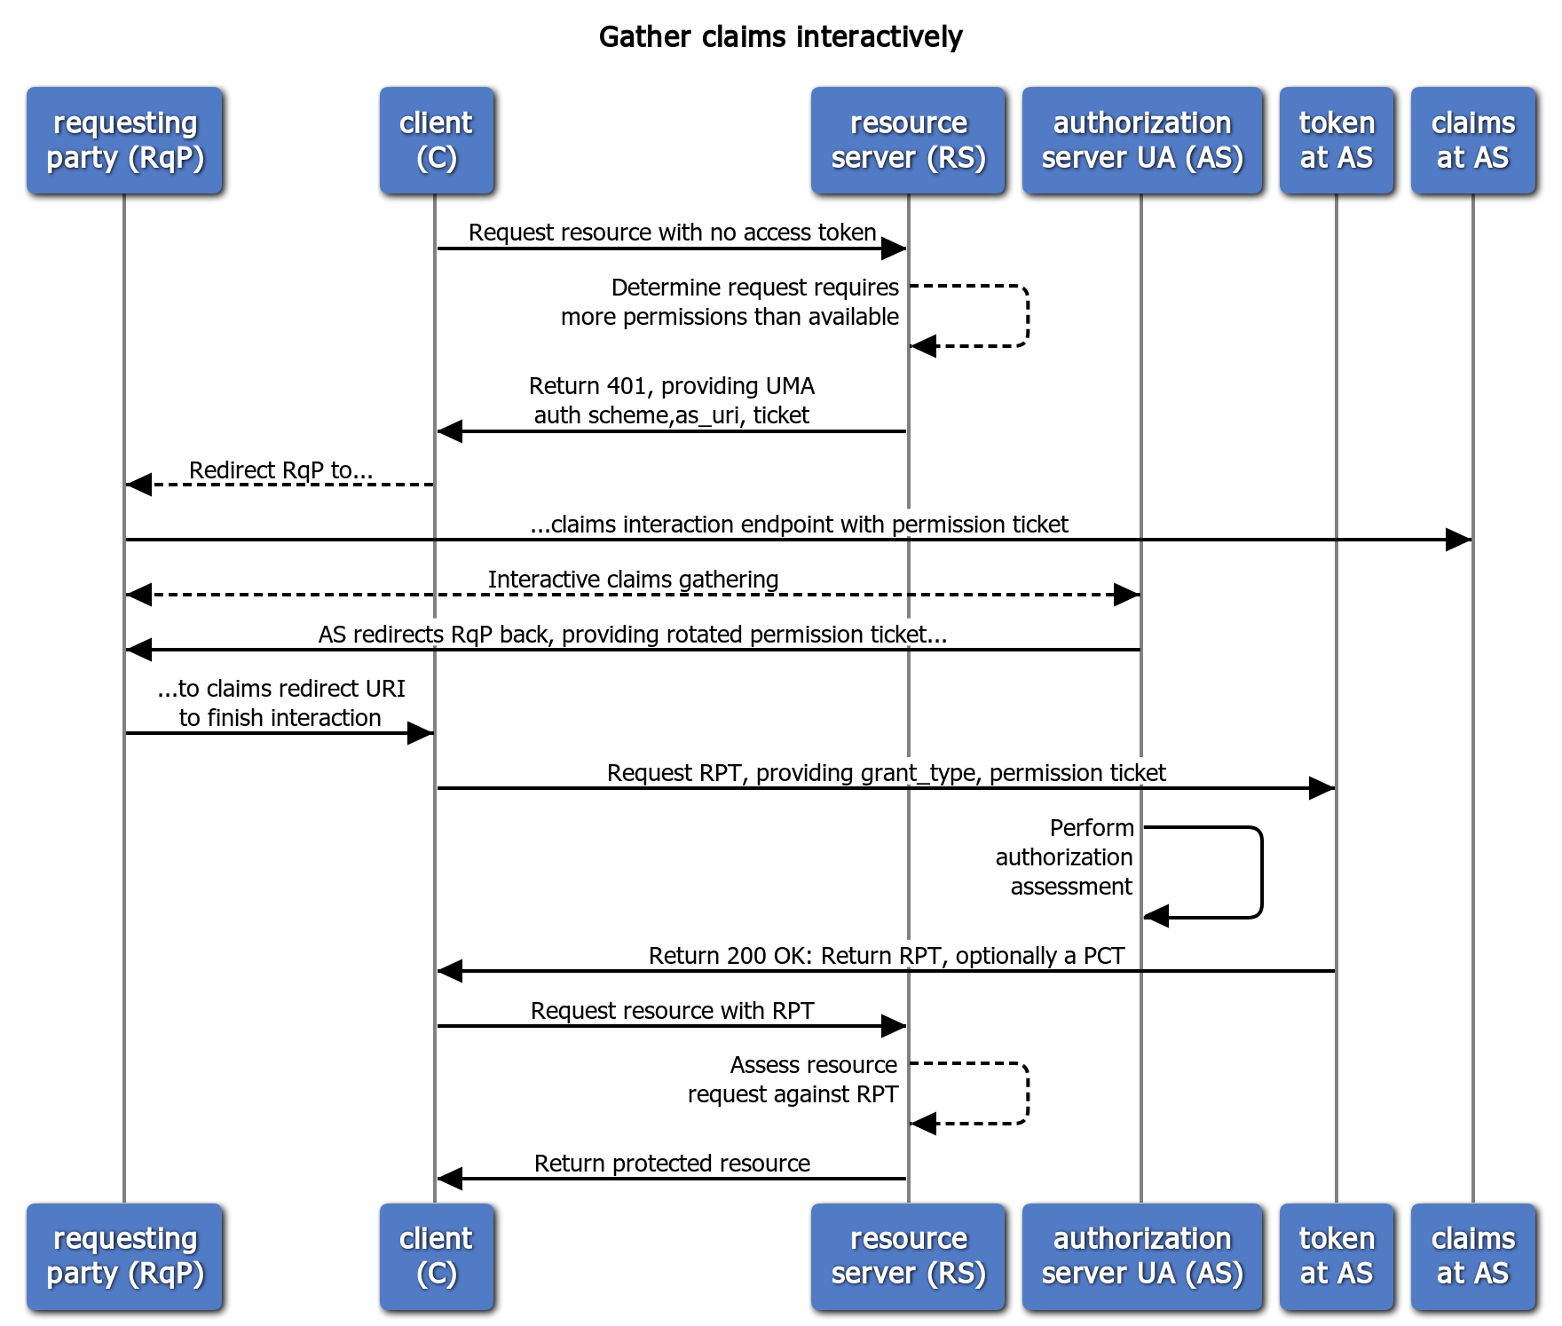
Interactive claims gathering scenario: for wide ecosystems
(eliding detail already seen)
A claims interaction endpoint must have been declared in the discovery document to allow this flow
The AS mediates gathering of claims from any source
A key “metaclaim” to think about: consent to persist claims
A PCT potentially enables a better RqP experience next time; the AS can then re-assess using claims on hand
Resembles the authorization code grant, but can apply to non-unique identities and is repeatable and “buildable”

Slide 26
Federated authorization

Slide 27
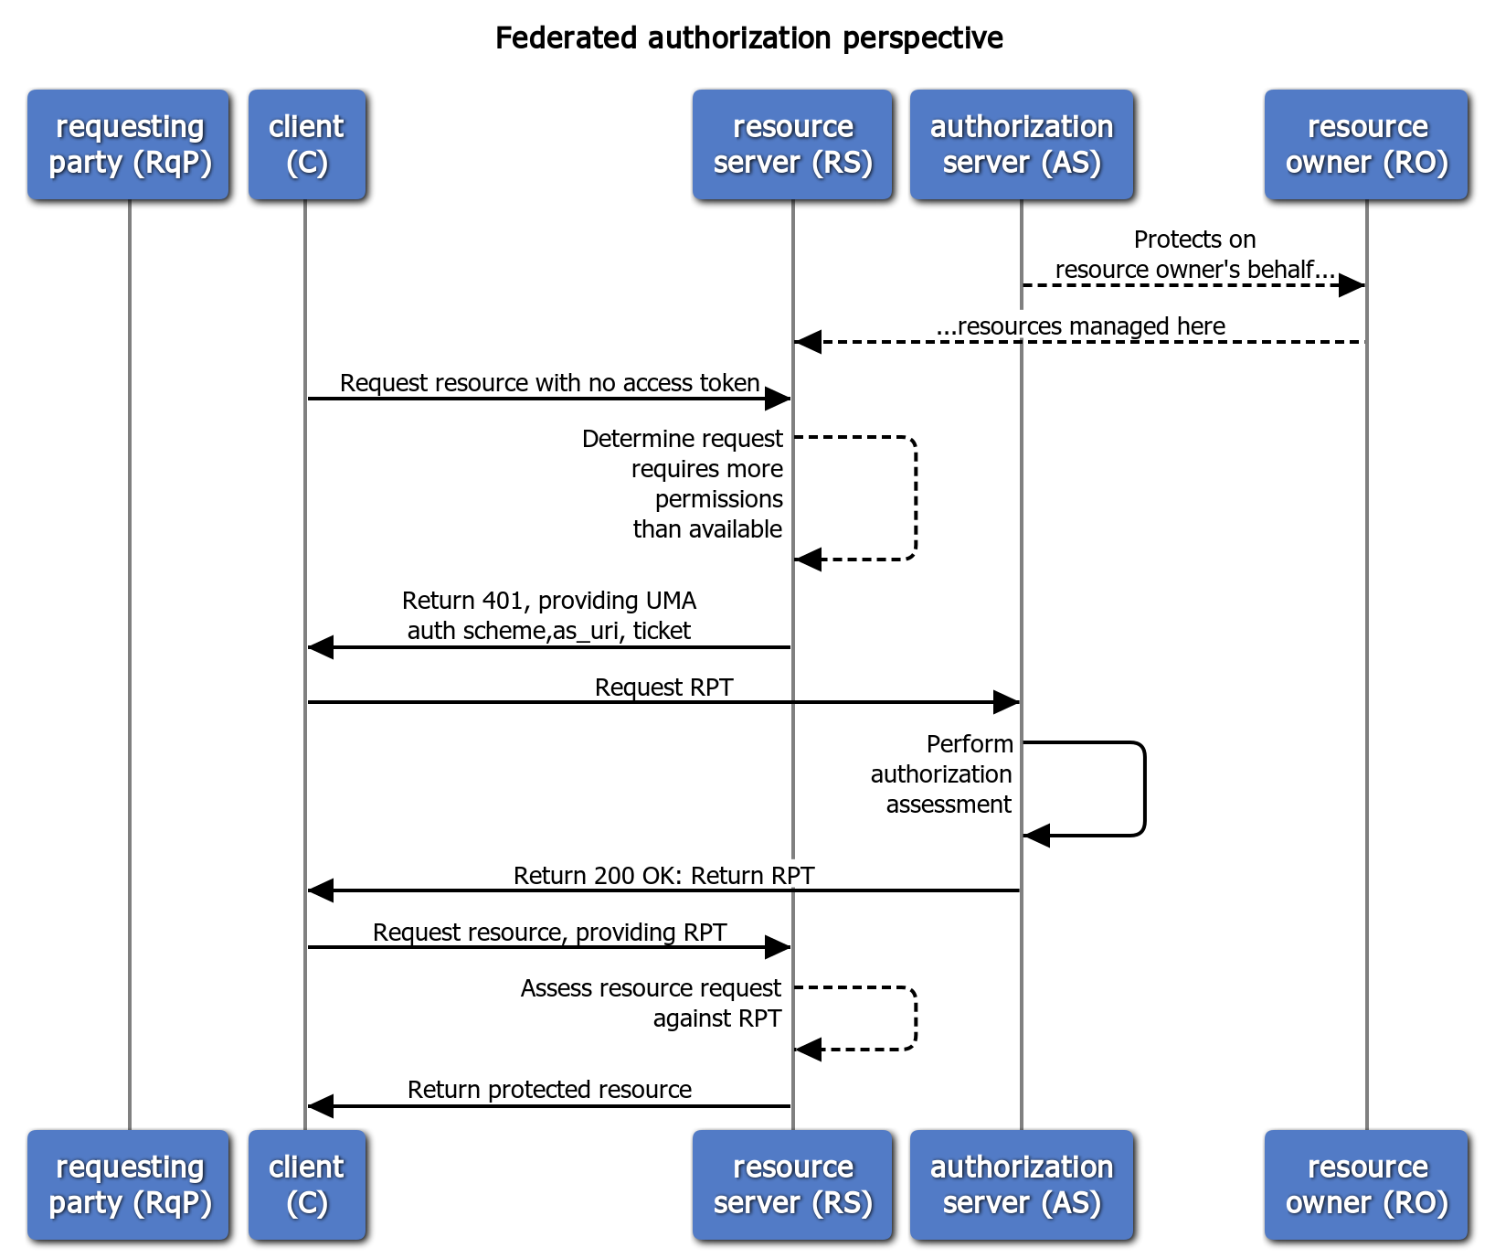
A new perspective on the UMA grant
How does the AS know when to start protecting resources?
How does the RS know what ticket the AS is associating with the RS’s recommended permissions?
Is there anything special about token introspection?
Let’s standardize an interface at the AS for these jobs

Slide 28

The protection API: how you federate authorization
RS registers resources: This is required for an AS to be “on the job”
  Scopes can differ per resource
  Resource and scope metadata assist with policy setting interfaces
RS chooses permissions: The RS interprets the client’s tokenless resource request and requests permissions from the AS
  The AS then issues the initial permission ticket
RS can introspect the RPT: UMA enhances the token introspection response object
RO controls AS-RS trust: The protection API is OAuth-protected
  The resource owner authorizes the scope uma_protection
  The issued token is called the PAT
Authorization server
Resource server
Resource server
Resource server

Slide 29
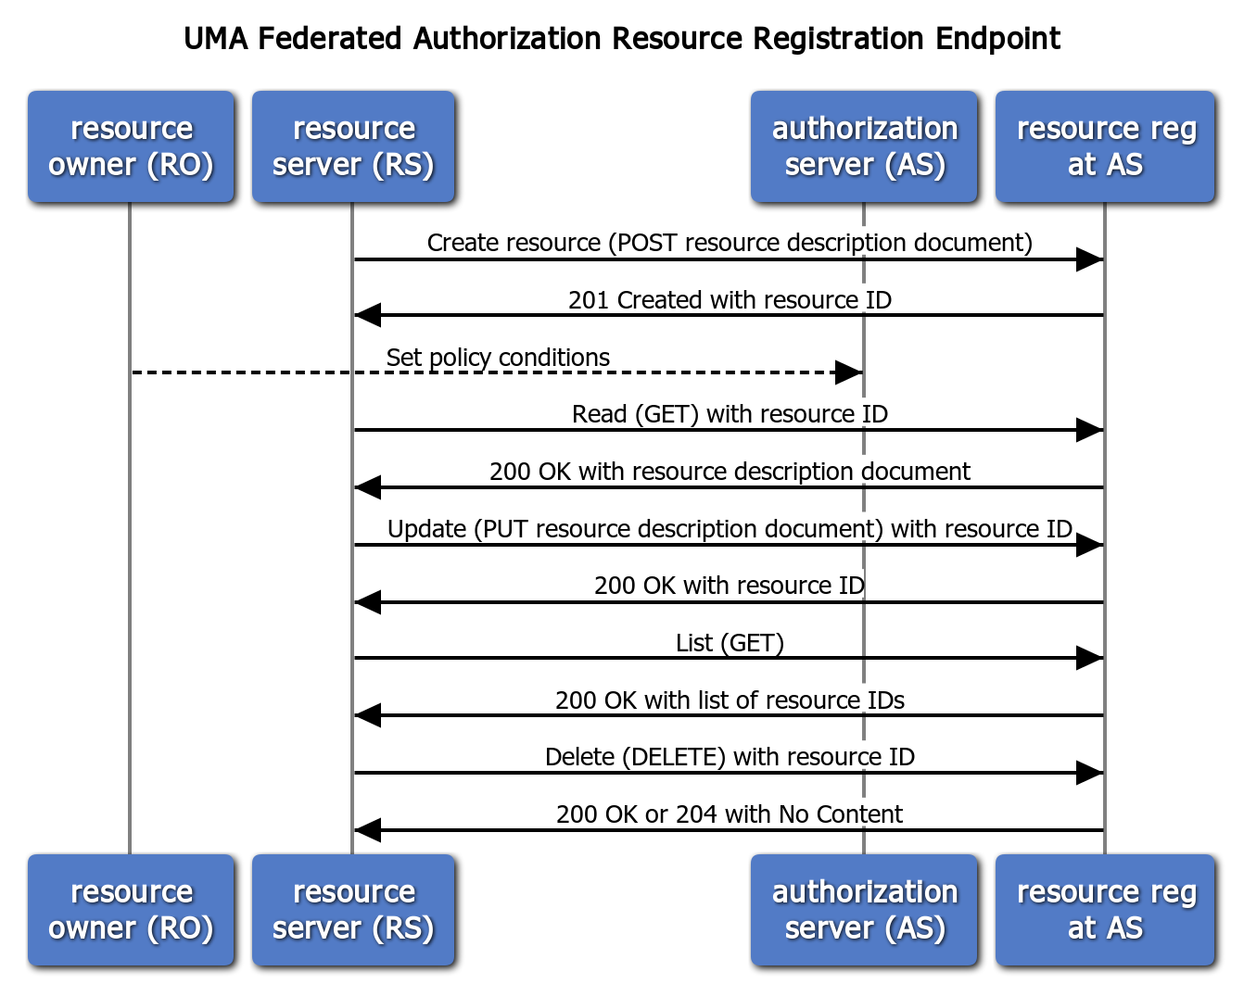
The resource registration endpoint
Registering a resource puts it under protection
Setting policies can be done anytime after creation
Deregistering a resource removes it from protection

Slide 30
Resource and scope registration
The RS is authoritative for what its resource boundaries are
  It registers them as JSON-based descriptions
  There is a resource “type” parameter
Scopes can be simple strings or URIs that point to description documents
Create request:
POST /rreg/ HTTP/1.1 Content-Type: application/json
Authorization: Bearer MHg3OUZEQkZBMjcx
...
{
"resource_scopes":[
"patient/*.read"
],
"icon_uri":"http://www.example.com/icons/device23",
"name":"Awesome Medical Device Model 23",
"type":"https://www.hl7.org/fhir/observation.html"
}
Response:
HTTP/1.1 201 Created
Content-Type: application/json
Location: /rreg/rsrc1
...
{
"_id":"rsrc1"
}

Slide 31
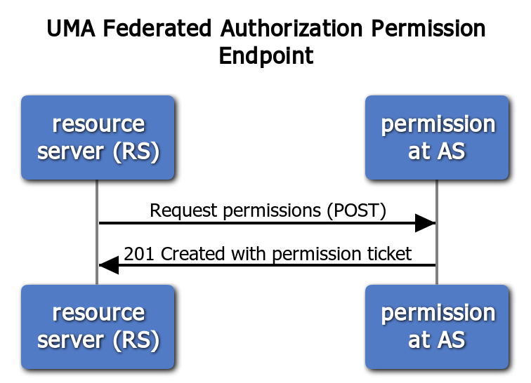
The permission endpoint
The RS interprets the client’s tokenless (or insufficient-token) resource request
The RS must be able to tell from the client’s request context which RO and AS were meant
Request:
POST /perm/ HTTP/1.1
Content-Type: application/json
Host: as.example.com
Authorization: Bearer MHg3OUZEQkZBMjcx
...
{
"resource_id":"rsrc1",
"resource_scopes":[
"patient/*.read"
]
}
Response:
HTTP/1.1 201 Created
Content-Type: application/json
...
{
"Ticket":"016f84e8-f9b9-11e0-bd6f-0021cc6004de"
}

Slide 32
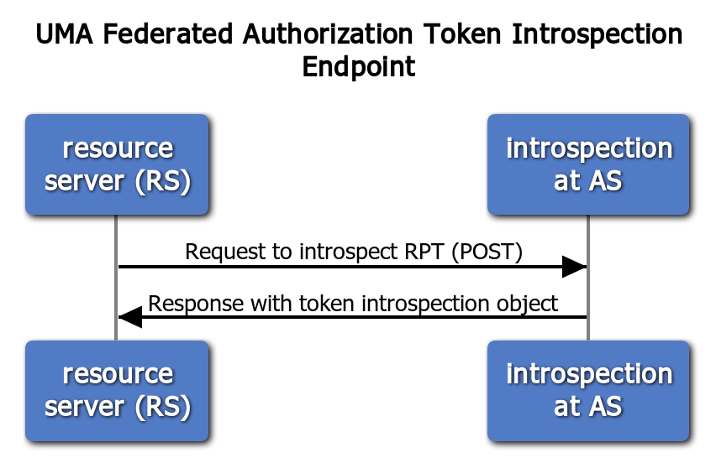
The token introspection endpoint
UMA enhances the token introspection response object
A permissions claim is added, with resource ID-bound scopes
Response:
HTTP/1.1 200 OK
Content-Type: application/json
Cache-Control: no-store
…
{
"active":true,
"exp":1256953732,
"iat":1256912345,
"permissions":[
{
"resource_id":"rsrc1",
"resource_scopes":[
"patient/*.read"
],
"exp":1256953732
}
]
}
Request:
POST /introspect HTTP/1.1
Host: as.example.com
Authorization: Bearer MHg3OUZEQkZBMjcx
…
token=mF_9.B5f-4.1JqM

Slide 33
Authorization assessment

Slide 34
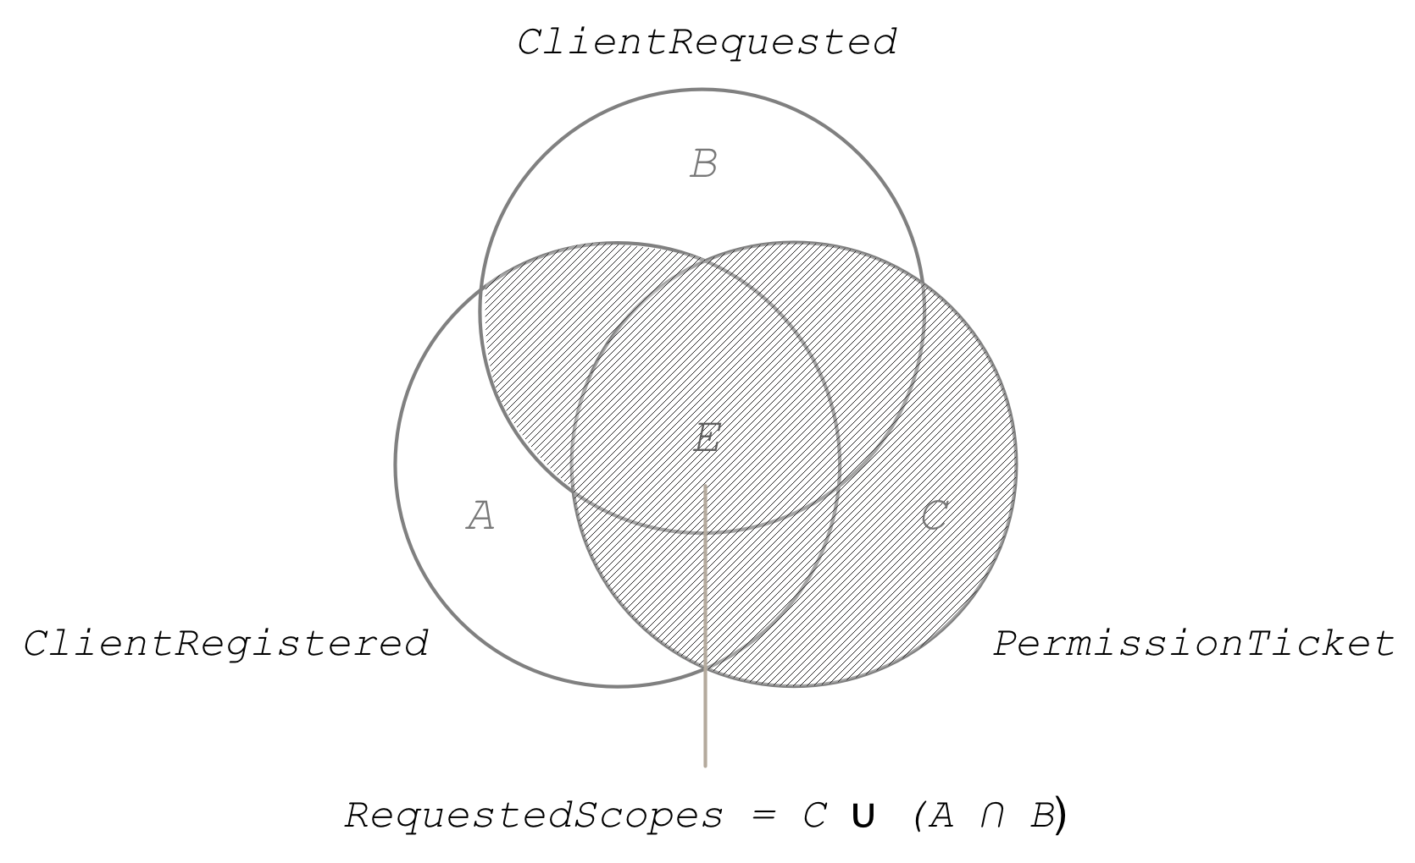
Authorization assessment: how the AS adheres to the RO’s wishes in the larger context
The client can request scopes at the token endpoint, but must have pre-registered them with the AS for it to work
The AS treats the scopes in this intersection as matching any available scope associated with a resource in the ticket
Permissions associated with the ticket can add to total requested scopes
If authorization assessment results in only a subset of client-desired scopes, the AS can choose to error

Slide 35
Privacy and “BLT” implications

Slide 36
Relevance for privacy
Features relevant to privacy regulations (GDPR, CCPA, OB, PSD2, CDR, HHS ONC info blocking rules...):
  Asynchronous resource owner control of grants
  Enabling resource owner to monitor and manage grants from a “dashboard”
  Auditability of grants (consent) and PAT-authorized AS-RS interactions
Work is well along on an UMA business model
  Modeling real-life data-sharing relationships and legal devices
  Technical artifacts are mapped to devices
  Goal: tear down artifacts and build up new ones in response to state changes

Slide 37
(Most) legal relationships in the business model
resource owner
requesting party
Resource Rights Administrator
Requesting Agent
Licenses-perm-getting-to
(Agency Contract)
Delegates-perm-authority-to
Delegates-mgmt-to
(Access Contract)
Permits-knowing- claims
Delegates-seek- authority-to
authorization server
resource server
client
Authorization Server Operator
Resource Server Operator
Client Operator
Licenses-perm-
granting-to
Licenses- perm-getting-to

Slide 38

UMA implications
…for the client
Simpler next-step handling at every point
…for the RS
Standardize management of protected resources
…for the RO
Control data sharing/device control
Truly delegate access to other parties using clients
…for the AS
Offer interoperable authorization services
Don’t have to touch data to protect it
…for the RqP
Seek access to a protected resource as oneself
…for the client operator
Distinguish identities of resource owners from mere users
…for the resource server operator
Externalize authorization while still owning API/scopes
…for the resource rights admin
Manage sharing on behalf of data subjects, not just for oneself
…for the authorization server operator
Prove what interactions took place or didn’t
…for the requesting agent
Revoke access (or request it) to someone else’s assets

Slide 39
Join us!
Thank you!
Questions?
Eve Maler, Kantara Initiative UMA Work Group chair
@xmlgrrl | @UMAWG | tinyurl.com/umawg
IIWXXVIII | 30 Apr 2019

